Slide 1

Welcome to this
Quality Conversation

Slide 2
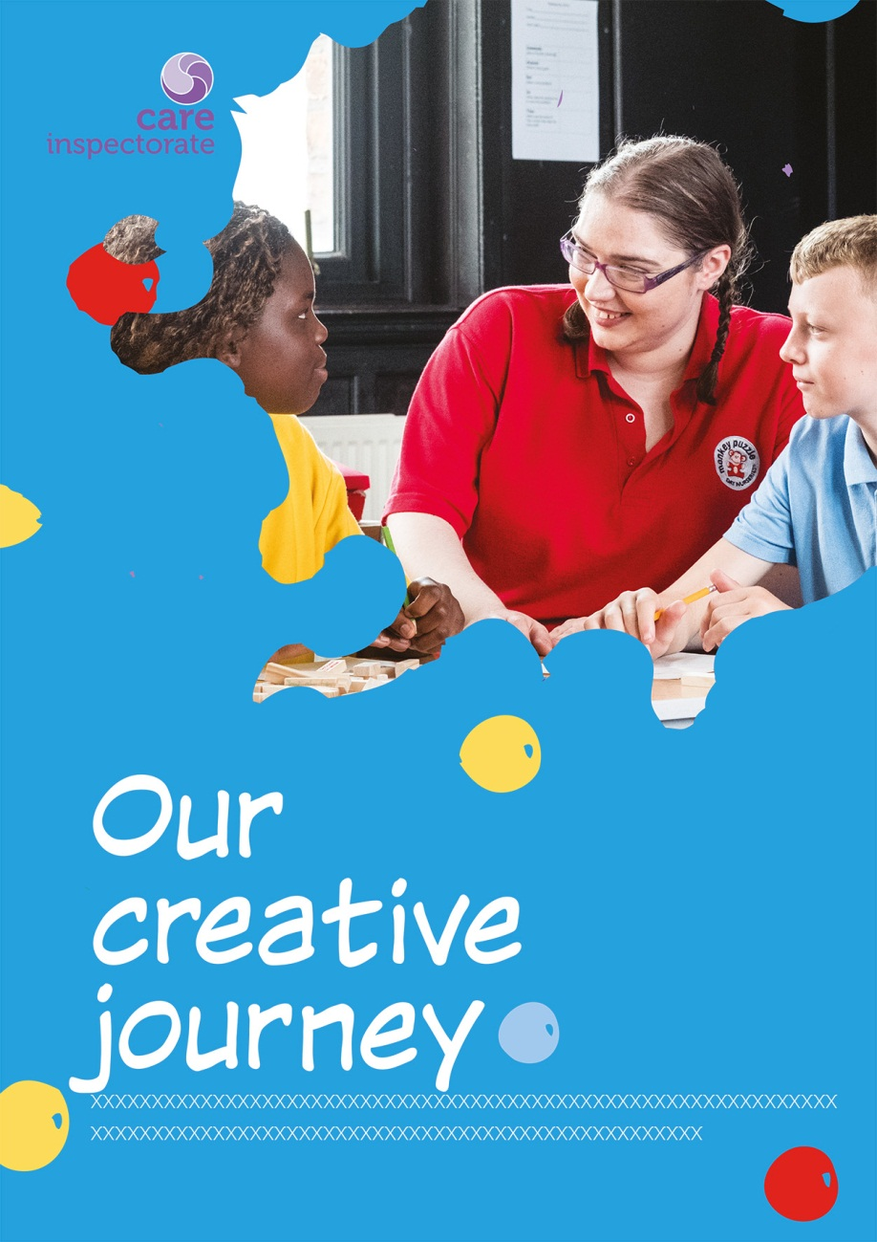
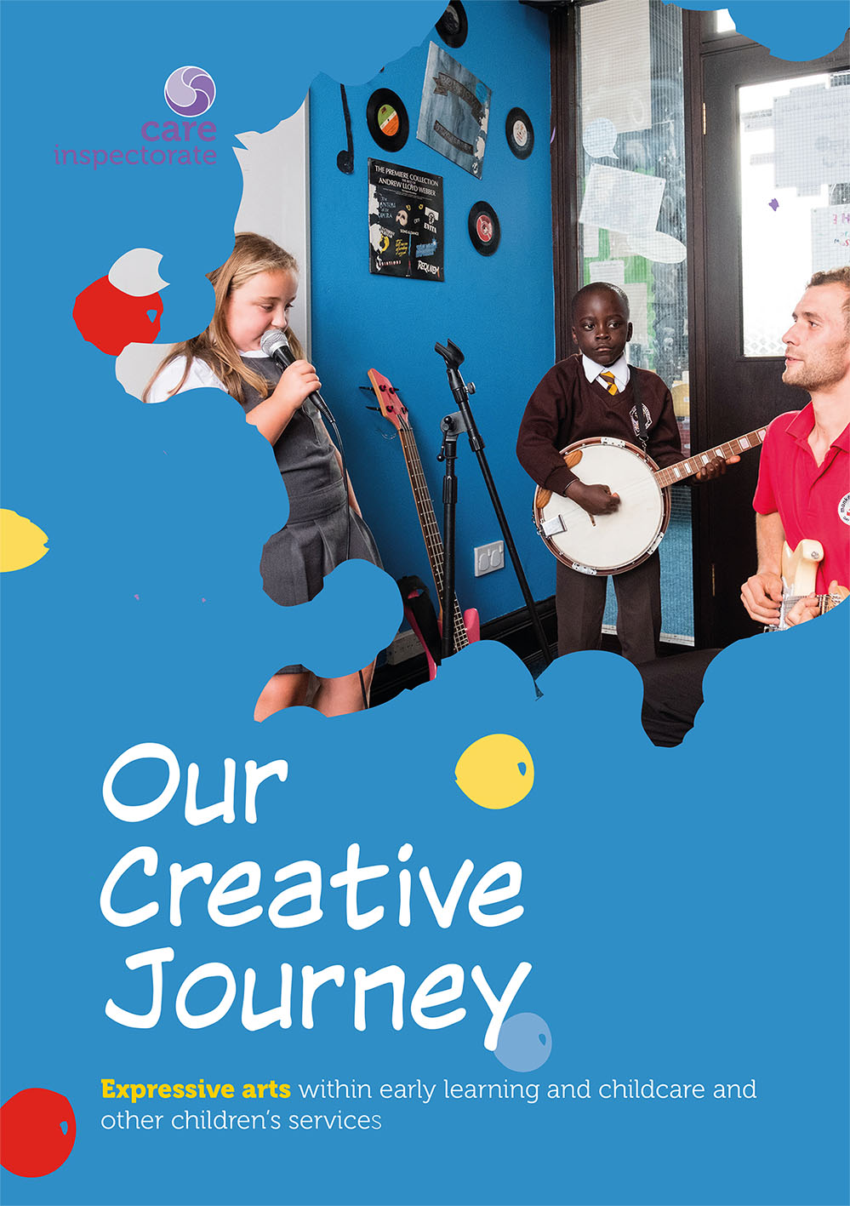
Quality Conversation
Glasgow
29 November 2017

Slide 3


Slide 4
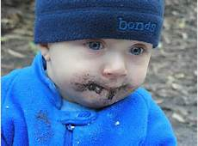
Eat dirt

Slide 5
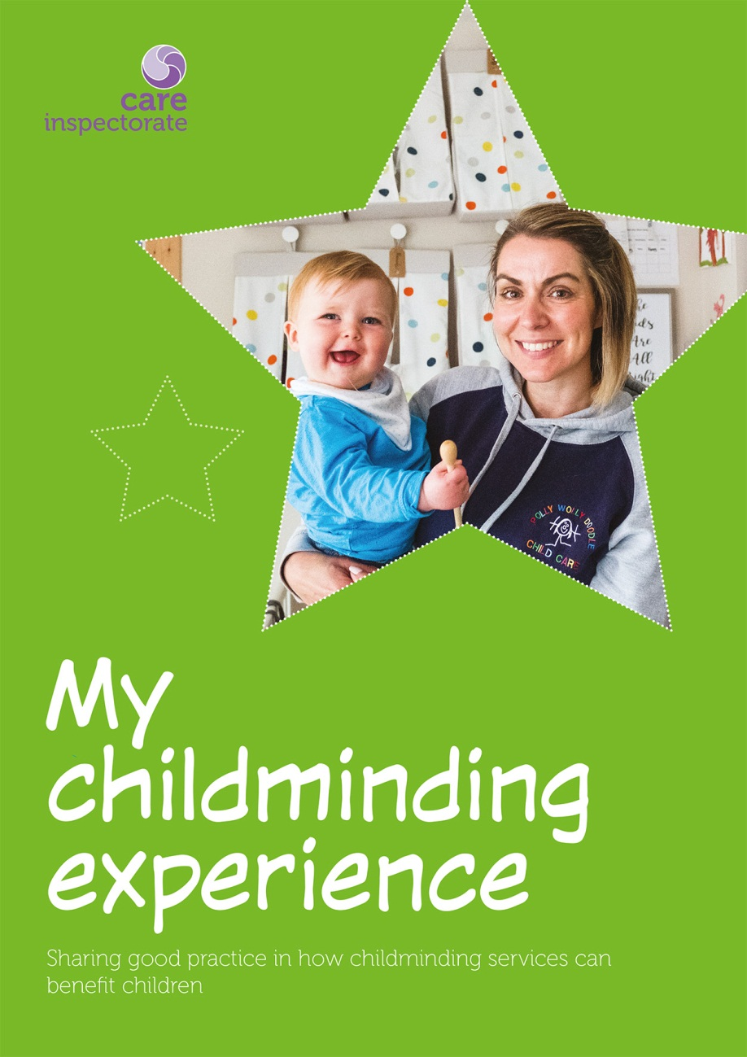

Slide 7












Slide 8
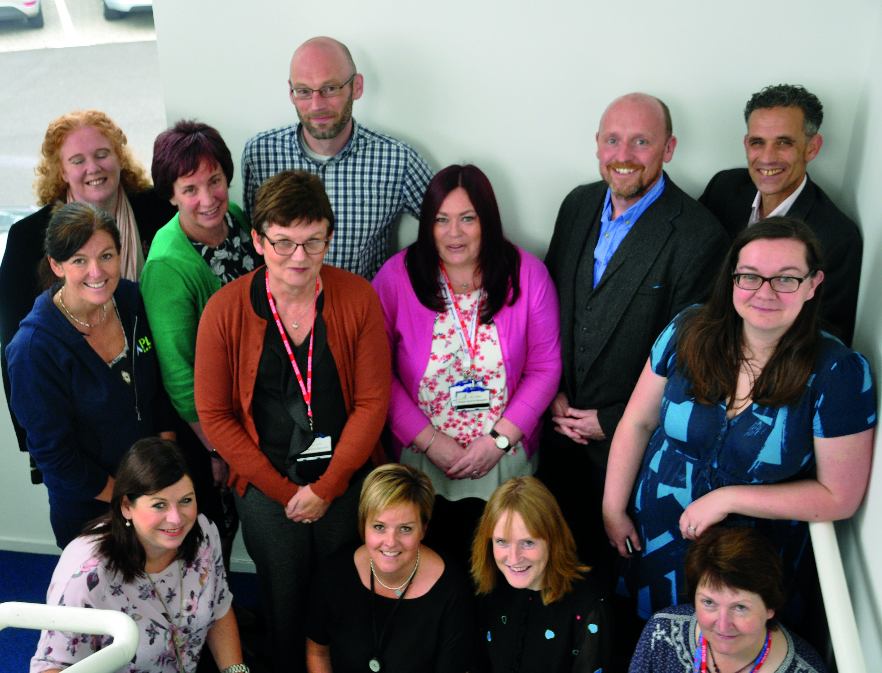

Slide 9



Slide 10




National Care Standards in 2002
“Children and young people can experience and choose from programmes and day-to-day activities that are planned, designed, evaluated and put into practice by staff, taking account of national and local guidelines.”
“Children and young people will be able to enjoy the activities and be motivated by them. The activities will be flexible and take account of ages, development needs, interests, and hours and patterns of attendance of each child or young person.”

Slide 11
National Care Standards in 2002
“You know that the activities provided by staff will allow the children and young people to enjoy both organised and free play and leisure and recreation, including quiet times.”

Slide 12

1.25 I can choose to have an active life and participate in a range of recreational, social, creative, physical and learning activities every day, both indoors and outdoors.
(Glossary: “creativity includes artistic activities, such as arts, crafts, music, drama and dance.”)

Slide 13
1.30 As a child, I have fun as I develop my skills in understanding, thinking, investigation and problem solving, including through imaginative play and storytelling.

Slide 14
1.31 As a child, my social and physical skills, confidence, self-esteem and creativity are developed through a balance of organised and freely chosen extended play, including using open ended and natural materials.

Slide 15

2.27 As a child, I can direct my own play and activities in the way that I choose, and freely access a wide range of experiences and resources suitable for my age and stage, which stimulate my natural curiosity, learning and creativity.

Slide 16
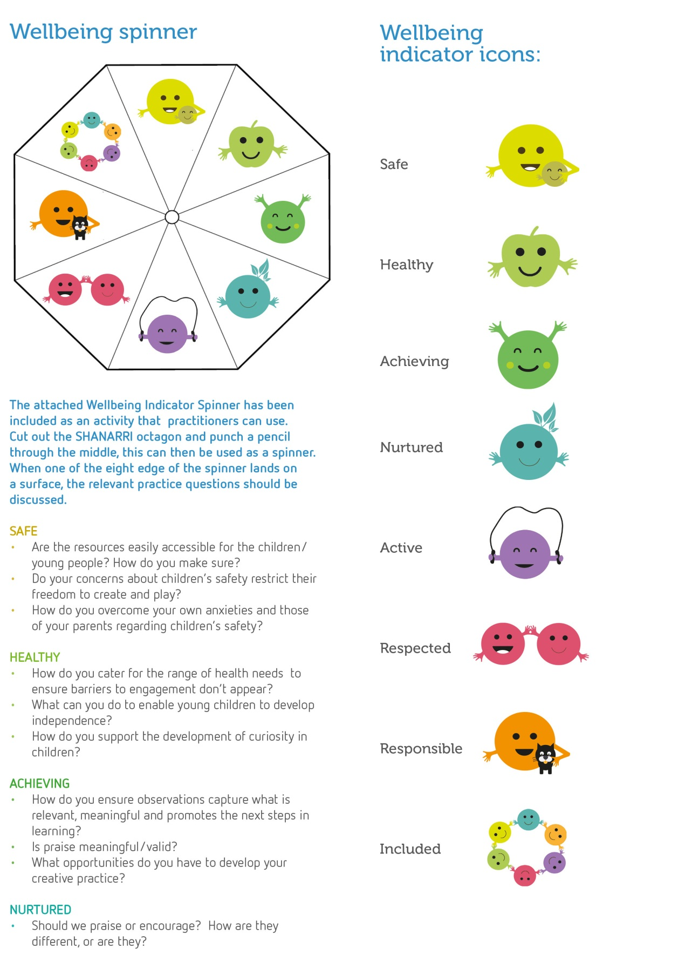

Slide 17

Safe

Slide 18
Key learning points
How can creative activities help children feel safe, confident and secure?
If you are working with children with English as an additional language, there might be particular expressive arts activities that develop language and communication skills.
Working with children in the same space as their parents/carers can benefit some children and lead to different ways of working.

Slide 19
Key learning points
Different kinds of expressive arts activities work really well with babies and help develop attachment.
Are there ways that your anxieties or those of parents about children’s safety unnecessarily restrict their freedom to create and play?
What training might you or your team need to embrace creativity safely?

Slide 20

Healthy

Slide 21
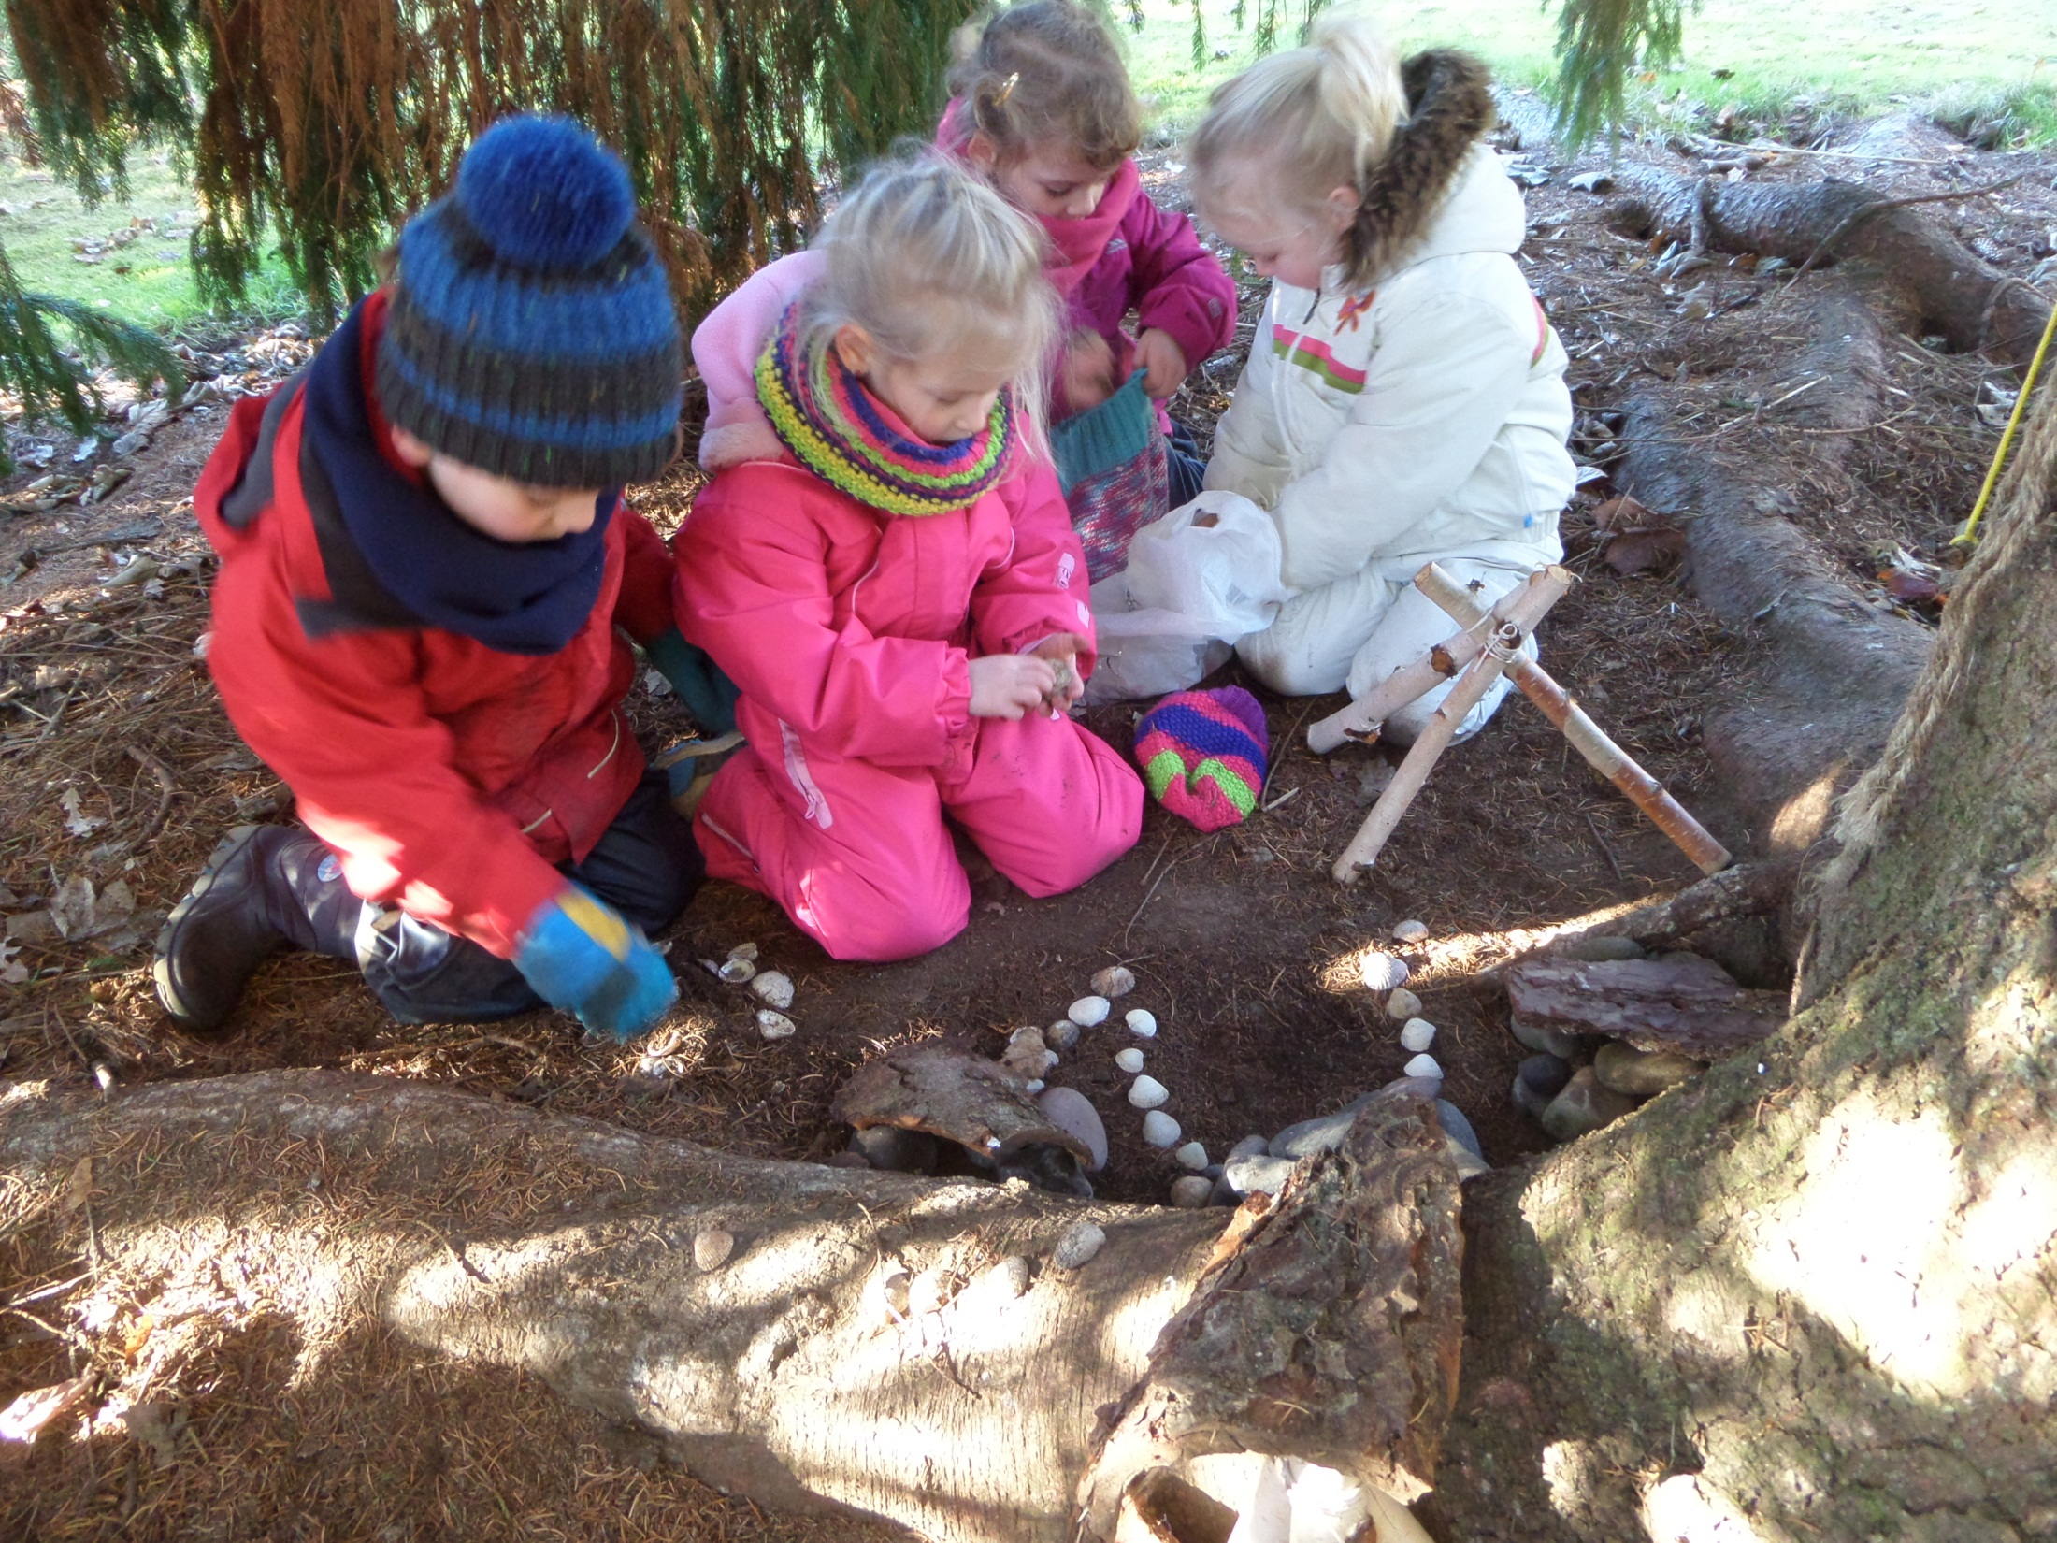

Slide 22
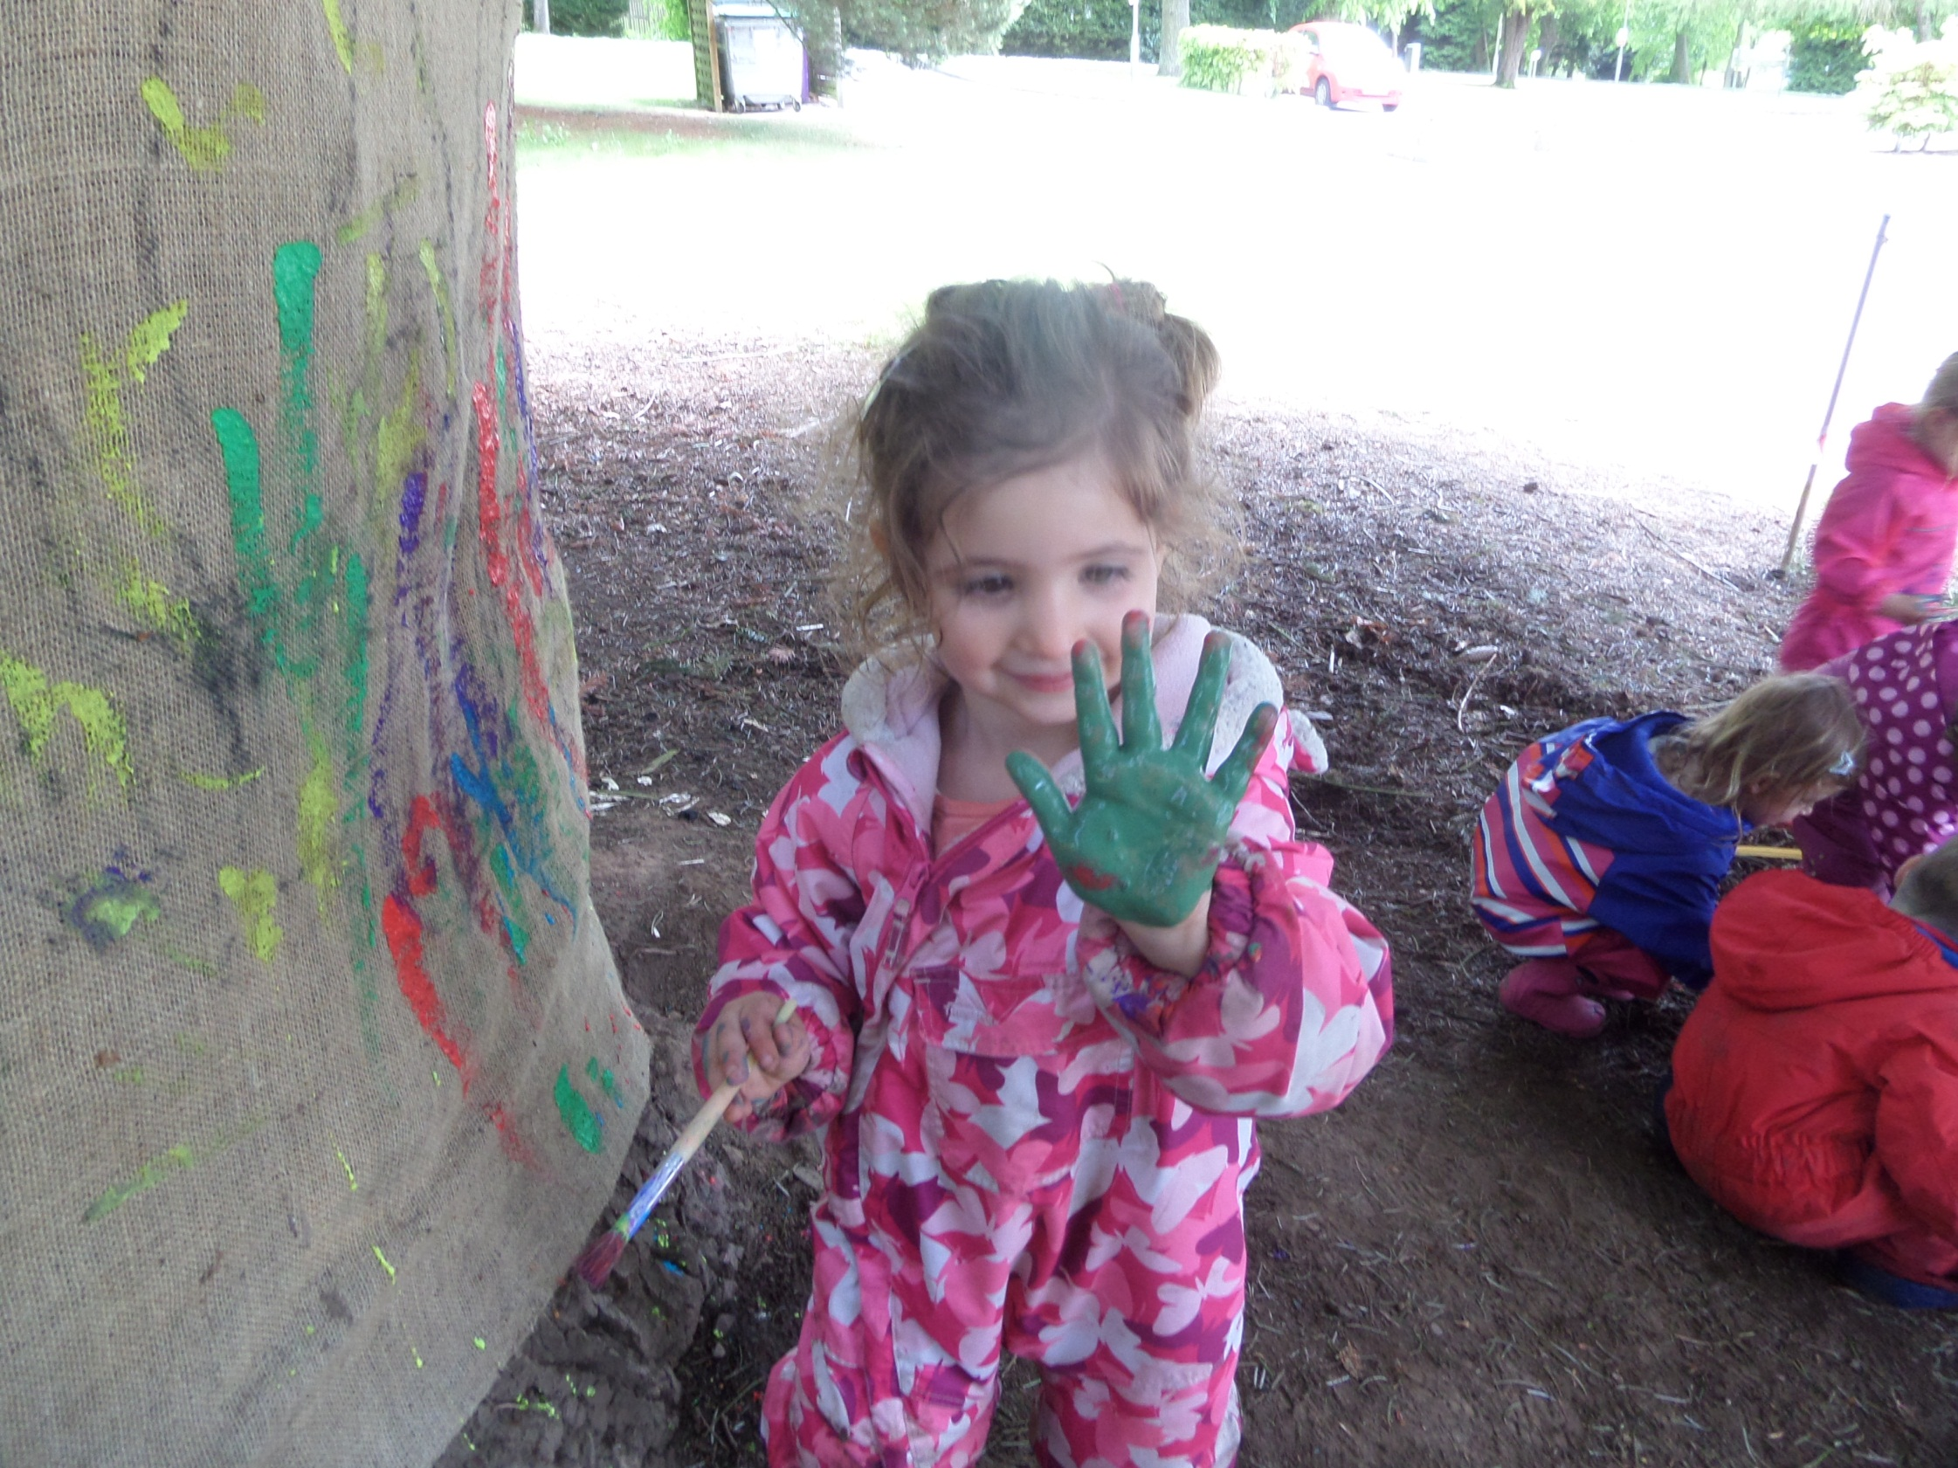

Slide 23
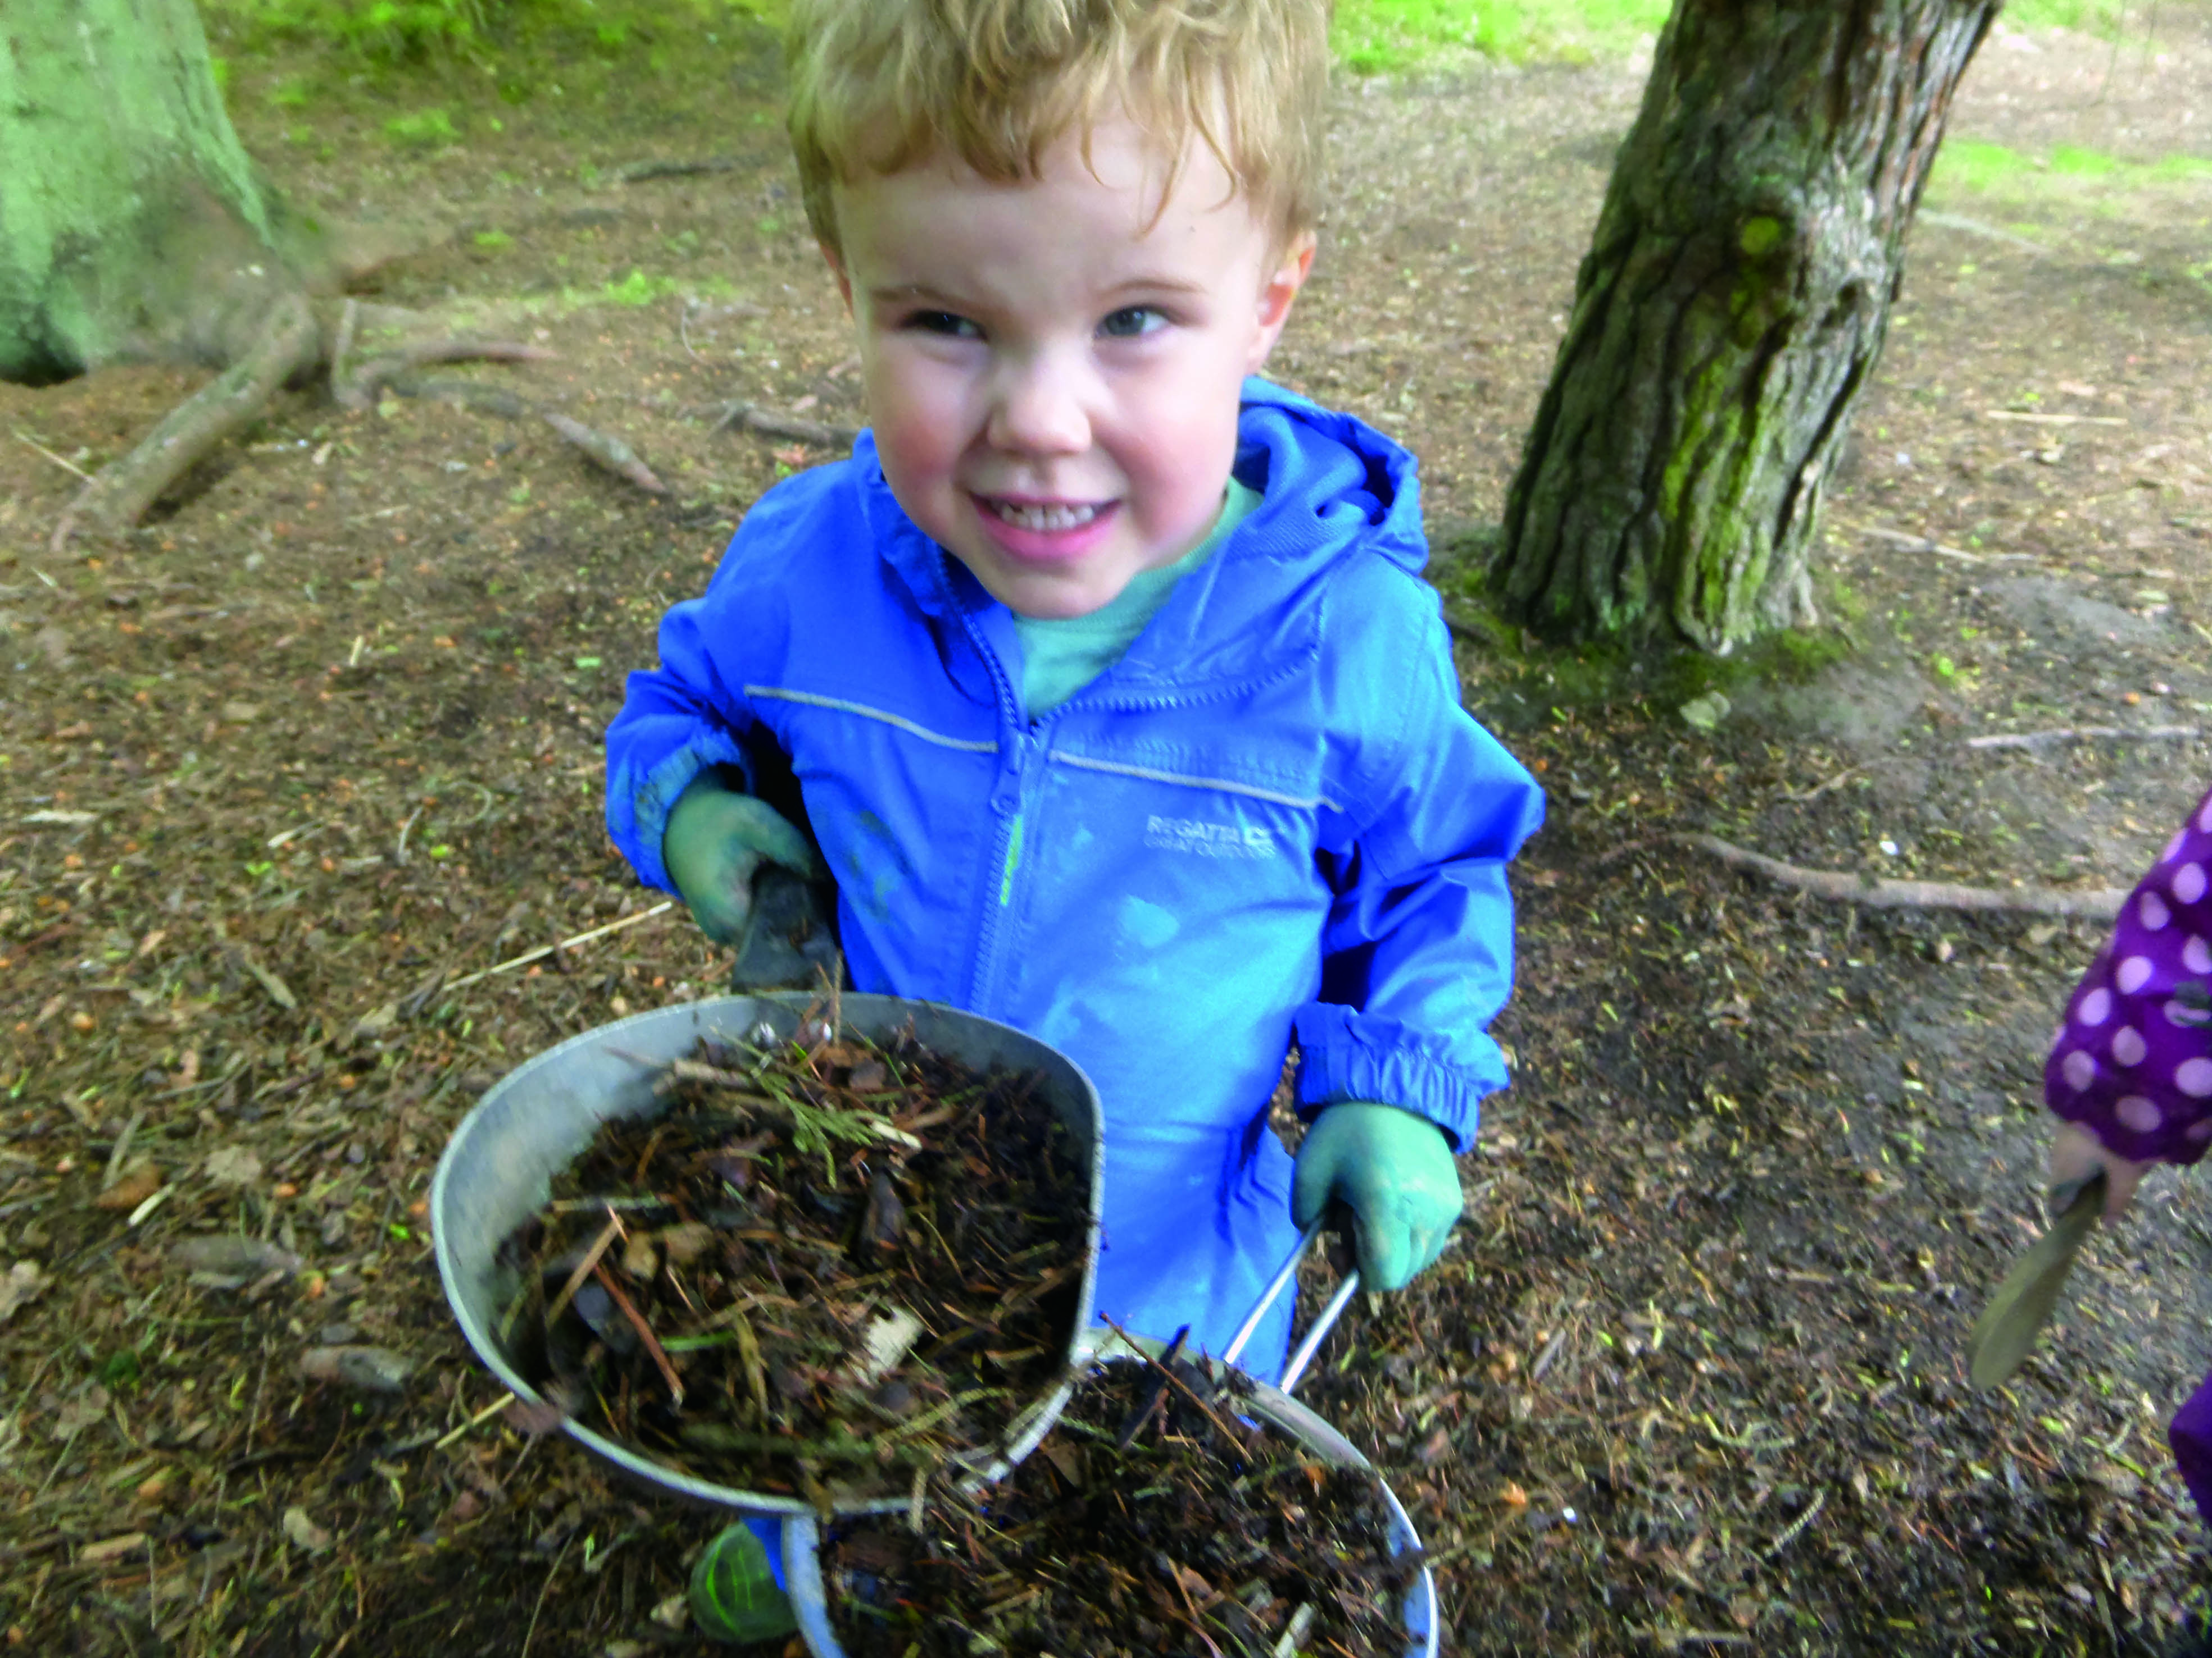

Slide 24
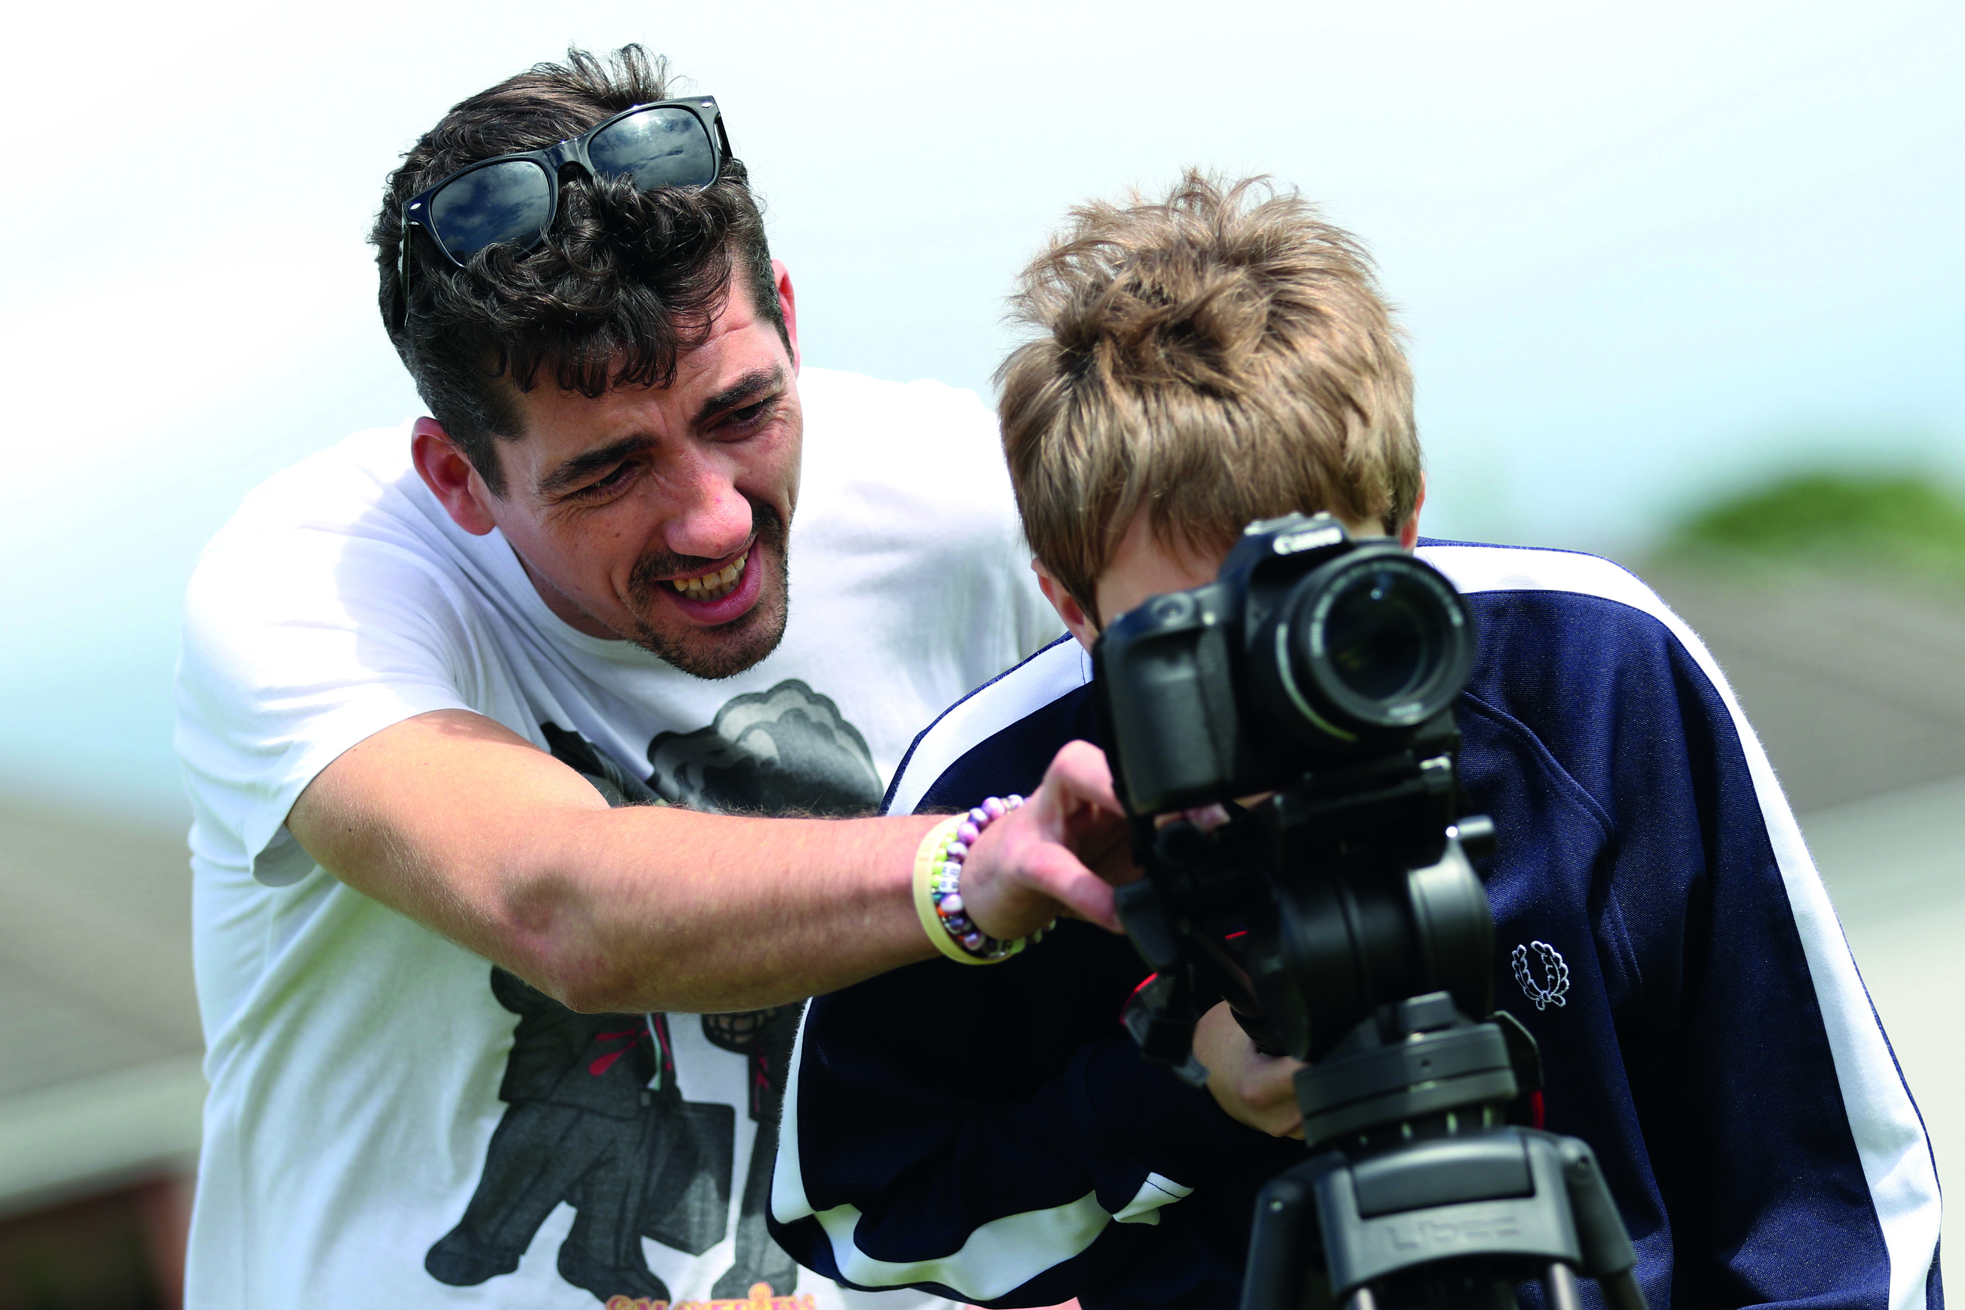

Slide 25

Achieving

Slide 26
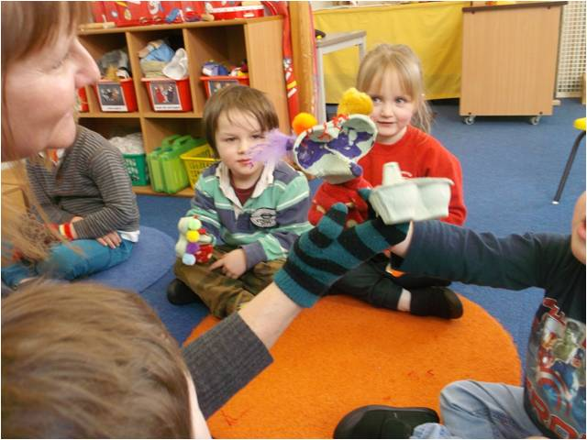

Slide 27
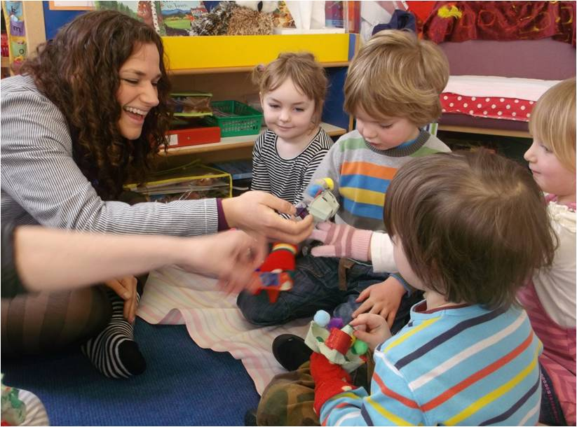

Slide 28
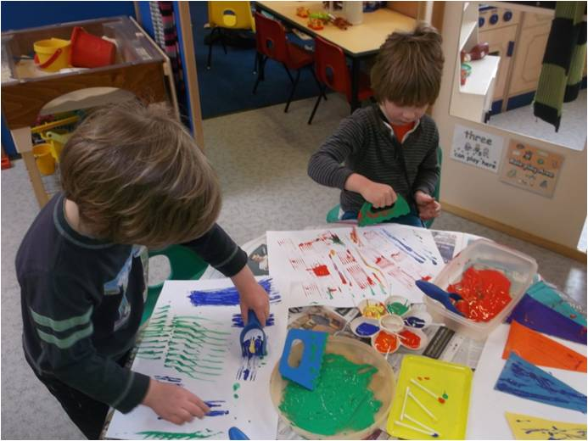

Slide 29
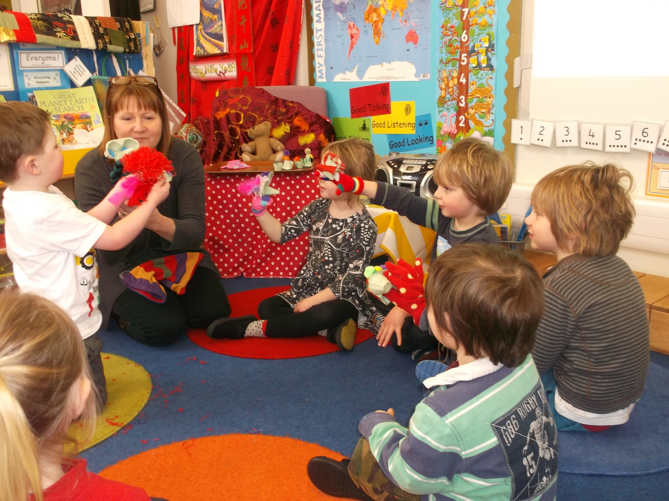

Slide 30
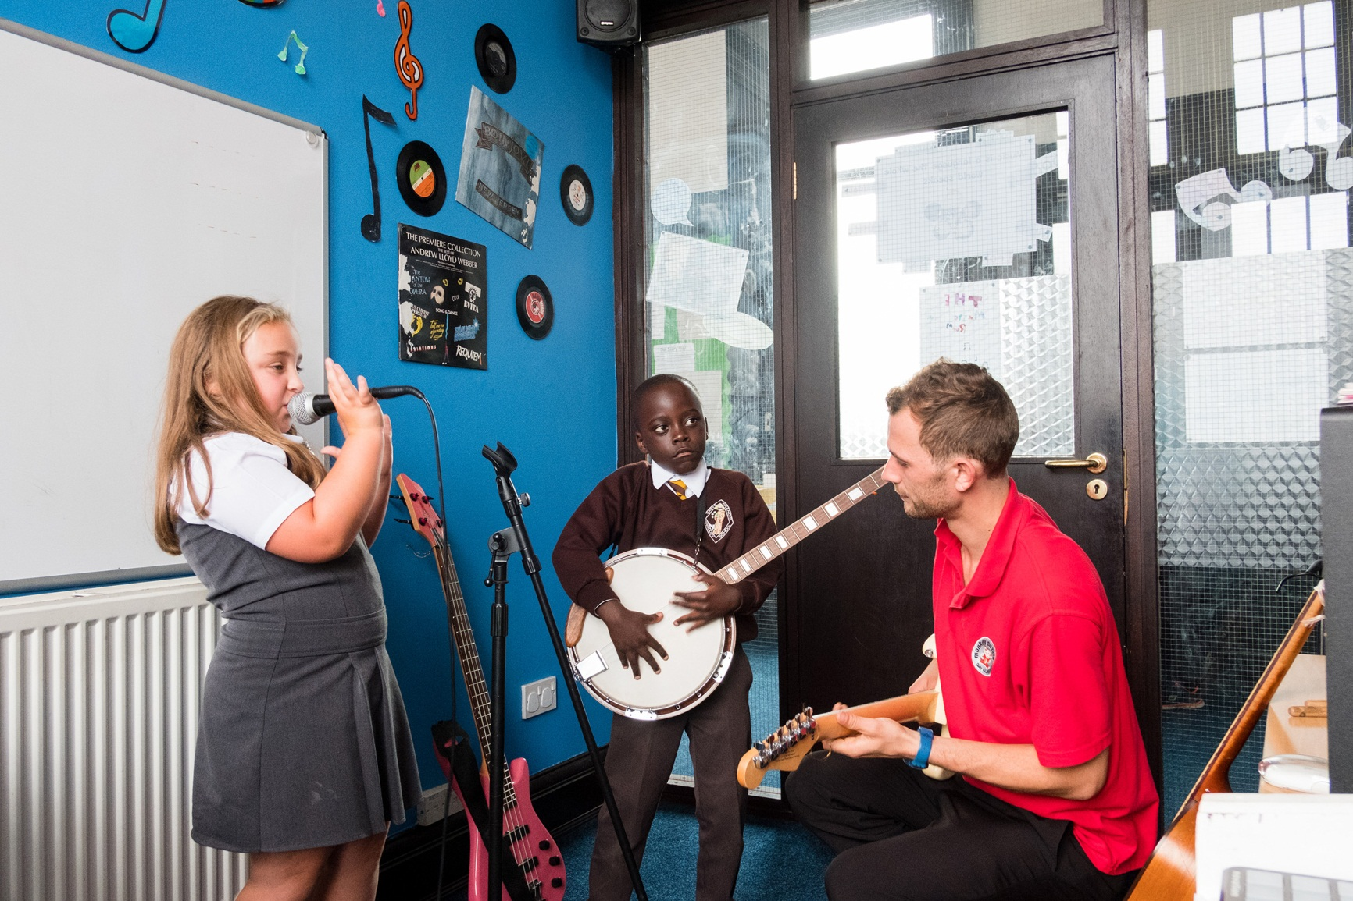

Slide 31

Nurtured

Slide 32
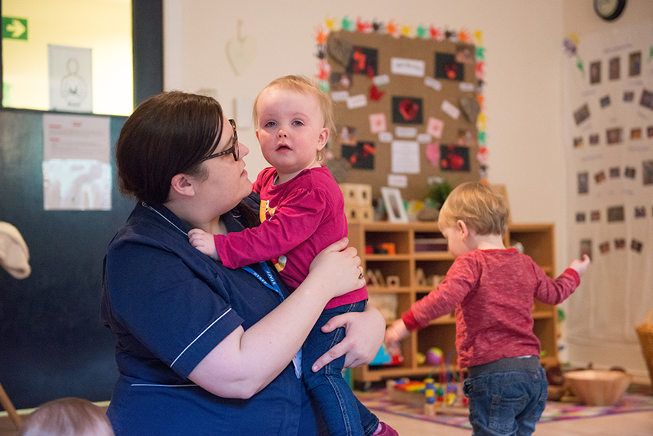

Slide 33

Active

Slide 34
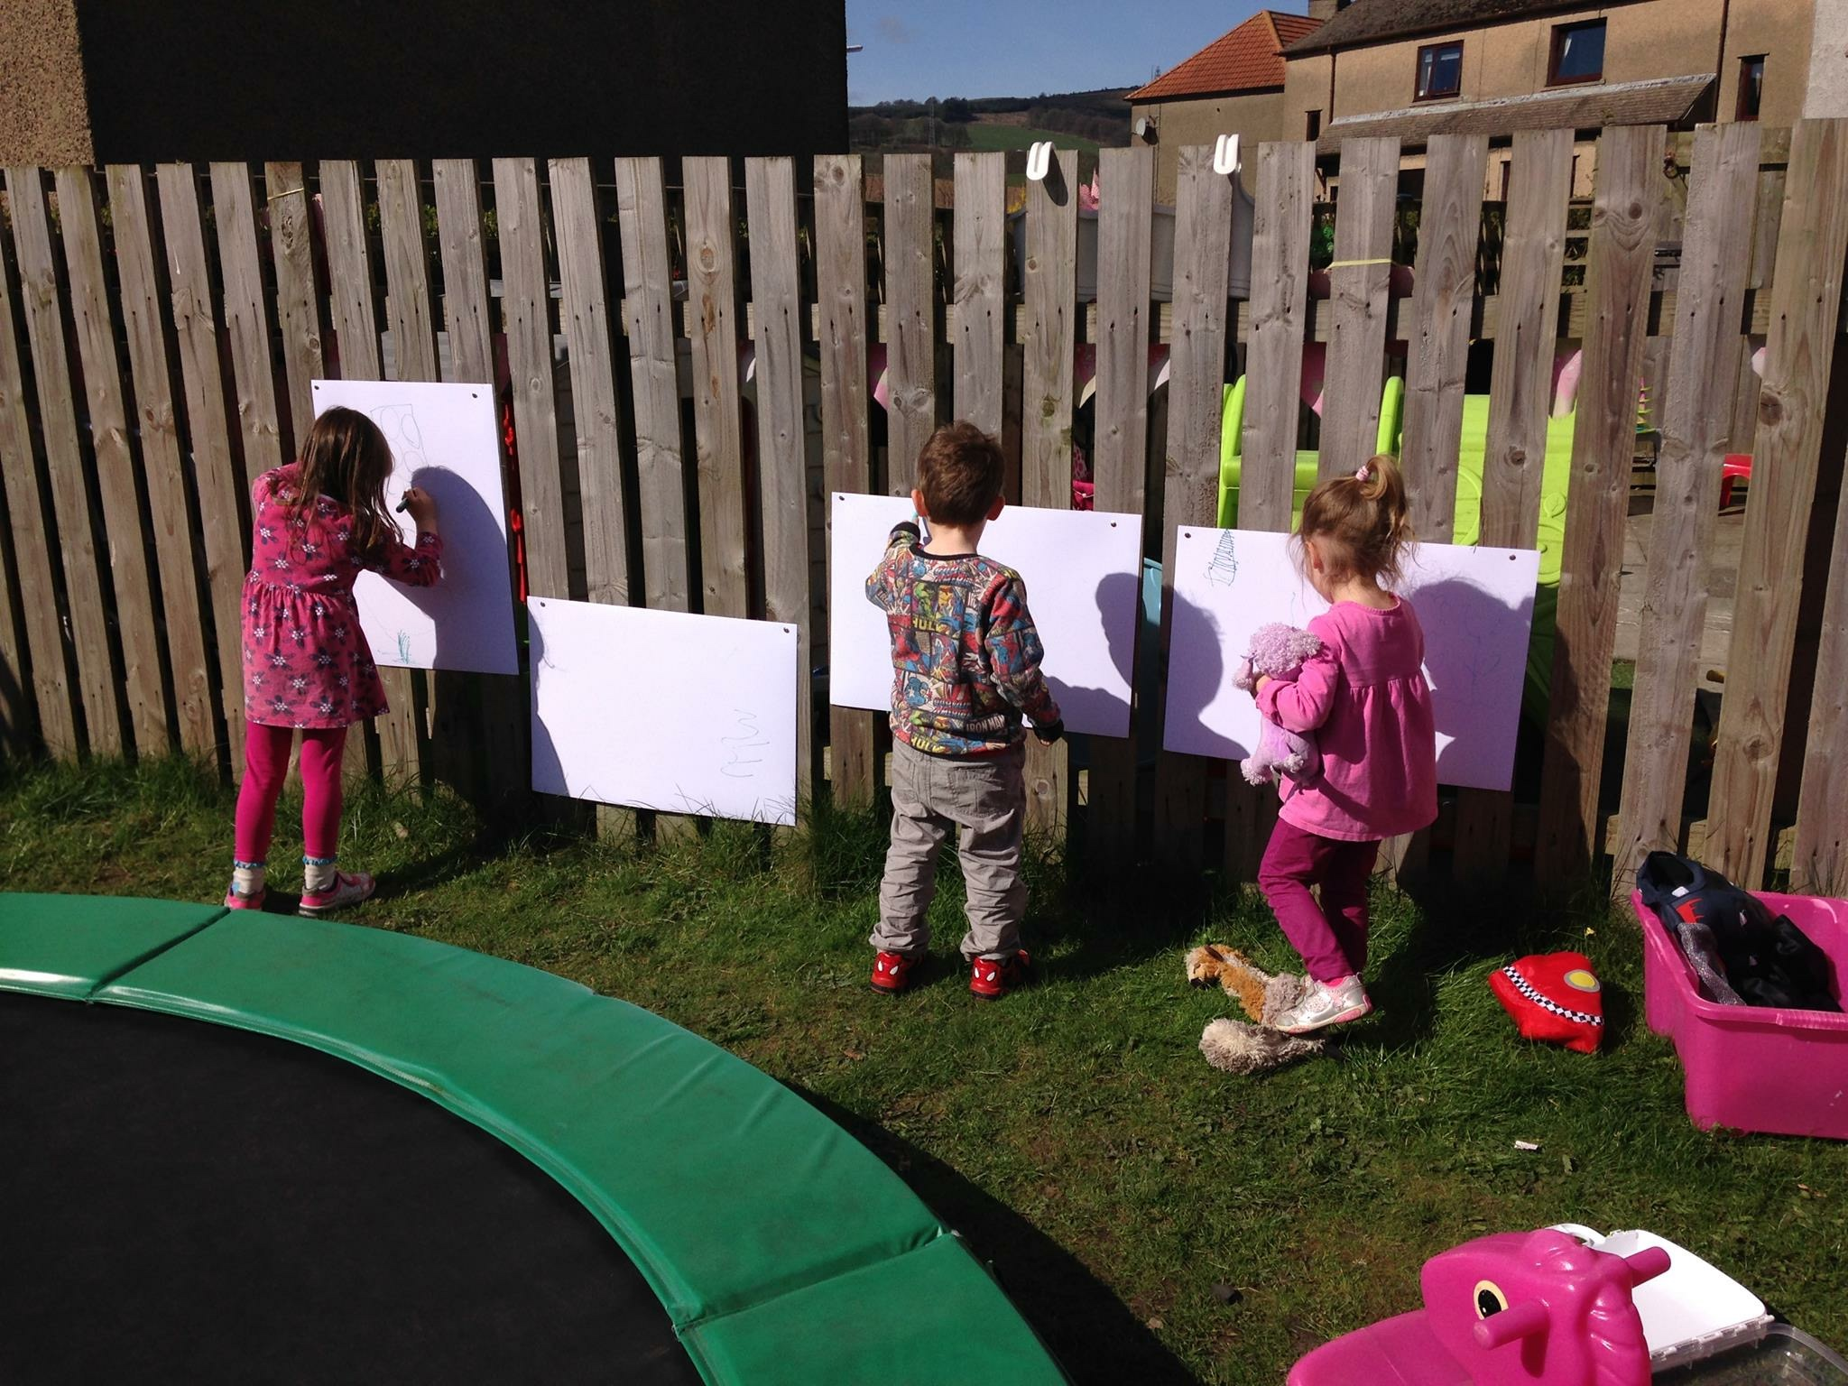

Slide 35

Respected

Slide 36
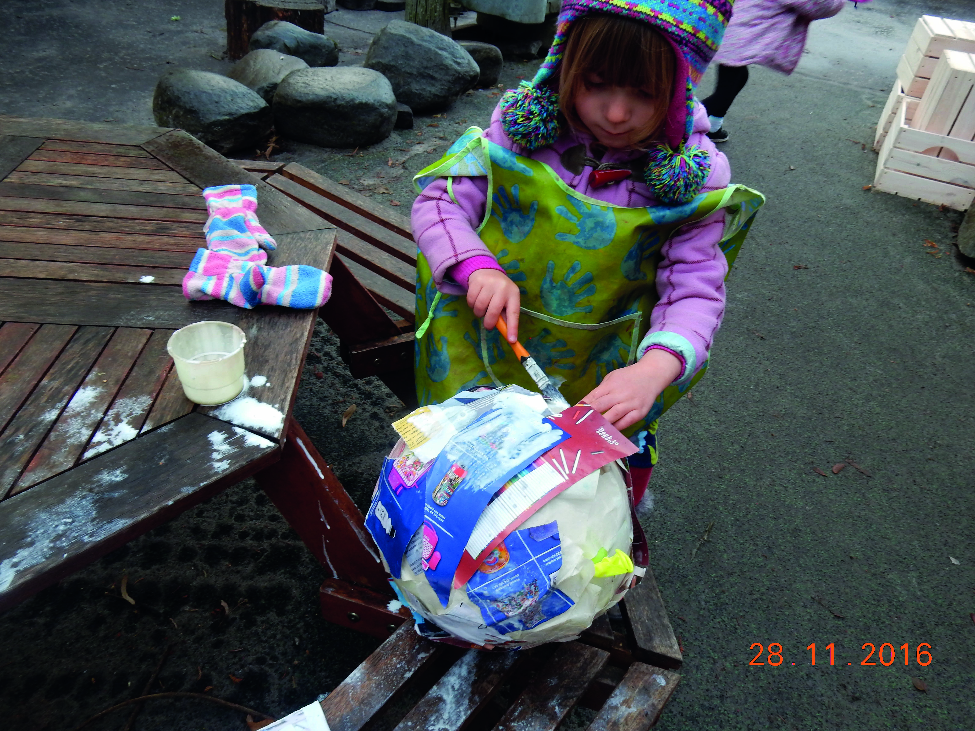

Slide 37
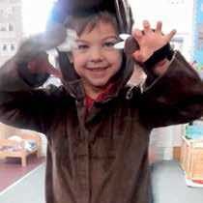

Slide 38
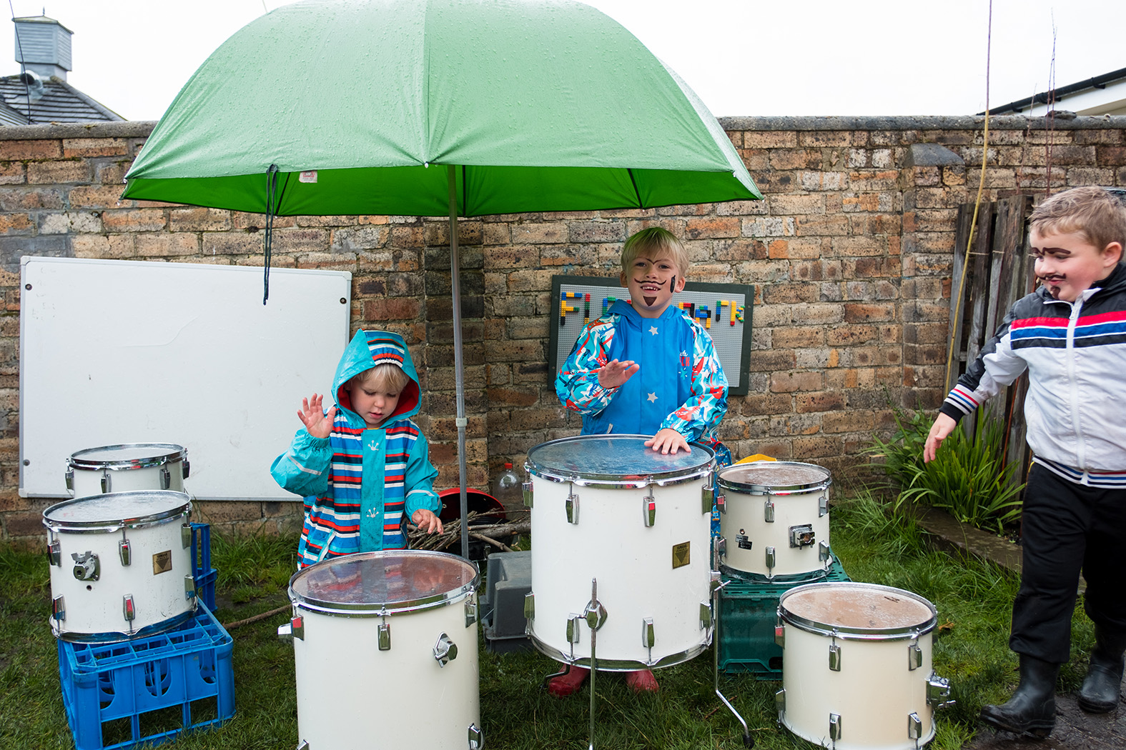

Slide 39
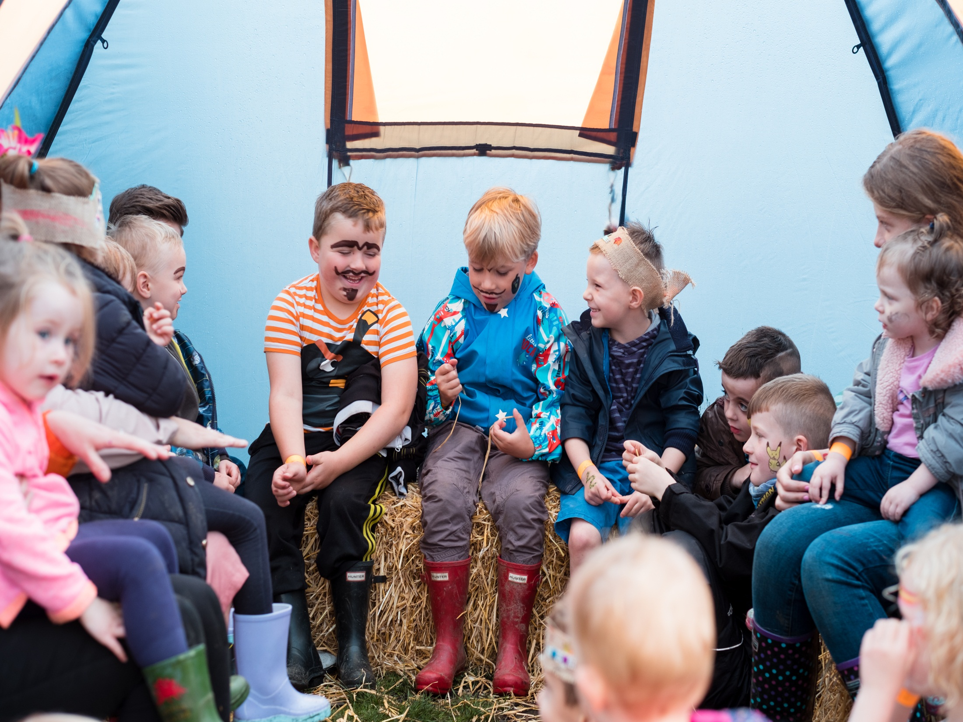

Slide 40
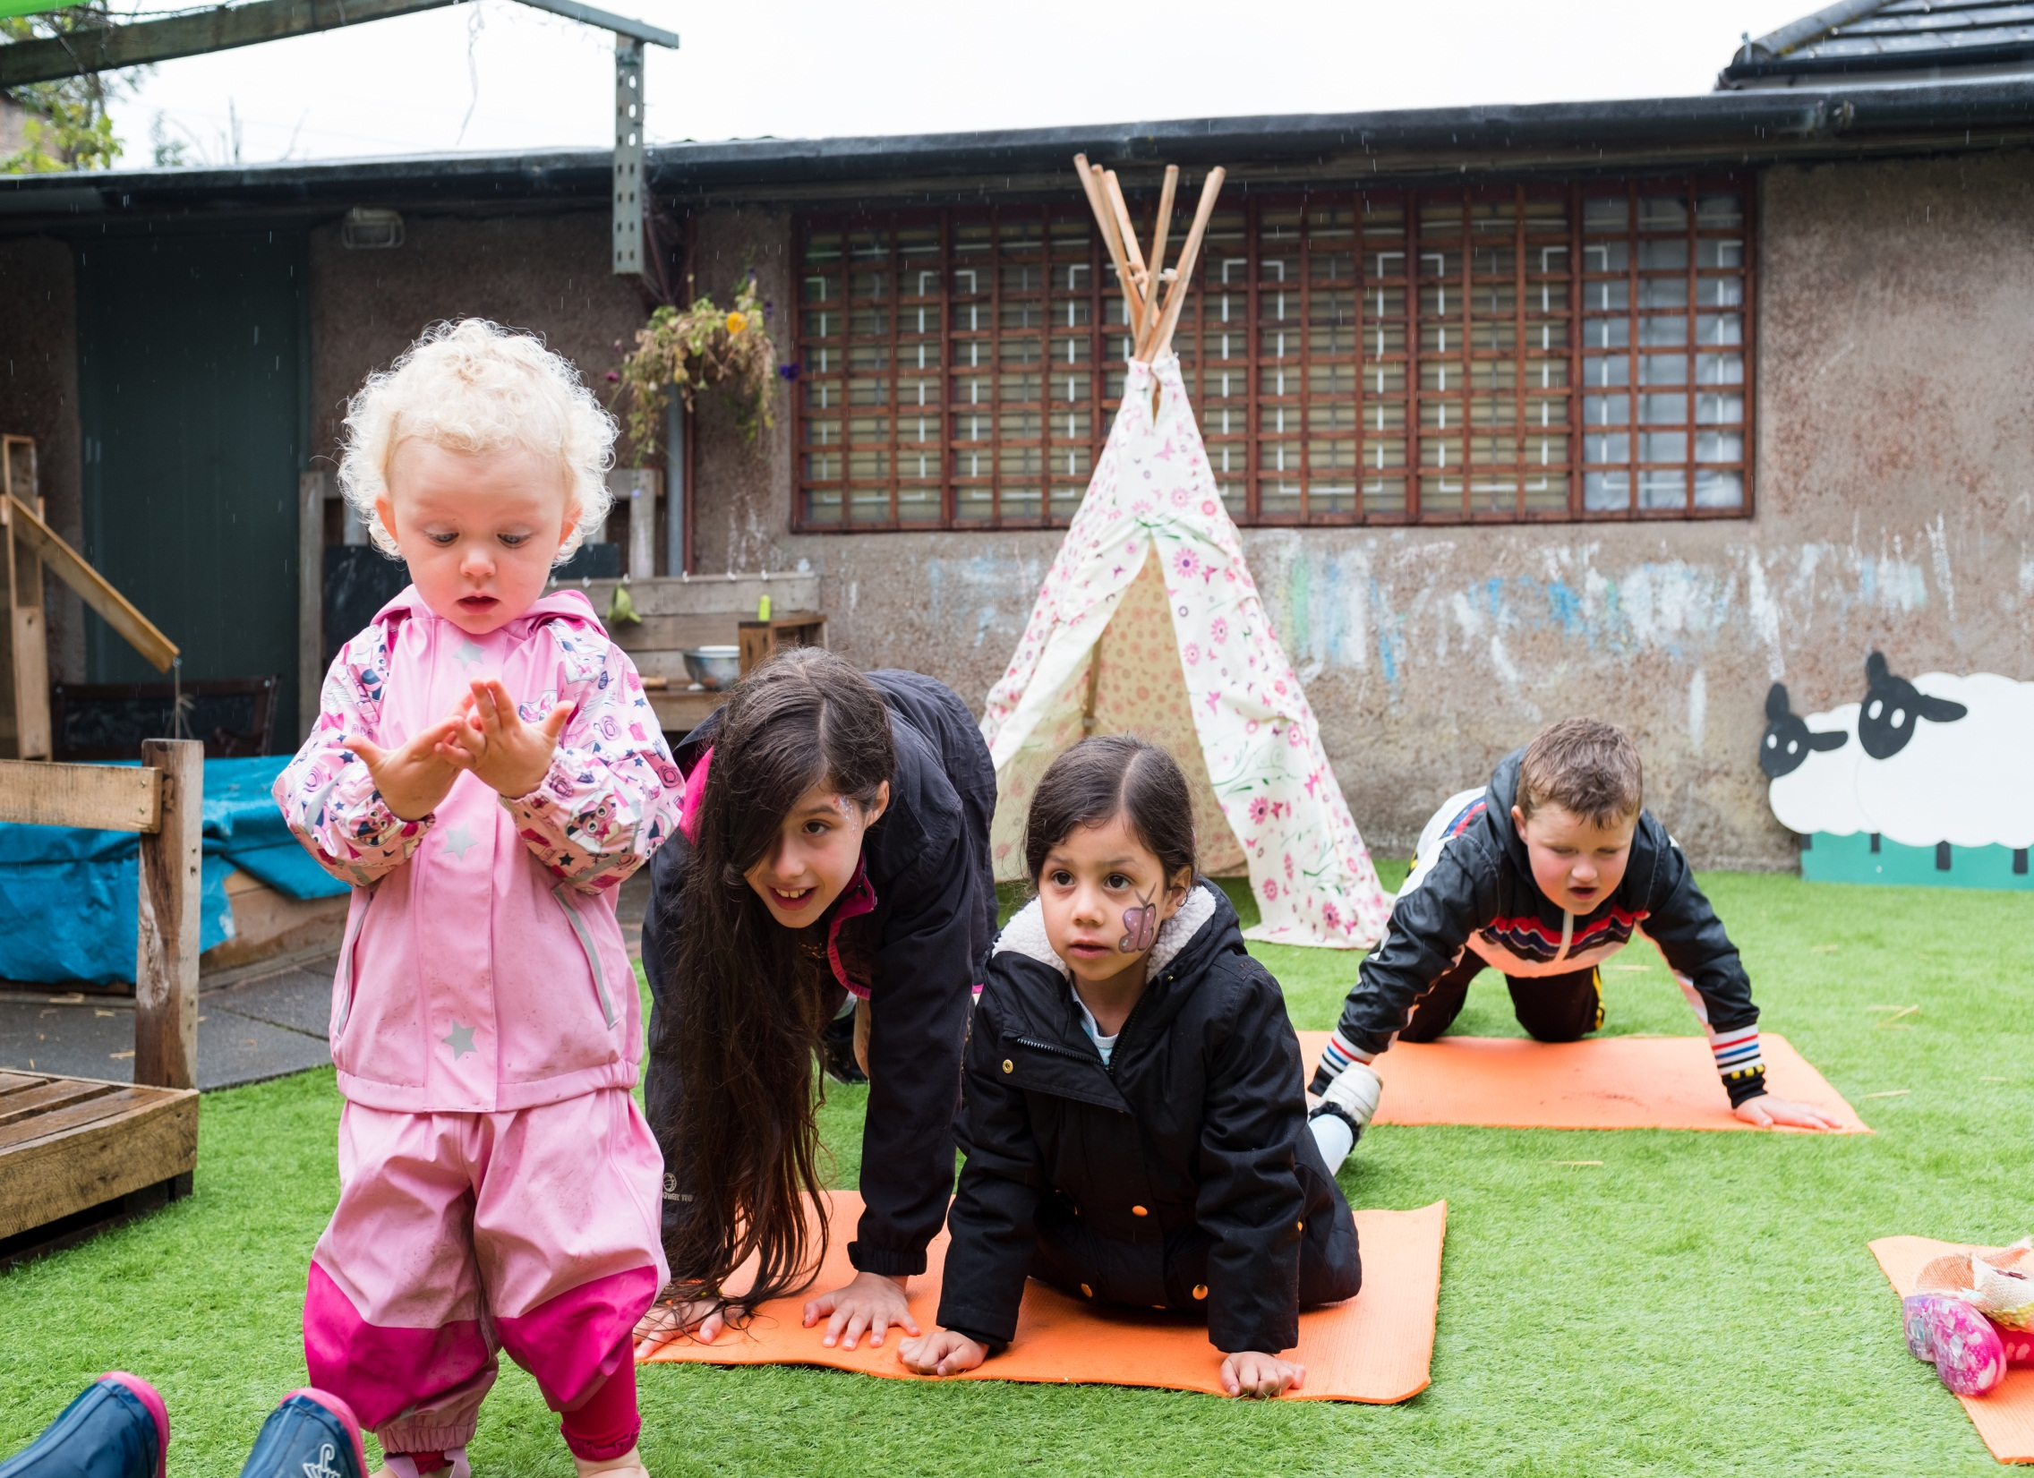

Slide 41
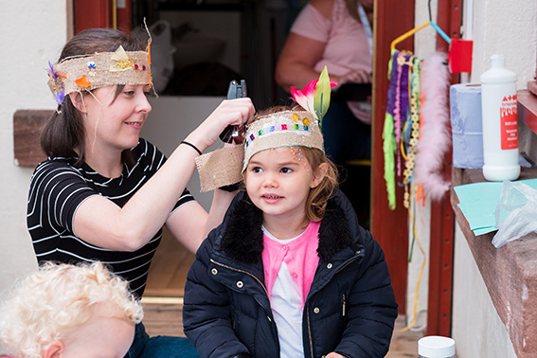
Planning Tree

Slide 42

Responsible

Slide 43
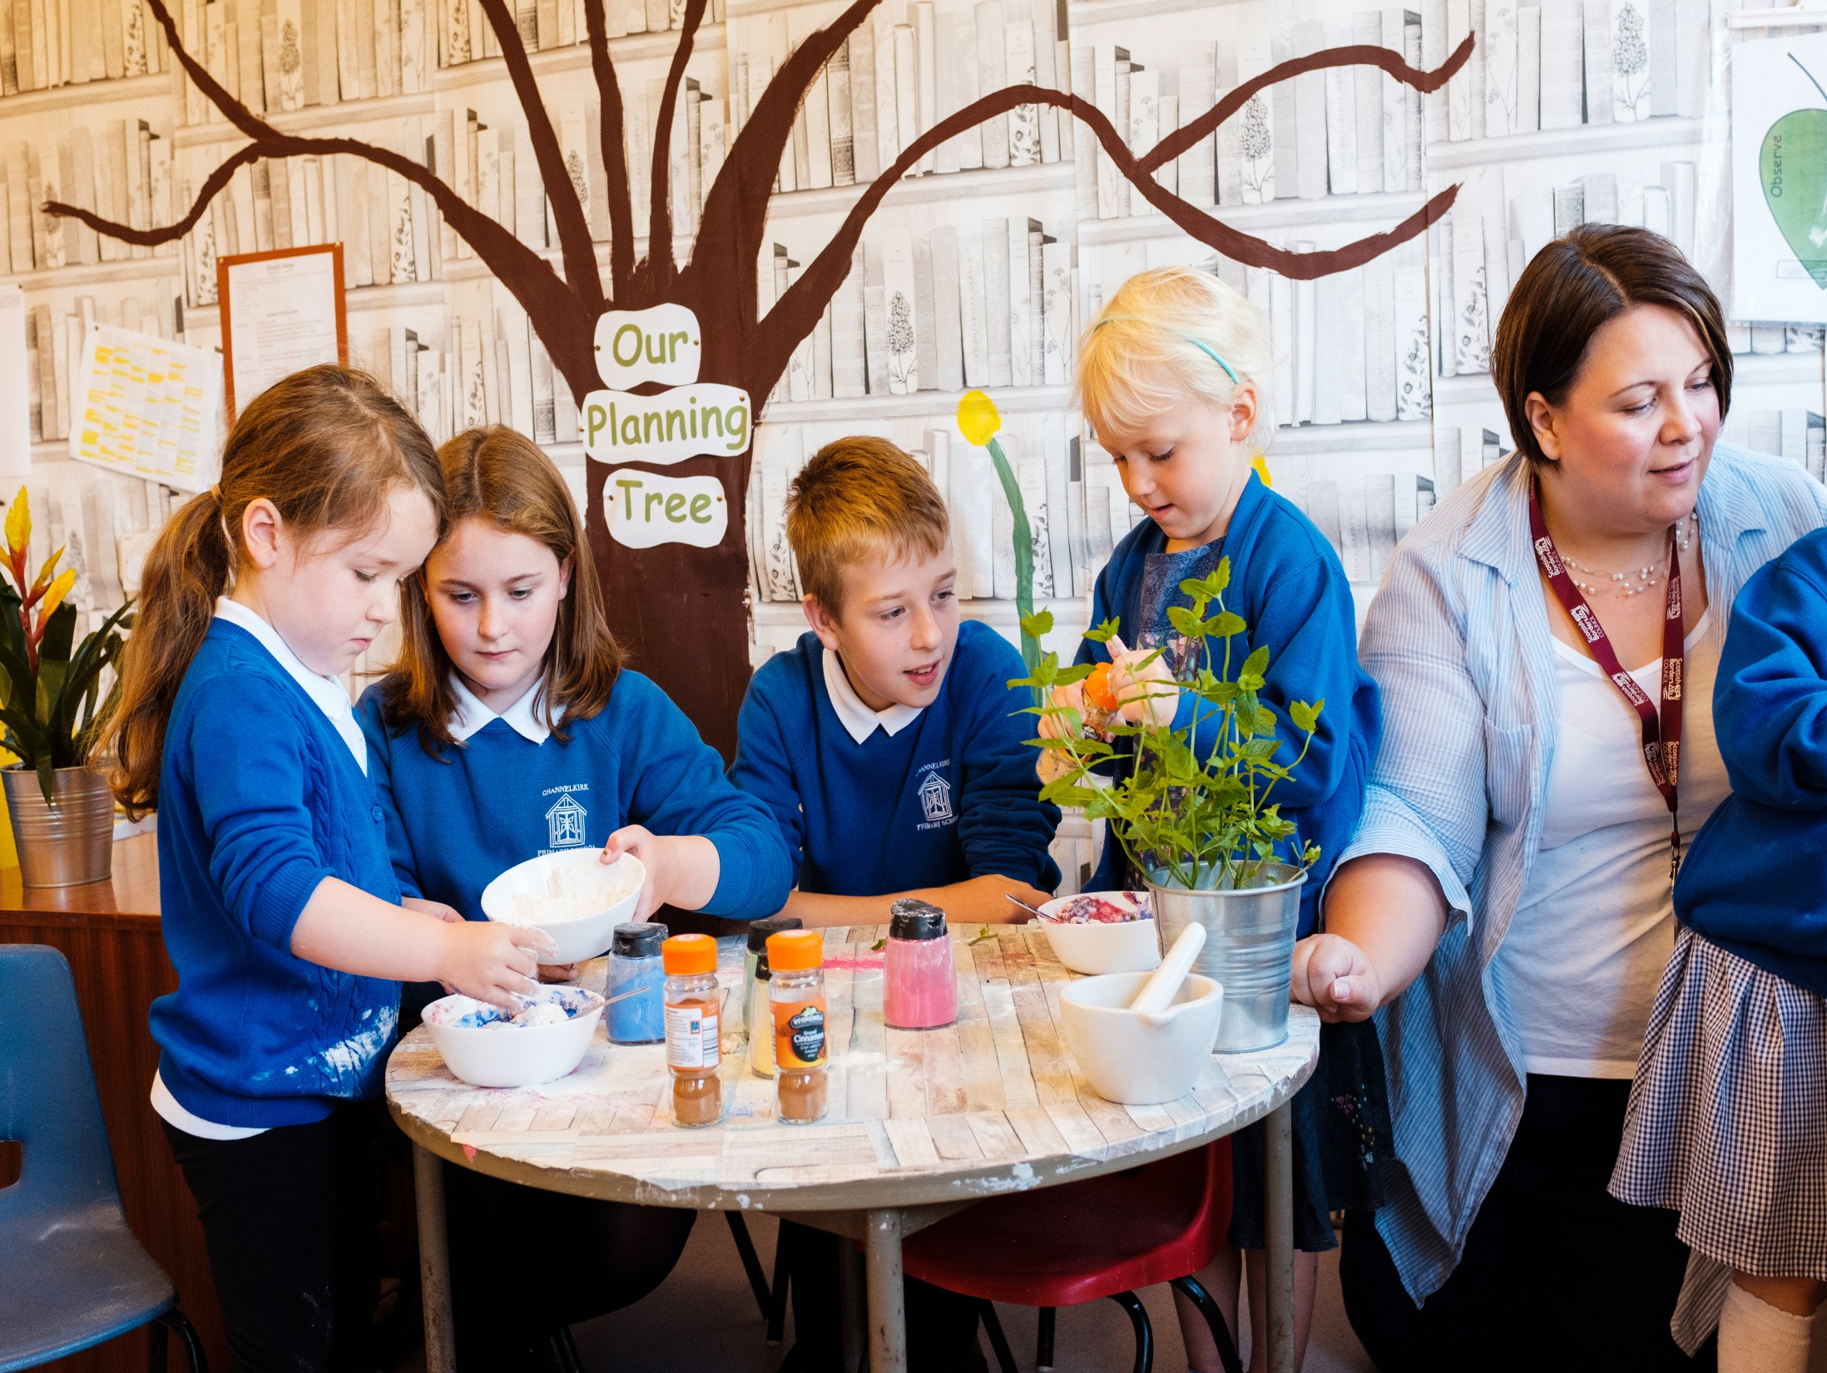

Slide 44
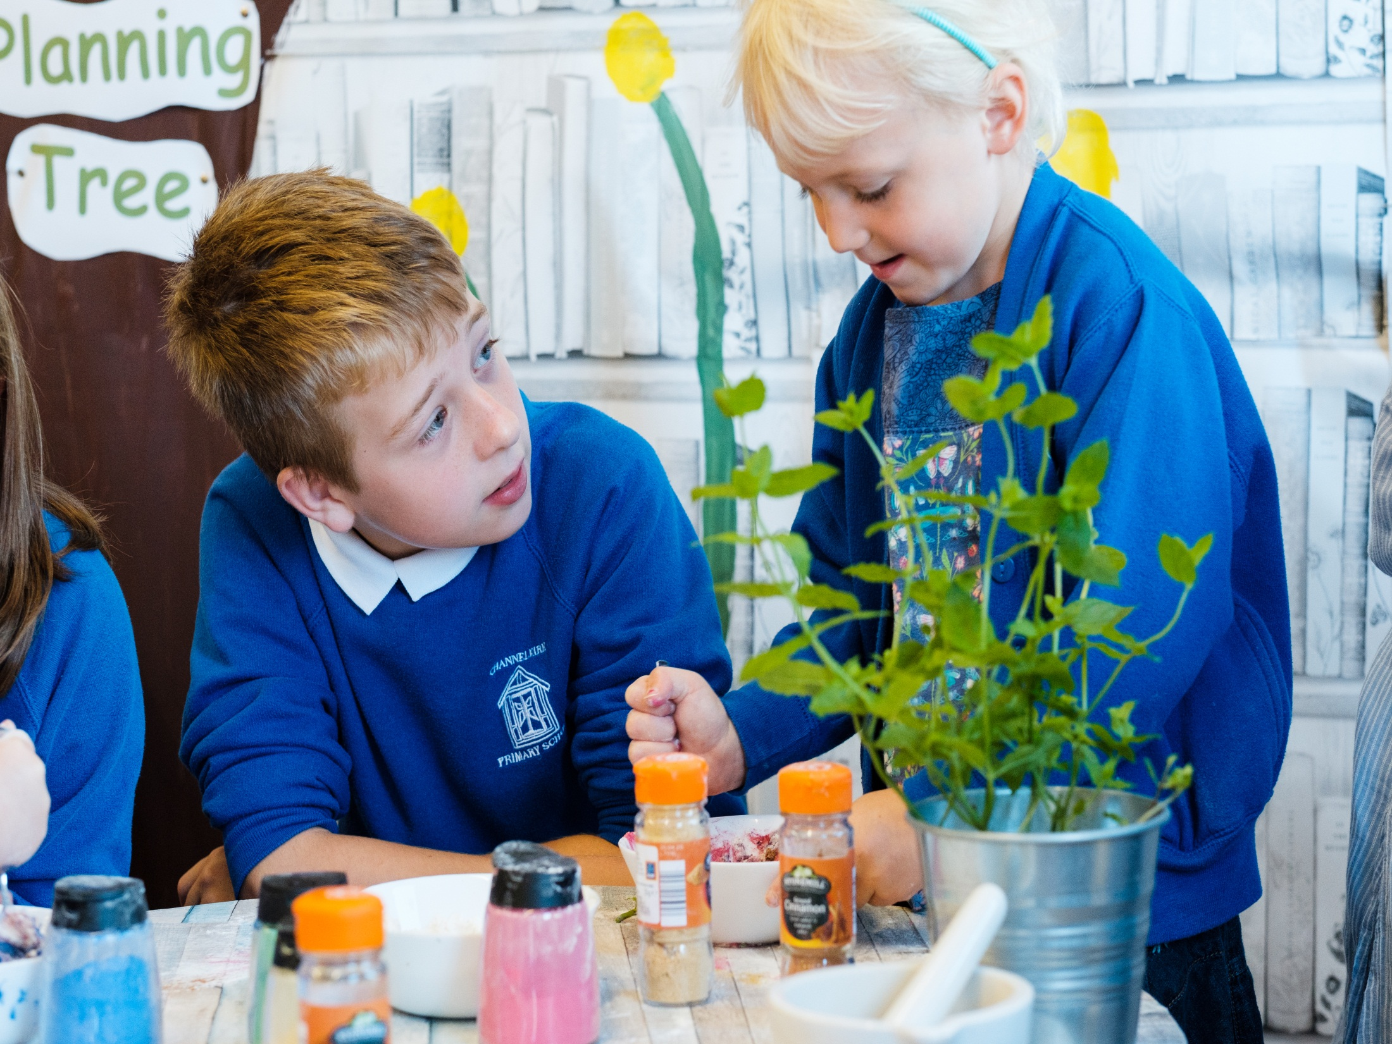

Slide 45

Included

Slide 46
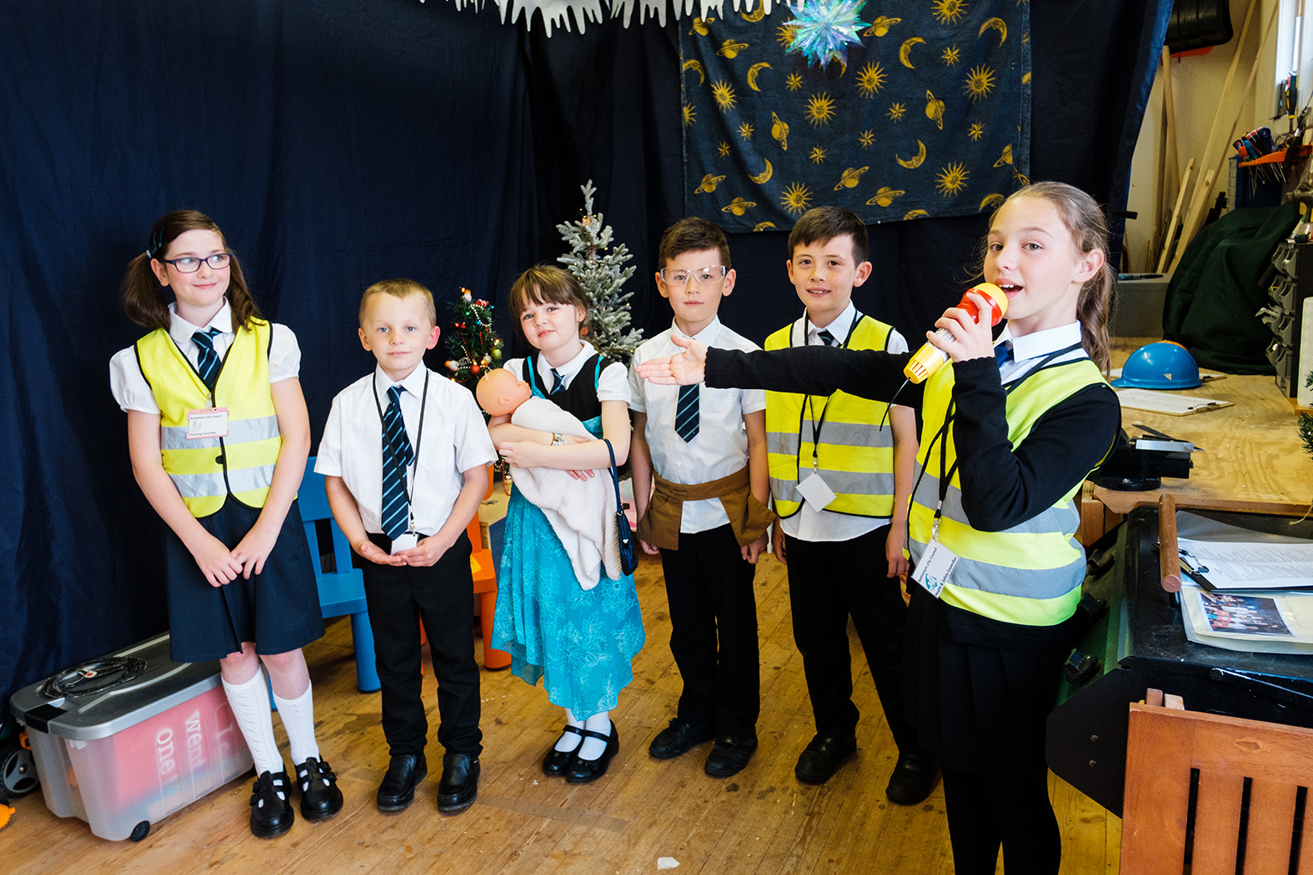
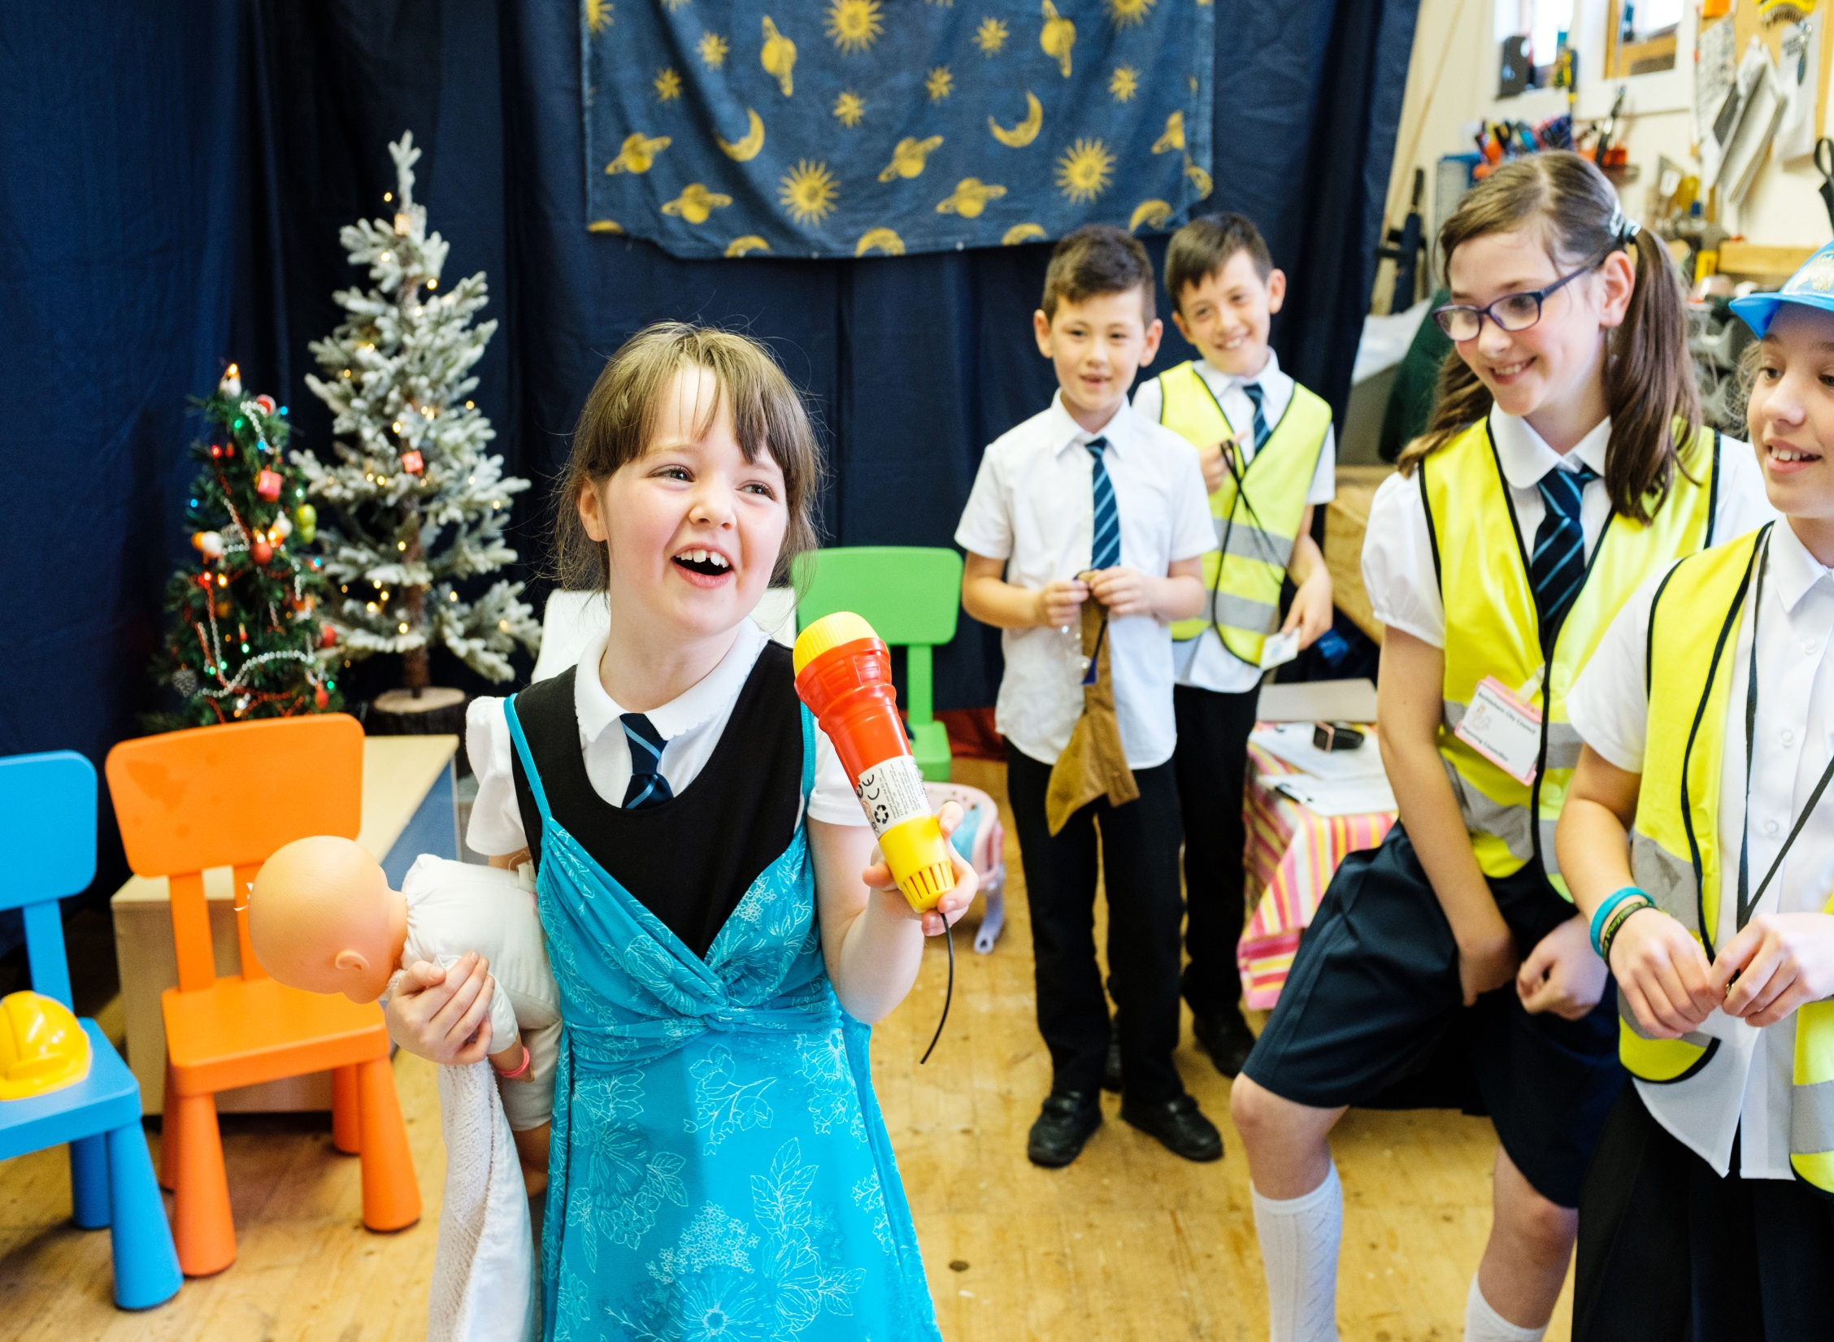

Slide 47
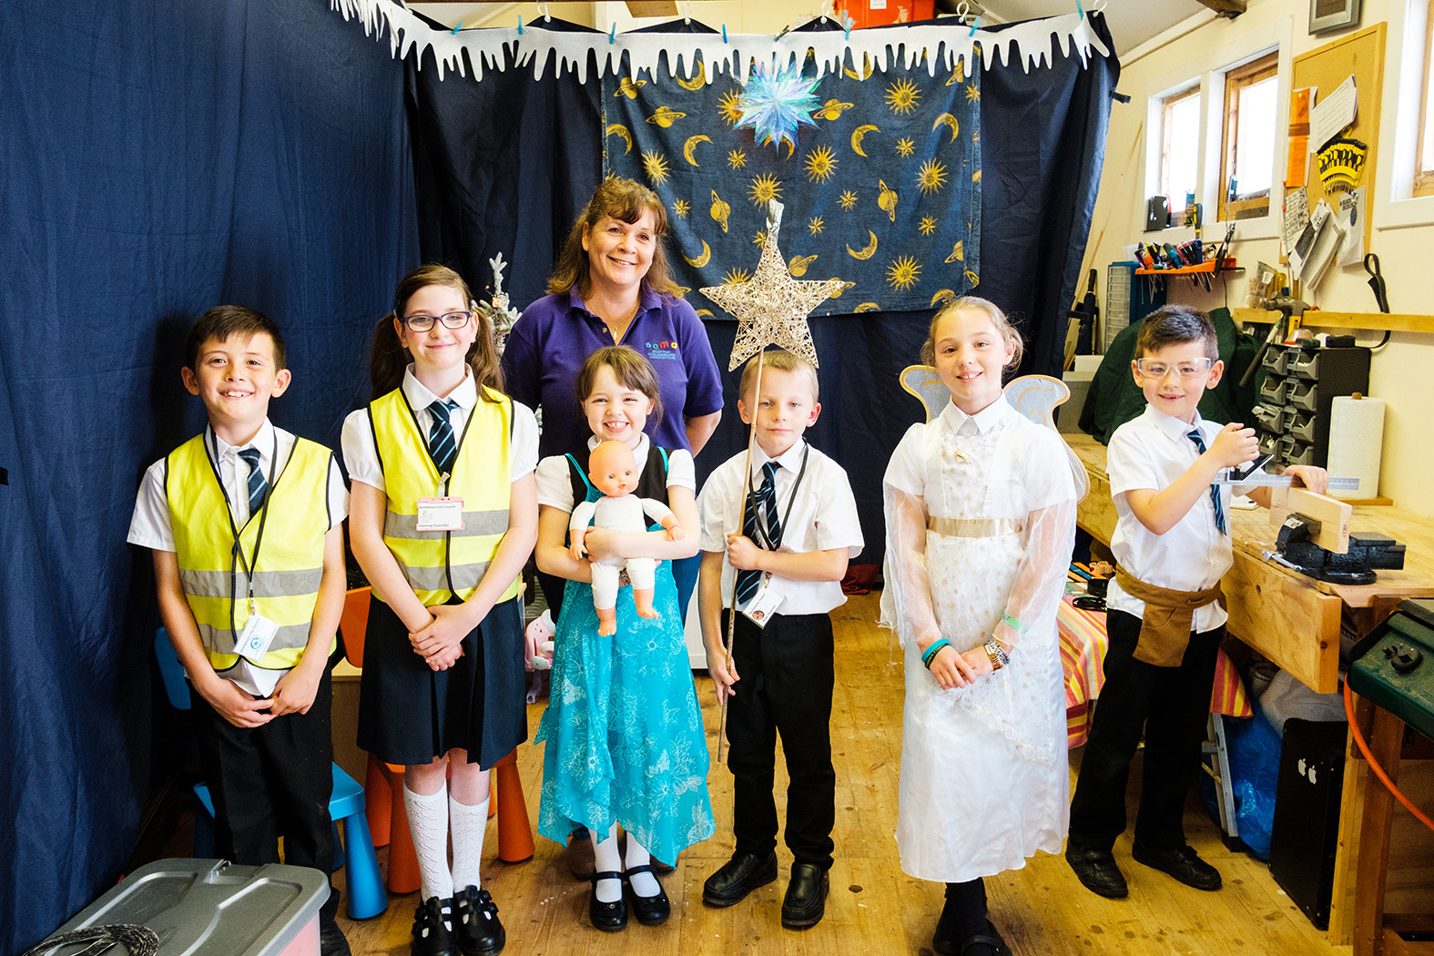

Slide 48
Lillie, age 9:
“I was the planning councillor and I liked it because I got to play in the nativity. My favourite line was “Well it looks like the hotel manager is using the shed as an extension, WITHOUT PLANNING PERMISSION!”

Slide 49
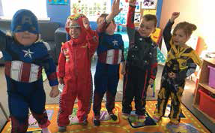
Notes:
Caroline Coll took“One of the things I’ve changed is story time. Before, when I tried to share a story with the children,
they would squabble over who could see the book. I’ve started improvising stories using different
props and costumes in the playroom. Sometimes they’re based on a book, but often the stories are
inspired by objects the children find. Some days we choose a theme, such as red, and everyone has to
find something red and use those objects as we build the story together.
“One story started with me saying there was a big chocolate factory under the trampoline outside.
The children carried it on to say someone had stolen all the chocolate and eaten it. The children all
wanted to hide, so we made a den and they had their snack in there. Children take the lead
sometimes, for example on one occasion a person was only allowed to talk and tell the story if they
wore a mask, I had one too.

Slide 51
Eating and drinking:
1.33 I can choose suitably presented and healthy meals and snacks, including fresh fruit and vegetables, and participate in menu planning.
1.35 I can enjoy unhurried snack and meal times in as relaxed an atmosphere as possible.
.

Slide 52
1.36 If I wish, I can share snacks and meals alongside other people using and working in the service if appropriate.
1.37 My meals and snacks meet my cultural and dietary needs, beliefs and preferences.

Slide 53
1.38 If appropriate, I can choose to make my own meals, snacks and drinks, with support if I need it, and can choose to grow, cook and eat my own food where possible.
1.39 I can drink fresh water at all times.

Slide 54
Quality Conversation
Glasgow
29 November 2017

