Slide 1


Coronavirus (COVID-19)
Supporting primary children at points of transition
Advice for primary colleagues
For Scotland's learners, with Scotland's educators

Slide 2
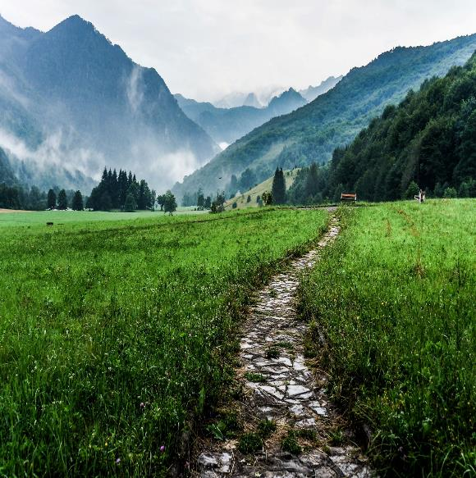
”The path before us is through uncharted territory and will need careful navigation.
Our guiding values should be kindness, compassion, openness and transparency.”
COVID – 19 – a framework for decision making
Scottish Government: April 2020
For Scotland's learners, with Scotland's educators
Notes:
Education Scotland intends to offer the best practical transitions advice and support to staff in primary schools in planning children’s transitions.
The emergence of the COVID-19 virus quickly changed our Scottish education system in an unexpected and unprecedented way. The impact on every child has been profound. Every life has been affected. For many this has meant real and possibly long-lasting difficulties.
It is clear we cannot expect to return to how things were such a short time ago. The task before us is not straightforward.
Our whole education system will clearly have to engage and respond openly, collegiately, flexibly and transparently in supporting all the transitions being made by our children and young people.
As children move from primary to a new environment, they will experience changes in their daily routines. They will be required to re-establish relationships and forge new ones with their peers and the adults who look after and educate them. To start the next part of their learning journey, periods of adjustment will be required, and planned for in the short and longer term.
The advice in this presentation offers practitioners, senior leaders and others a starting point for discussions. Discussions that will require us to work together to intentionally plan for children’s transitions from one primary stage to another and from primary to secondary school.
We are living in uncertain times, where significant concerns are rightly being expressed by parents, by policy makers, senior leaders, others, staff and children themselves, about how we can safely plan for transitions. By being solutions-focussed and responsive to the changes yet to come, transitions will be more effective.

Slide 3
Primary transitions in the new context
Why is this advice needed for the primary sector?
To ensure practitioners have access to practical advice based on what we currently know about best transitions practice, learning from others, and applying this in a Scottish context,
To intentionally plan for a safe transition that builds on the learning children bring with them from primary,
To provide reassurance that despite the significant impact that Covid-19 is having on all of our lives, we will be doing the right thing for our children if we adopt approaches which are grounded in nurturing principles.
Notes:
Why is this advice needed?
On the 20th March children and young people across Scotland left their familiar educational settings facing a period of significant change and uncertainty that may have a lasting effect on their future lives. The full impact of these system-wide changes on the wellbeing of children, families and their communities, is as yet, unknown.
Transition is a complex and dynamic process. To better understand this complexity, particularly in the current climate, we need to be aware of the shifting social and cultural contexts that are a reality for our children, young people and their families. More specifically, being responsive through intentional transition planning for the needs of those most at risk, and who may show symptoms of traumatic stress.
Reassurance is needed in these challenging times. Advice that is practical, flexible and achievable is offered here. We offer advice that is considered, reasonable, fair and equitable.
Much of the advice applies generically to transitions in and across primary. Where it is useful to do so specific advice is outlined in later slides.
The advice will be updated and extended to reflect emerging scientific data and changes to the lockdown and social distancing arrangements as set out by SG to tackle the impact of COVID-19 on our children and families.

Slide 4

Transitions matter - to me
Transitions do matter to children and families, in the new context they matter even more.
The traditional induction processes no longer fit with the challenges of Covid-19 but we can still support children’s transition from primary to secondary school.
We will be doing the right thing for children if HWB and nurturing principles permeate all of our transitions planning.
For Scotland's learners, with Scotland's educators
Notes:
https://www.epinsight.com/post/supporting-post-lockdown-education-using-the-6-principles-of-nurture

Slide 5

Communication: connecting and reconnecting
Communicating visually through digital technology offers children and families an immediate connection.
Staying connected and making connections at times of transition can promote children’s confidence and self esteem. Children will be curious and ask questions, they will want to know who their new teacher(s) may be, will they keep the same friends etc.…we need to listen to their voices. As proposed in the context of early years education, how do we create a pedagogy of dialogue (Malaguzzi) for transitioning primary pupils that includes the voice of the child?
Things to think about:
Not all of our families will have Wi-Fi and the necessary hardware to keep up in touch with practitioners and teachers.
Could we use social stories for all/some transitioning pupils to connect and reconnect previously established communication networks?

Slide 6
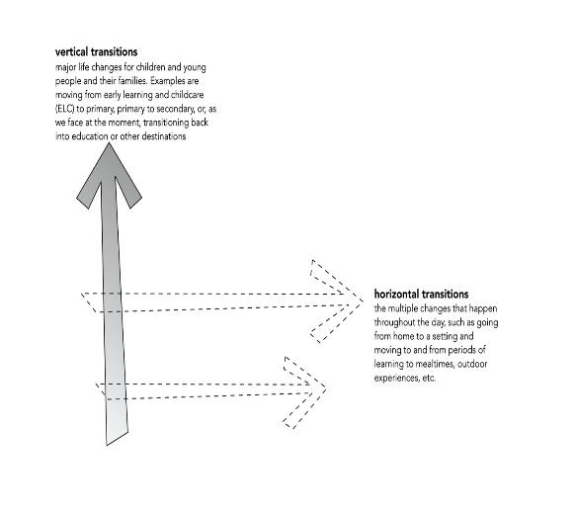
Supporting children’s multiple transitions
Children may experience more than one horizontal transition in the course of their day-these transitions are part of everyday life. For example, from classroom to dining hall or from school to home
As children move from primary to secondary school, this is considered a major vertical transition.
In these challenging times we need to consider how best to support children’s horizontal and vertical transitions.
Notes:
Supporting children’s multiple transitions
We can begin by reflecting on our own policies and practice. How relevant are they now? How will you redesign curriculum programmes. This is especially important for P1 teachers who may want to reconsider the content of their early level programmes of study. There is surely an opportunity here to reflect with ELC colleagues on curriculum continuity and progression in learning across the early level.
We advise a strong focus on promoting nurturing relationships by considering the type of interactions, experiences and spaces that children will encounter as they transition vertically from home learning to ELC and from ELC to P1. And horizontally at different times in their day: the small routines such as handwashing and mealtimes. (see also RTA, pages 89 and 90)
The next three slides offer some advice, some of it is applicable to vertical and horizontal transitions.

Slide 7
Sharing information for P7 – S1 transition – what you might do …..
The use of digital platforms and video conferencing can be utilised to allow staff to have ‘face to face’ discussions about the children transitioning to high school. This is an approach that many schools have started to use successfully. It is important to ensure that all staff involved have access to professional learning and support around use of these platforms if required.
Parents may be able to give updates of the wellbeing of their children and make staff aware of changes to their social and emotional needs. This is particularly crucial given the current context and as always, staff should ensure that conversations around wellbeing are dealt with sensitively.
Focused discussion around the wellbeing indicators, close observation and opportunities to link up with a designated staff member may help.
In relation to academic progress, schools should continue to use a range of formative and summative assessment strategies to build up an accurate picture of strengths, gaps and areas for further development.
Children may have already started to gather information about their interests, strengths and individual circumstances in a portfolio. They may need support and time to complete this.
For children who do not have this, they could start to create a P7 to S1 passport detailing areas as outlined above. This could be done on paper or in digital form. OneNote could be used for a whole cohort with dedicated areas for each child to complete.
For Scotland's learners, with Scotland's educators

Slide 8
Emotional Support and enhanced transition P7-S1 – what you might do …..
There are numerous ways that formal and informal information sharing and collaborative planning can take place:
Phone calls, video conferencing, team pages and emails are being used effectively by many schools at this time to ensure that all parties have access to relevant information and can share expertise. It will be important to keep parents fully involved in collaborative planning as much as possible.
Many parents/carers will be anxious about their child’s transition to secondary school and will require reassurance and clarity about the support which will be provided.
Approaches to help children to become familiar with, for example, new staff and children and the physical environment can be addressed in the ways outlined in the P7 to S1 transition section.
Developing social stories related to transition could help support children.
It will be important that the professional needs of staff in relation to supporting pupil wellbeing are audited.
Schools may also want to work with different partners to support enhanced transitions, for example, Community Learning and Development.
Retrospective celebrations of primary school achievements can be organised at a safe time, and many schools have already used online platforms to collate, share and acknowledge the significance of children’s time at primary school.
For Scotland's learners, with Scotland's educators

Slide 9
Advice and reflective questions: transitions from primary P7 to secondary S1 - a vertical transition
Advice
Early communication with parents by phone, email, face to face using digital media. Regular check-ins with families to share concerns, issues etc.
Develop a communications plan across clusters, agree a consistent message and protocols for sharing information-collaborate with key players and agencies.
Involvement-include parents in any arrangements-seek their views and use these to shape revised transition programmes.
Planning ahead, be transparent about the need to change arrangements, responsive and intentional plans.
Respond to concerns and acknowledge you don’t have all the answers,
Be transparent about what can and cannot be done safely to environments
Adjust curriculuar programmes to ensure there is enough time for vital post lockdown HWB check ins.
Reflective questions
How do you provide opportunities for young people to talk and communicate their feelings and needs? What changes to practice in your situation do you need to make to ensure that children/parents are well supported ?
How are you involving parents in determining reasonable adjustments to the physical environment to ensure pupils are able to adhere to physical distancing and can still access resources inside and outdoors?
To what extent is there collaboration between primary and secondary practitioners which is focused on planning a continuous CfE curriculum experience.
Have you adjusted the CfE level planners to ensure young people have increased possibilities to talk, to learn and play outside more often than inside?
Notes:
Advice and reflective questions from ELC to P1 – a vertical transition
Advice on making a memory box from Midlothian -Rannoch ELC
drive.google.com/file/d/1R8_61Q…

Slide 10
Moving from one primary stage to another – what you might do …..
There are obvious benefits, if it is possible, to avoid unnecessary changes to classroom and teacher.
Inviting children’s views remotely on changes and plans for the new session would help to give them ownership of their learning environment and address the issue of moving forward rather than going back to what they knew before lockdown – aiming for a balance of continuity and progression.
Photos and videos can be used effectively to help to introduce, familiarise or remind the children of their classroom and the staff who will be working alongside them. Schools often take this approach to supporting children with additional needs and it can be adapted for wider use.
Electronic leaflets or emails with key information around class composition could be circulated to all parents to help to inform them about the process and reduce related anxiety.
Perhaps a FAQ resource would provide answers to the most common queries, with a designated staff member addressing any individual concerns via phone or email.
School staff will be able to share their most up to date knowledge of children’s attainment in person or electronically prior to return. It will be essential that staff use their full range of assessment strategies to ascertain current attainment levels in order to plan future learning. However, children’s wellbeing will be at the forefront of all decisions and it may be useful to audit and plan for enhanced professional learning around areas such as nurture, resilience, trauma, bereavement and anxiety. This will help schools to respond to the wide range of needs which may be presented when schools return.
For Scotland's learners, with Scotland's educators

Slide 11
Advice and reflective questions: transitions from one primary stage to another
Advice
Early communication with parents by phone, email, face to face using digital media.
Involvement-include parents in any arrangements-seek their views and use these to shape revised transition programmes. Planning ahead, be transparent about the need to change arrangements.
Respond to concerns and acknowledge you don’t have all the answers,
Be transparent about what can and cannot be done safely to the environments (inside and outside) pupils will access-strive for consistency of approach with the needs of the individual in mind.
Reflective questions
Are there communication systems that keep parents and children well informed about likely moves of classrooms and changes of teachers.
How will you adjust practice to include involvement from parents, relevant health care specialists and others who can provide targeted and universal support for parents of children with additional support needs, with EAL, and for families facing multiple barriers including situational poverty related challenges linked to Covid-19?
Notes:
Advice and reflective questions: transitions within and across ELC- a horizontal transition

Slide 12
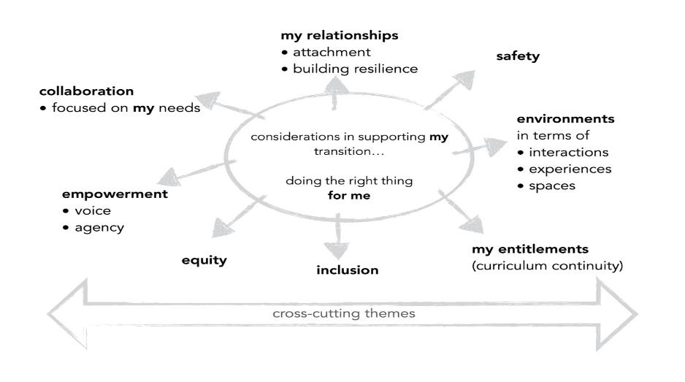
Considerations for primary transitions
Notes:
The diagram shows how this advice links to the generic principles for supporting children’s transitions in the new context and the cross cutting themes in COVID – 19 – a framework for decision making
Scottish Government: April 2020
The cross cutting themes are: situational poverty and stress, building understanding of trauma, interrupted learning, supporting parents, ASN, vulnerable children and families and the longer term consequences.

Slide 13

Education Scotland
Denholm House
Almondvale Business Park
Almondvale Way
Livingston EH54 6GA
T +44 (0)131 244 5000
E enquiries@educationscotland.gsi.gov.uk
For Scotland's learners, with Scotland's educators
Notes:
This is a back cover page in blue. You may edit the address if needed only. It can only be once and at the end of the PowerPoint presentation. Use the corresponding blue internal and back pages if you are using this page.

