Slide 1
Outcomes-based policy making – the Process
National
Outcomes/
SDGs
Intermediate Outcomes
Priorities and planning
Evaluation
& reporting
Action plan
Implement
STEP 1: National Outcomes/SDGs “Contribution Story”: Explain the linkages your work/policy area has to the National Outcomes and associated Sustainable Development Goals. Initially, by thinking broadly across the 11 National Outcomes before narrowing down. This will help you identify relevant National Outcomes/SDGs you are contributing to. Engage with any underpinning evidence you may have at this early stage, and throughout the steps that follow.
STEP 2: Intermediate Outcomes: Together with your partners identify what your intermediate (i.e. policy or programme level) outcomes are. You could do this by defining the overall strategic aim or vision for your area then breaking that down into more detailed steps that need to be achieved in order to realise it. Consider relevant SDG targets here to understand where you need to be by 2030.
STEP 3: Priorities and planning: What do the evidence and your partners tell you about where we are in Scotland in achieving your intermediate outcomes? Where are you most falling short? Use this evidence to review and prioritise whether your policies and practice are contributing towards your intermediate and the National Outcomes. Is there anything else you should be doing? Are there things you are currently doing that have a weak evidence-base or a poor link to National Outcomes/SDGs that you should reconsider? How effectively are tensions, trade-offs and competing aims being surfaced and considered?
STEP 4: Action plan: Based on your priorities, develop a plan of action based on the evidence and a strong theory of change. Use tools like logic modelling to show the inputs and actions that will contribute to outcomes and identify where joint working with other partners and/or policy areas would be beneficial. Engage and collaborate with your partners about the feasibility of proposed actions right from the start (e.g. do actions require additional staff or new skills? How long will these take to develop? Is there the funding available in years 1,2,3? What digital tools might be required? Will there be a need for the procurement of products or services?).
STEP 5 and 6: Implementation, evaluate and report: Monitor and evaluate the implementation of your activities as robustly as possible. Keep assessing and telling your contribution story and be open to evidence that indicates when something is not working (e.g. because it is not achieving intermediate outcomes or contributing effectively towards National Outcomes)

Slide 2
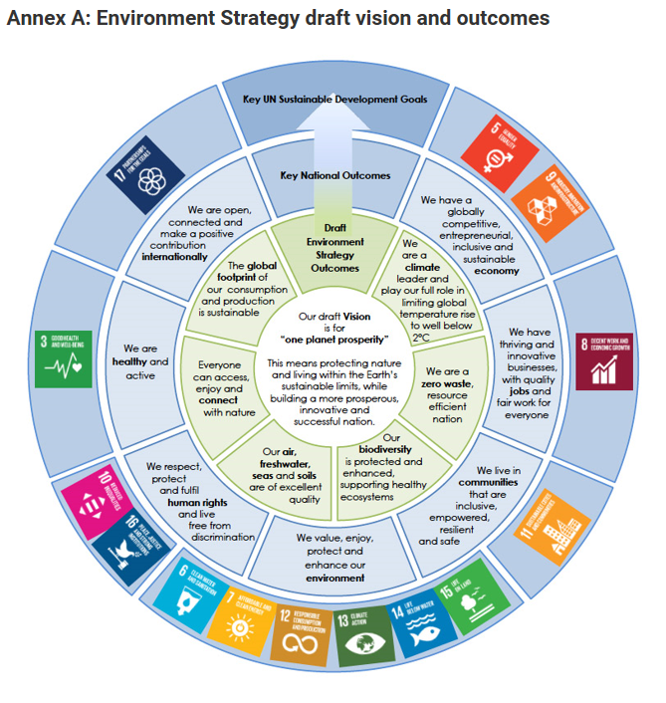
Example
… contributing to a range of National outcomes & associated SDGs where evidence and partners’ views tell credible contribution story
… setting out vision
… set of intermediate outcomes, constructed with and co-owned by partners

Slide 3
Prompt Questions and Considerations
Do you understand how your programme of work and/or policy area can contribute to the delivery of a range of National Outcomes? This doesn’t mean to all National Outcomes but to the ones where you can tell a credible contribution story supported by evidence and your partners’ views
Given the breadth of your contribution across the National Outcomes do you have the right partners both within your organisation and more widely? Are there opportunities to collaborate further with others?
Do you have intermediate outcomes/do you know how they relate to the National Outcomes? Do your partners support these intermediary outcomes? Have they been jointly developed?
How strong is your evidence-base? Can you assess where you are now and where you need to get to? Are there gaps? Can it tell you what works?
How is your spend contributing to delivering the intermediary outcomes?
Consider the role of your outputs (key documents, e.g. strategies) and how they support your outcome contribution story.

