Slide 1
STUC – SG Biannual – June 2013
Labour Market Trends
Employment in Scotland is increasing and unemployment is decreasing.
Scotland is outperforming the UK on all headline labour market measures, employment, unemployment and inactivity.
For both men and women employment is increasing over the year and unemployment decreasing.
Youth unemployment is falling.
More recent LFS data shows that youth employment has increased in late 2012/early 2013.
The youth unemployment rate remains higher than average rate prior to the 2008 recession.
APS (annual) data for 2012 shows modest decreases in youth unemployment and decreases in youth employment.
Meeting Modern Apprenticeship targets
Work patterns are changing.
Between 2008 and 2012 the number of self employed people increased by 33,200.
Real earnings are decreasing.
Real earnings decreased by 8.1% since 2009.
Real earnings decreased by more across the UK than in Scotland.
Real earnings fell faster for people working part-time.
There were 25,691 modern apprenticeship starts in 2012/13.
SDS research shows of those who complete apprenticeships: 92% are in work 6 months later and 79% are in full-time employment.
Employer research undertaken by SDS shows that 96% of employers reported that MA completers were better able to do their jobs
Recent increases in employment driven by improvements in both male and female employment rates.
Between 2008 and 2013 the number of people working full time decreased by 92,000, however over the past year full-time employment has increased by 41,000.
The number of people employed on a temporary basis has increased by 32,000 since 2008.

Slide 2
Labour Market Trends
Latest Headline Results
Employment Rate
(16-64) Seasonally Adjusted
Unemployment Rate (16+) Seasonally Adjusted
Economic Inactivity Rate
(16-64) Seasonally Adjusted
Notes:
TEXT BOXES WILL UPDATE AUTOMATICALLY. UPDATE ARROWS USING ARROWS ON “BRIEFING TEXT” WORKSHEET AS A GUIDE FOR DIRECTION AND COLOUR.

Slide 3
Labour Market Trends
Performance by Gender
Employment Rate (16-64)
% of
16-64 population
Change on year (%pts)
Unemployment Rate (16+)
Economic Inactivity Rate (16-64)
% of 16+ economically active population
% of
16-64 population
Change on year (%pts)
Change on year (%pts)
Notes:
WILL ALL AUTO UPDATE – CHECK TIME SERIES CHART, SHOULD UPDATE FROM CURRENT MONTH TABLES AND CHARTS EXCEL FILE. UPDATE GRAPHIC USED FOR ARROW IF CHANGED FROM INCREASING TO DECREASING

Slide 4
Labour Market Trends
Youth Unemployment
Labour Force Survey
339,000
Young people in employment, UP 21,000 over the year (Feb – Apr 2013)
Annual Population Survey
319,000
Young people in employment, DOWN 11,000 over the year (Jan – Dec 2012)
61,000
Young people unemployed, DOWN 25,000 over the year (Feb– Apr 2013)
83,000
Young people unemployed, DOWN 7,000 over the year (Jan – Dec 2012)
Unemployment Rate – International Comparisons
Improvements in recent months visible in LFS data but not reflected in the annual APS data.
Scotland has a higher youth employment rate and lower unemployment and inactivity rate than the UK.
Only 5 EU countries have a lower youth unemployment rate: Austria, Germany, Netherlands, Malta and Denmark.
Between 2004 – 2007 average youth unemployment rate in Scotland = 13.5%
Current rate in Scotland = 16.1%
Notes:
Latest Analysis

Slide 5



Labour Market Trends
Modern Apprenticeships - Gender segregation
Overall Modern Apprenticeships attract more men than women.
But the position has been steadily improving over time.
The number of female MA starts has increased by 8,200 or nearly 300% between 2008/09 and 2012/13 – more than 3 times faster than the increase in male MAs.
In 2012/13, 43% of MA starts were women compared with 27% in 2008/09.
The percentage of females in training has also increased over the same period from 16% to 33%.
Change in MA starts by Gender, 08/09 to 12/13
Percentage share of MA starts by Gender
On leaving school females are less likely to go into training or employment than males but much more likely to go into HE or FE and are also less likely to be unemployed.
School leaver destinations 2010/11
(3 months after leaving school)
There is strong gender segregation within frameworks – More than 80% of female new starts in 2012/13 were in just 7 frameworks:
business & administration
children’s care, learning & development
customer service
hairdressing
health & social care
hospitality
retail
Starts in construction, engineering and freight logistics are mainly male.

Slide 6
Labour Market Trends
Modern Apprenticeship Surveys (Skills Development Scotland)
SDS have published independent survey research carried out with 2,000 people who had recently left an MA and 2,500 employers who offered MAs.
What do Apprentices think?
What do employers think?
What are the employment outcomes for apprentices?
92% of those who completed an MA are in work 6 months later with 79% in full-time employment. Of those who completed part of their MA programme 66% were in work 6 months later.
Those taking higher level MAs were more likely to be in employment 6 months after leaving (80% at level 2; 89% at level 3 and 92% at level 4).
Older MAs were more likely to be in employment 6 months after leaving (81% for under 20s; 91% for 20-24s and 94% for over 25s).
Are apprentices satisfied with MAs?
87% of apprentices were either very satisfied (70%) or satisfied (17%).
Existing employees who complete an MA show benefits over non-completers in terms of job security with their employer and feel that it has contributed to their progression at work.
Why do some apprentices not complete their MA?
Apprentices gave the following reasons for leaving the MA early: offer of better paid employment (19%); poor support/relationship with employer (13%); made redundant (15% overall – rising to 21% in construction, manufacturing or engineering sectors).
What are the benefits for Employers of offering MAs?
Employers said that 98% of apprentices were better able to do their job as a result of their MA.
68% of employers reported improved productivity, 67% reported improved product quality, and 66% reported improved morale.
Are employers satisfied with MAs?
85% of employers were satisfied with the relevance of the training and 83% of employers were satisfied with the quality of training.
Why do employers think some apprentices do not complete?
37% of employers had an MA who did not complete. The reasons given for this included the attitude of the apprentice and the apprentice moving into a new industry or career.
Most employers felt that there was nothing that they could have done to prevent an apprentice dropping out early.
Will employers use MAs in future?
83% of will continue offering MAs. Of these 88% plan to recruit the same or more MAs and 10% expect the number to decrease.
The most common reason for not continuing MAs was cost.
82% of employers surveyed would recommend MAs if asked by another employer in their industry sector.

Slide 7
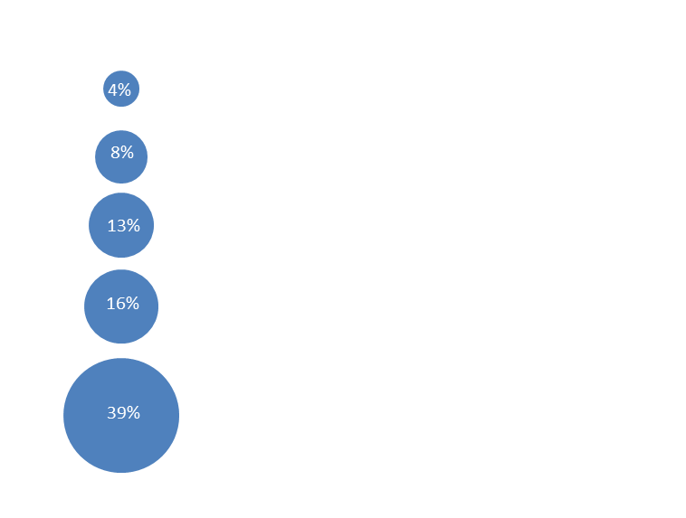
Labour Market Trends
Self-Employment
Self- Employed
301,700
The number of self-employed workers in Scotland.
Employees
2,145,700
The number of employees (those working for someone else) in Scotland.
Change in Self-Employment by Gender, Scotland, 2008 to 2012
13,600 (17%) increase in women self-employed
Self-Employment by Gender, Scotland, 2012
+33,200
The increase in self-employed workers in Scotland since 2008; an increase of 12%.
-96,900
The decrease in employees in Scotland 2008; a decrease of 4% over this period.
Self-employed workers by age group, Scotland, 2012
19,700 (10%) increase in male self-employed
Comparison to the UK as a whole
A similar picture is seen across the UK as whole with self-employed workers increasing by 11% between 2008 and 2012.
Across the UK the female self-employment level has increase by more than the level for men (female level up 211,000; male level up 160,000). This differs to Scotland where the increase was driven by an increase in male
self-employment (men up 19,700; women up 13,600).
% in employment that are self-employed
Source: Annual Population Survey (Jan – Dec datasets), ONS

Slide 8
Labour Market Trends
Employment Patterns
Full Time Working
+41,000
Increase over the year
-92,000
Decrease since 2008
Type of employment
5.3%
Of people in work are employed on a temporary based.
Part-Time Employment by Gender, Scotland, 2008 - 2013
Part-time employment by Gender, Scotland 2013
16,000 (3.0%) increase in women working part-time
72%
Employment is full-time, compared to
75%
in 2008.
133,000
People employed on a temporary basis.
+32,000
since 2008
Change in employment patterns – 2008 – 2013, by Gender
44,000 (31%) increase in men working part-time
Reversing trends? Over the year the number of people employed full-time increased, while part-time employment was stable
Similar trends across the UK
Between 2008 and 2013 in both Scotland and the UK, the number people employed part-time and the number of people self-employed has increased. In Scotland there has been a larger decrease in the number people with a second job than in the UK and in Scotland there has been a larger increase in temporary employment.
Source: Labour Force Survey (Jan – Mar datasets), ONS

Slide 9
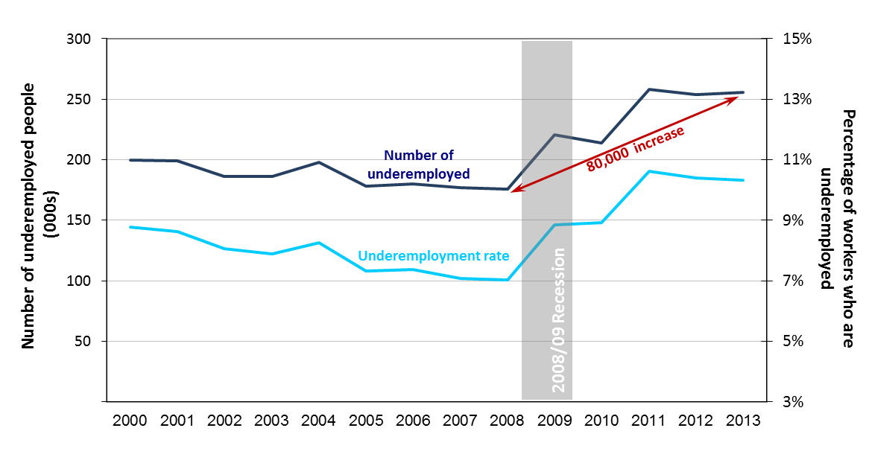
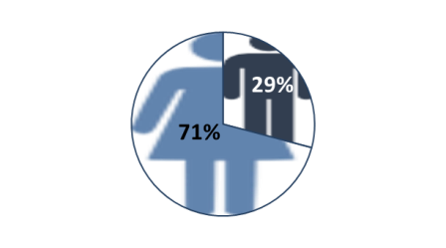
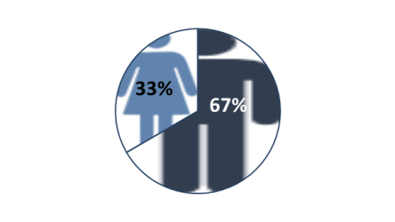
Labour Market Trends
Underemployment
Underemployment level and rate , Scotland, 2000 to 2013
256,000
The number of underemployed workers in Scotland
10.3%
The underemployment rate* in Scotland, and increase of 3.3 %points since 2008
80,000
The increase in level of underemployed workers in Scotland since 2008
* Note: Underemployment rate excludes those whose underemployment status was unknown.
Average increase in underemployed workers in Scotland Jan-Mar 2005 - 2008 and Jan-Mar 2010 - 2013
68%
Permanent private sector workers accounted for most of the increase in underemployment
16-34 year olds
accounted for just about
half the increase in private sector underemployment
Breakdown of increase in Public permanent underemployed
Almost ¾ of this group are aged 35-64
Just under ¾
of the rise in public sector underemployment was due to increases seen by part-time female workers
Just under 90%
of the increase in underemployment in the 16-34 year old age group was due to males.
Breakdown of increase in Private permanent underemployed
Almost ½ of this group are aged 16-34
Source: Labour Force Survey, Jan-Mar datasets, ONS

Slide 10
Labour Market Trends
Real Earnings
Real median hourly earnings excluding overtime, 2012 constant prices
Fall in average hourly earnings of employees in real terms, 2009-2012 (%)
Part-time earnings decreased by more than £1.00/hour for men and women
18% Of employees earn less than living wage in Scotland. This equates to 418,000 employees
36% are aged 16-24
93% are working in the private sector
40% are women working part-time
64% are women
The number of people earning below the living wage in Scotland decreased by 23,000 over the year.
Note: Arrow shows change 2009 -2012 in percentage points
Notes: Current Living wage is £7.45, in April 2012 and 2011 the living wage was £7.20. The analysis shown here is based on nominal earnings.
Source: ASHE 2012, ONS

Slide 11
Labour Market Trends
Real Earnings
Real median hourly earnings excluding overtime, 2012 constant prices
Fall in average hourly earnings of employees in real terms, 2009-2012 (%)
Part-time earnings decreased by more than £1.00/hour for men and women
18% Of employees earn less than living wage in Scotland. This equates to 418,000 employees
36% are aged 16-24
93% are working in the private sector
40% are women working part-time
64% are women
The number of people earning below the living wage in Scotland decreased by 23,000 over the year.
Note: Arrow shows percentage change 2009 -2012
Notes: Current Living wage is £7.45, in April 2012 and 2011 the living wage was £7.20. The analysis shown here is based on nominal earnings.
Source: ASHE 2012, ONS

Slide 12
Labour Market Trends
Sources of information
This analysis is based on data previously published by either the Scottish Government (SG) or the Office of National Statistics (ONS). Datasets and other relevant analysis are available from the following websites:
ONS: Regional Labour Market Statistics: http://www.ons.gov.uk/ons/rel/subnational-labour/regional-labour-market-statistics/june-2013/index.html
SG: Local Area Labour Markets in Scotland: http://www.scotland.gov.uk/Topics/Statistics/Browse/Labour-Market/Publications
SG: Labour Market Briefing : http://www.scotland.gov.uk/Topics/Statistics/Browse/Labour-Market/AnalyticalPapers
ONS: Real Earnings Analysis: http://www.ons.gov.uk/ons/rel/regional-trends/regional-economic-analysis/changes-in-real-earnings-in-the-uk-and-london--2002-to-2012/art-changes-in-real-earnings-in-the-uk-and-london--2002-to-2012.html

