Slide 1

Assistant Statistician Recruitment 2019

Slide 2
Aims for Today
Give you an insight into the work of the Scottish Government and National Records of Scotland Statistics Group.
Give you an opportunity to meet members of the Statistics Group and ask us questions.
Explain the application form and assessment centre process.

Slide 3
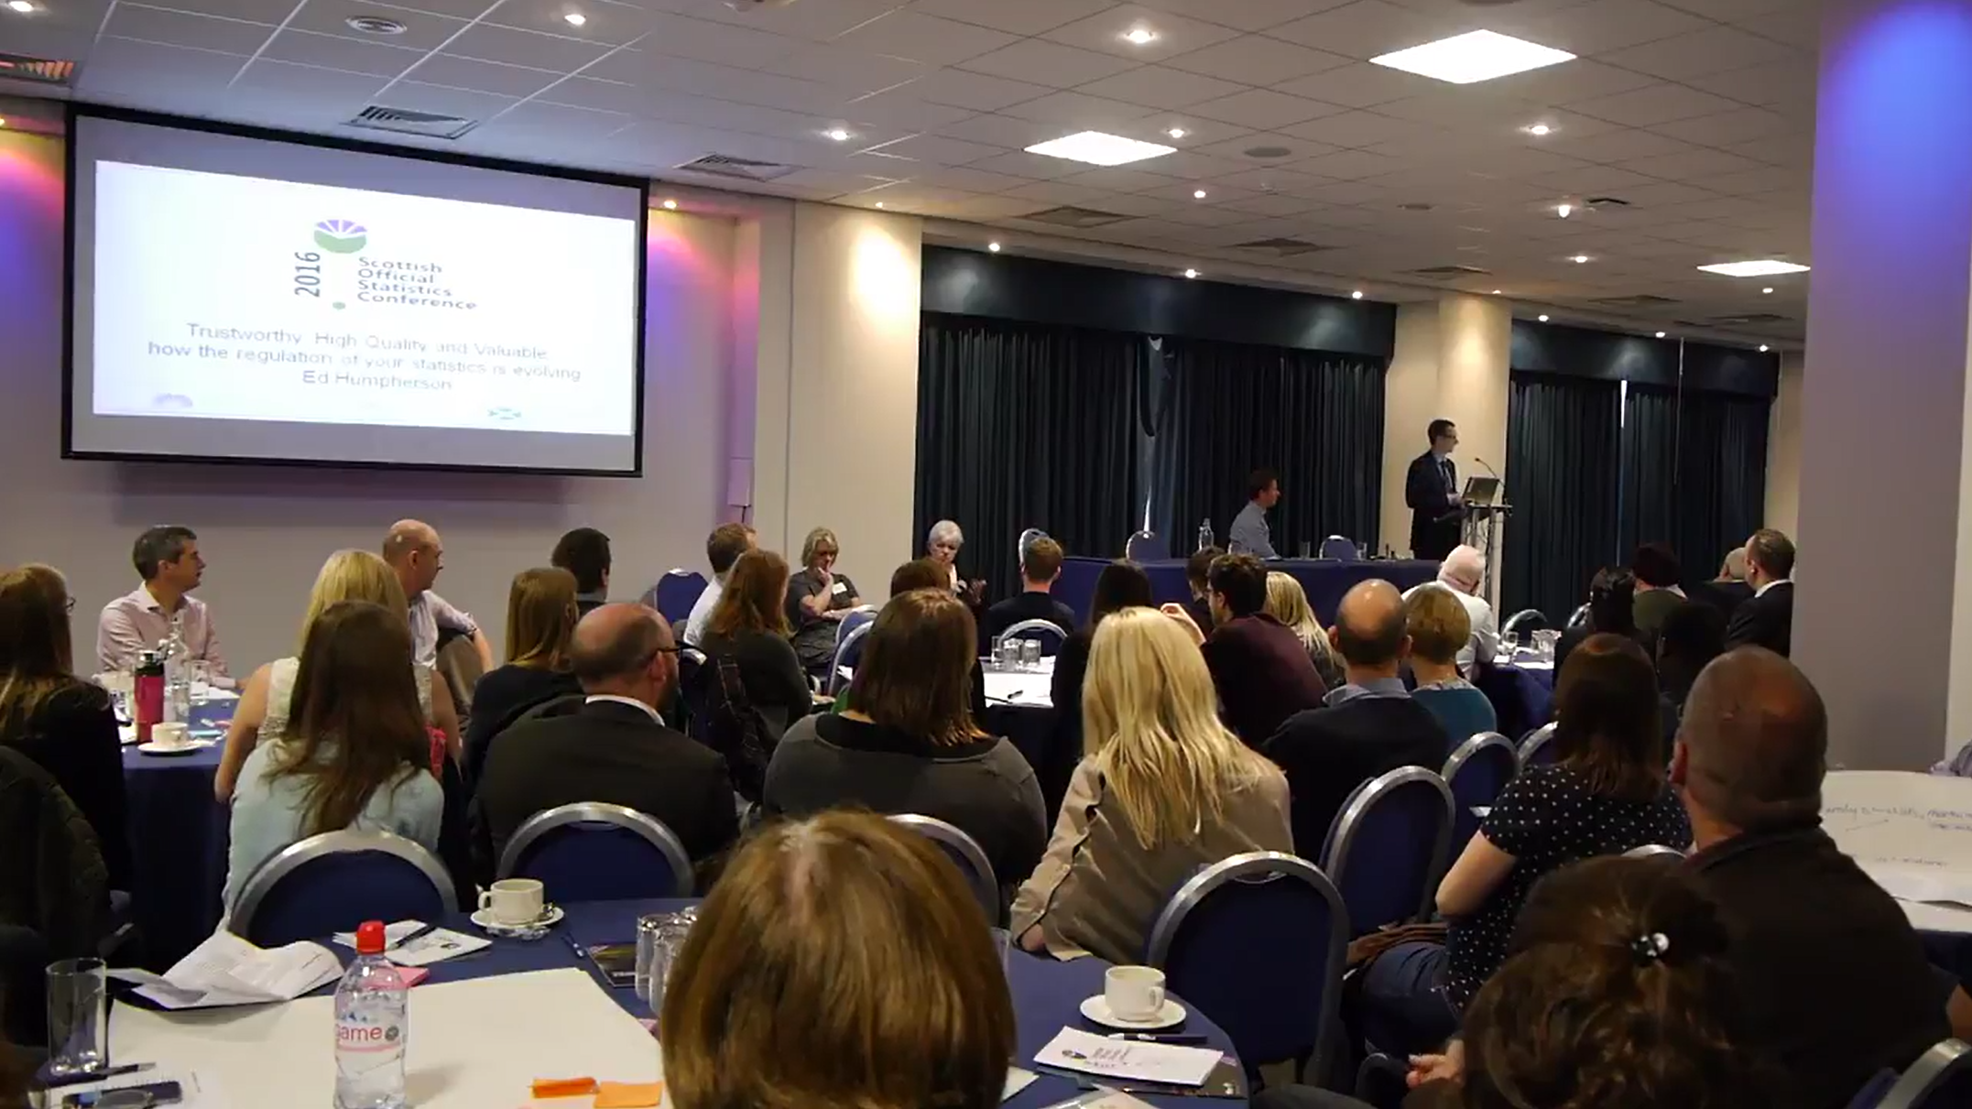
Work of the Statistics Group

Slide 4
Statistician Group - role and governance
The primary aim of official statistics in Scotland is to provide an accurate, up-to-date, comprehensive and meaningful picture of the economy and society.
We are a professional staff group of over 200 people: from B1 up to Chief Statistician (pay range £64k-£118k)
Our work is covered by the UK wide Statistics and Registration Services Act 2007; which also established UK Statistics Authority to regulate and scrutinise UK official statistics.

Slide 5

We work in outcome based government – stats underpin it

Slide 6
Statistician Group – how are we organised?
We work across all government functions, often with other analysts (economists & social researchers) in large teams supporting policy areas.
The Statistician Group also spans statistical staff at National Records of Scotland who run the Census and produce demographic statistics.
You are encouraged to move to new areas for your development, especially early in your career, and many people find that a really attractive part of the job.
You can also remain in one policy area for some time, perhaps moving role within a given topic area.

Slide 7
Topics we work on:
Arts, culture and sport
Building, planning and design
Business, industry and innovation
Children and families
Communities and third sector
Economy
Education
Energy
Environment and climate change
Equality and rights
Farming and rural
Health and social care
Housing
Law and order
Marine and fisheries
Public safety and emergencies
Public sector
Transport
Work and skills
Population and Migration

Slide 8
Statistician Group – how are we organised?
We work in C1 Statistician (pay range £47k - £58k) led branches covering specific topics.
Some staff, often C1 level, are the highest graded statistician on a given topic and have a non-statistician as their line manager.
All staff have a C2 Senior Statistician (pay range £60k – 70k) to advise them on sensitive issues, career development & Continuous Professional Development.
Most posts are in Edinburgh, some in Glasgow and we try hard to ensure work/life balance.
Genuinely strong on equality – with flexi time, pension, gyms, and a pool at Victoria Quay all good perks!

Slide 9
Nature of the work
The huge range of posts offers an enormous variety of role and type of work: from Parliamentary Questions to £ allocations.
Most areas are involved in the design, collection, analysis and publication of statistics – together with answering queries about them. These can range from simple ad-hocs to work needing statistical analysis.
Some areas use sophisticated modelling techniques e.g. to estimate the impact of policy changes on different groups of society.
Others like Census and survey posts require strong technical skills – which you can develop in the job.

Slide 10
Statistician Group – how do we see ourselves?
We are characterised by a positive, supportive ethos.
  New staff can have a buddy, or a mentor, and are supported through a 12 month induction programme of events.
  Peer review of complex work is a great way to get support, reassurance and learn from others.
We are proactive, helpful and engaged.
We are valued for the insight we bring – we can have that “seat at the table” where decisions are made.
User consultation is key to ensuring the work is well targeted – so good interpersonal skills really matter, as well as a desire to have impact with your work.
Our skills are transferable - we can move into policy.

Slide 11
Statistician Group: commitment to Training & Development
Our staff are our key resource.
The UK wide statistician profession has a strong commitment to learning & development with an average annual requirement of 60-100 hours Continuous Professional Development (CPD): half statistical, half broader.
Sounds a lot, but most of it is acquired on the job!
We provide a huge array of CPD opportunities that are tailored to your own career path and stage of development. Not a set graduate programme.
We are very supportive around promotion e.g. staff will give mock interviews & detailed feedback to help you.

Slide 12
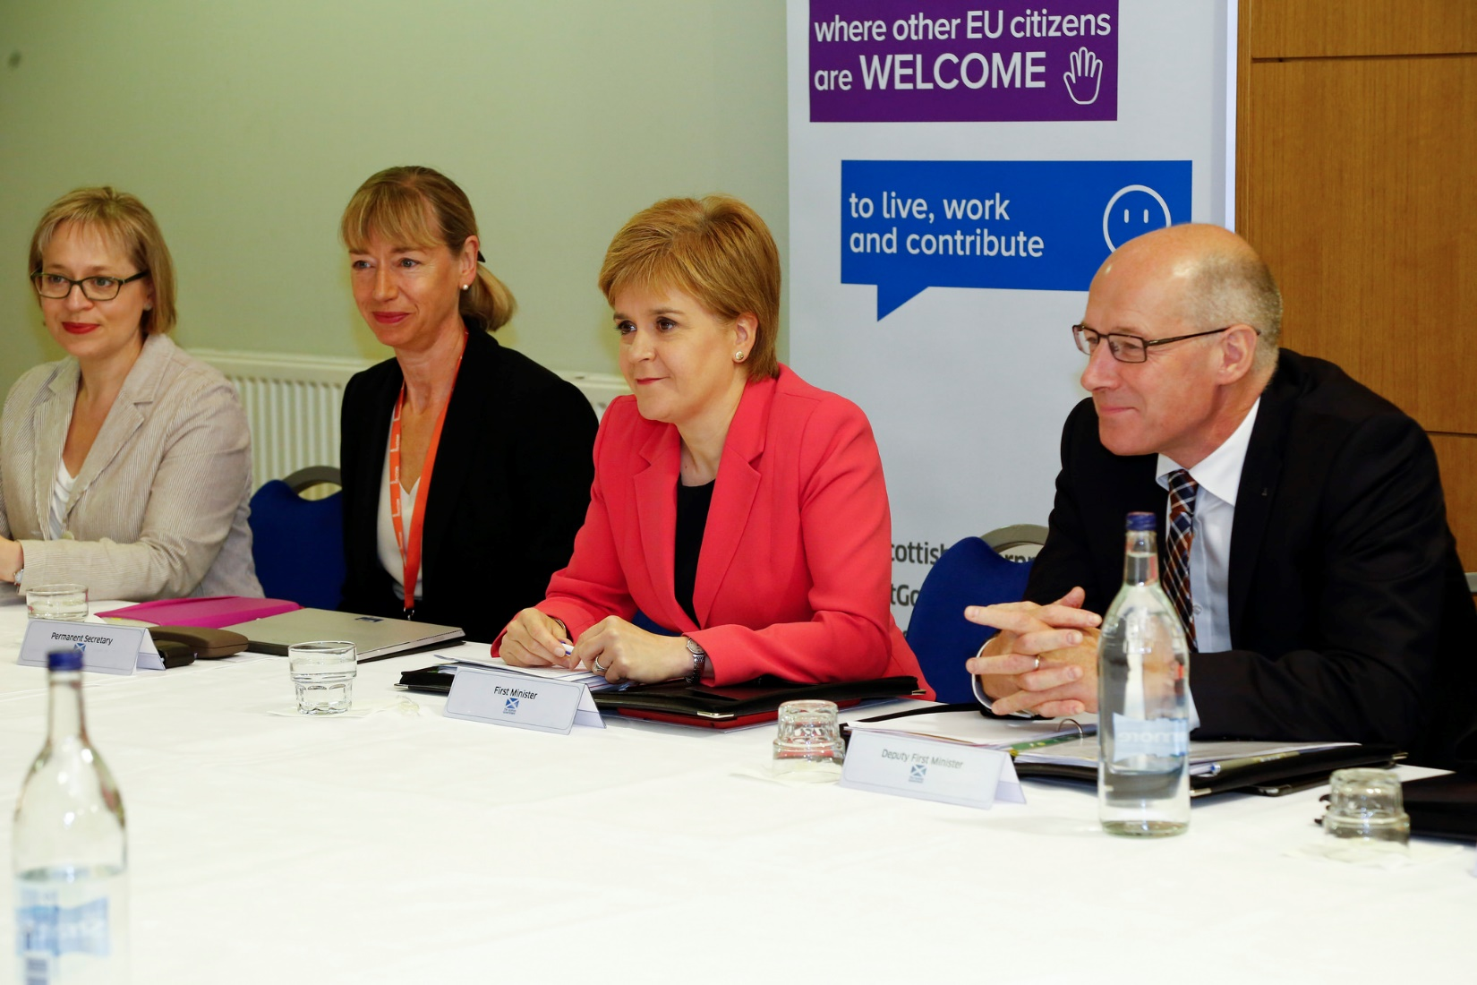
Application and Assessment Centre process

Slide 13
Recruitment Process: we want you to do well!
Hope to recruit around 40 people, and a reserve list which is valid for nine months.
We are recruiting at 2 grades: B1 (undergraduate level) and B2 (some relevant experience).
If in doubt apply for both grades and the panel will decide what level you pass at.
Most staff do progress quickly from B1 to B2 (often after a year to 18 months).
Please note that there are different essential criteria for B1 and B2 levels. The B2 criteria are at a higher level

Slide 14
Application form 1
We need people with technical aptitude and strong interpersonal skills – you see this in the form.
We ask for a numerate degree: so you don’t need to have covered lots of statistical areas, but you need to show an ability to learn them.
If the statistical component of your degree is not obvious list the modules of relevance.

Slide 15
Application form 2
Think about the quality and quantity of your evidence & how it demonstrates the essential criteria
Use the STARR approach:
  Situation – Explain the background to a specific circumstance where you demonstrated the particular competency/essential criteria
  Task – What was your role? What did you have to do?
  Action – What did you do and how did you do it?
  Result – What did you achieve? What were the results of what you did?
  Reflection - What did you learn from the situation?
Get feedback on your application before submitting it
STARR approach also applies to competency based interview

Slide 16
Application form 3
All of this evidence is scored on a 0-2 scale for each essential criteria, then ranked to determine who comes to interview.
  0 - Not Met Criteria
  1 - Met Criteria
  2 - Exceeded Criteria
  It’s necessary to pass all four essential criteria to be invited to the assessment centre.
  Those eligible under the Equality Act have a guaranteed interview if they pass all essential criteria.

Slide 17
Assessment Centre: overview
If selected for interview you will receive an information pack about what to expect. We’ll ask you for details of your statistical skills and experience to help us tailor questions for you.
Please tell us if you are unable to attend – as we have a reserve list of candidates to draw on and will offer your interview slot to one of them.
You will be assessed for the level you passed the sift at. If you passed the sift at B1 and B2 level you will be assessed against both, and if successful offered a post at the highest level at which you passed.
NB SG does not match pay. You will start at the minimum of the pay range unless there are exceptional circumstances.

Slide 18
Assessment Centre: elements
Written test giving a choice of different questions spanning a range of statistical techniques. If you’re invited to interview we’ll send you a sample version.
Presentation: akin to an in-tray exercise. We give you various tables of statistics on a topic to go thorough for 45 minutes and then you present the key findings to us – and cover several set questions.
Competency interview – spanning statistical and general competencies.
  Information pack explains the six competencies you will be assessed against: Self Awareness, People Management, Communications and Engagement, Improving Performance, Financial Management, and Statistician.

Slide 19
Assessment Centre: tips
Just be yourself – we are a very varied staff group.
Think about what the panel want from a candidate:
  what would you want if you were them?
  your evidence can come from any experience (e.g. a club) but try to tie the skills in to those needed in the office
  get a mock interview from a friend and feedback on how you come across – many people are not aware of this
Watch your time on the test & presentation but note it will be hard to cover everything in the time.

Slide 20
Assessment Centre: tips (cont)
Do ask for clarification if you need to – that’s fine.
Don’t be put off by the panel writing while you talk – we need to take detailed notes to ensure fairness and common standards across all days interviewing.
Panel are experienced and will try to get you back on track if you stray away from what is wanted – no tricks.
There are two chances to demonstrate each competency so
  don’t worry if you fluff something
  start afresh with the next question – try not to dwell on it
You can ask questions at the end.

Slide 21
Assessment Centre: outcomes
Candidates who pass
  Highest ranking will be offered posts first and we hope to take into account preferences for location, or topic ability.
  We will keep a reserve list for nine months
  Get feedback on how your form and interview came across.
Candidates who do not pass
  Get some feedback on how your form and interview came across.
  We might be recruiting again soon – depends on budgets and vacancies.

Slide 22
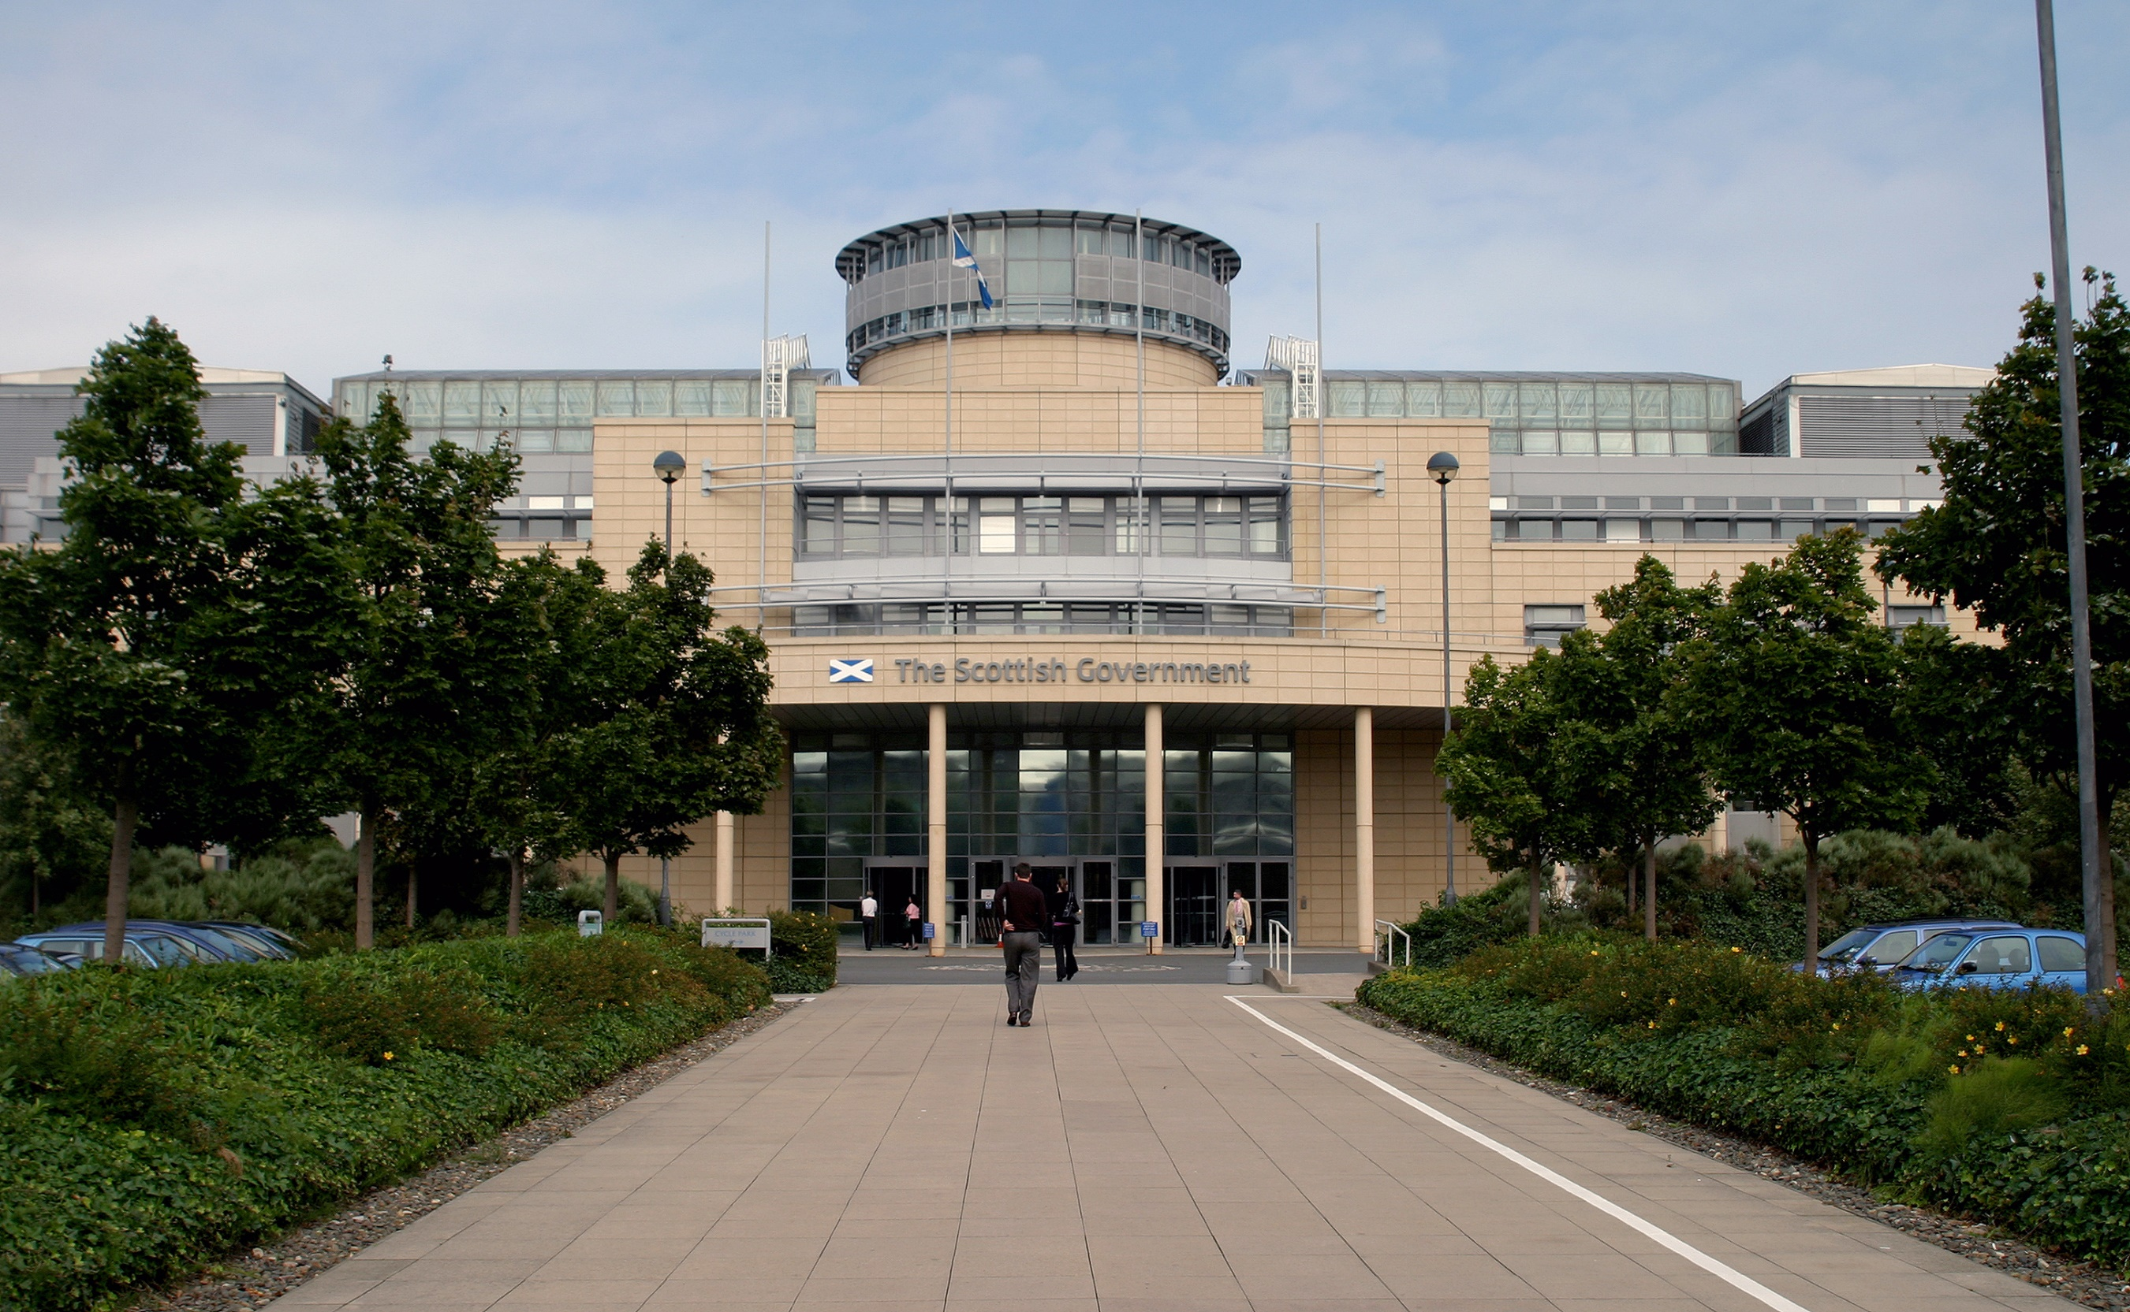
Any questions?

