Slide 1



Coronavirus (COVID-19)
Supporting young children at points of transition
Advice for early learning and childcare (ELC) and early primary colleagues
For Scotland's learners, with Scotland's educators

Slide 2
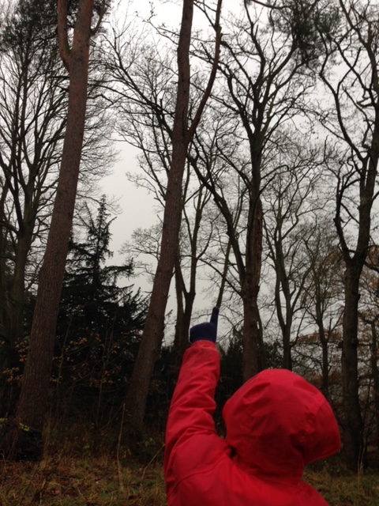
”The path before us is through uncharted territory and will need careful navigation.
Our guiding values should be kindness, compassion, openness and transparency.”
COVID – 19 – a framework for decision making
Scottish Government: April 2020
For Scotland's learners, with Scotland's educators
Notes:
Education Scotland intends to offer the best practical transitions advice and support to staff in ELC settings and primary schools in planning children’s transitions.
The emergence of the COVID-19 virus quickly changed our Scottish education system in an unexpected and unprecedented way. The impact on every child has been profound. Every life has been affected. For many this has meant real and possibly long-lasting difficulties.
It is clear we cannot expect to return to how things were such a short time ago. The task before us is not straightforward.
Our whole education system will clearly have to engage and respond openly, collegiately, flexibly and transparently in supporting all the transitions being made by our children and young people.
As children move from their homes; some probably to a new environment, they will experience changes in their daily routines. They will be required to re-establish relationships and forge new ones with their peers and the adults who look after and educate them. To start the next part of their learning journey, periods of adjustment will be required, and planned for in the short and longer term.
The advice in this presentation offers practitioners, teachers, senior leaders and others a starting point for discussions. Discussions that will require us to work together to intentionally plan for children’s transitions from home to ELC, within ELC ,and from ELC to starting school.
We are living in uncertain times, where significant concerns are rightly being expressed by parents, by policy makers, senior leaders, others, staff and children themselves, about how we can safely plan for transitions. By being solutions-focussed and responsive to the changes yet to come, transitions will be more effective if we adopt a child-centred approach.

Slide 3

Child-centred transitions in the new context
Why is this advice needed for the ELC sector and early primary stages?
To ensure practitioners and teachers have access to practical advice based on what we currently know about best transitions practice, learning from others, and applying this in a Scottish context,
To intentionally plan for a safe transition that builds on the learning children bring with them from home,
To provide reassurance that despite the significant impact that Covid-19 is having on all of our lives, we will be doing the right thing for our children if we adopt child-centred approaches which are grounded in nurturing principles, and,
To empower practitioners and teachers to embrace play as pedagogy.
Notes:
Child-centred transitions in the new context
Why is this advice needed?
On the 20th March children and young people across Scotland left their familiar educational settings facing a period of significant change and uncertainty that may have a lasting effect on their future lives. The full impact of these system-wide changes on the wellbeing of children, families and their communities, is as yet, unknown.
Transition is a complex and dynamic process. To better understand this complexity, particularly in the current climate, we need to be aware of the shifting social and cultural contexts that are a reality for our children, young people and their families. More specifically, being responsive through intentional transition planning for the needs of those most at risk, and who may show symptoms of traumatic stress.
Reassurance is needed in these challenging times. Advice that is practical, flexible and achievable is offered here. We offer advice that is considered, reasonable, fair and equitable.
Much of the advice applies generically to transitions in and across ELC and early primary. Where it is useful to do so specific advice is outlined in later slides.
The advice will be updated and extended to reflect emerging scientific data and changes to the lockdown and social distancing arrangements as set out by SG to tackle the impact of COVID-19 on our children and families.

Slide 4
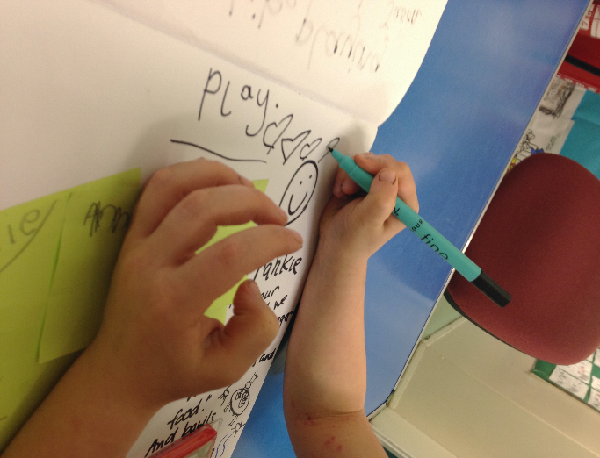
Why is play pedagogy important?
‘Play is an intrinsic part of human development.
Through play a child develops their cognitive, social, emotional and physical capacities’
Realising the Ambition: Being Me
p44
Notes:
Why is play pedagogy so important?
When we welcome our children into settings and schools it will be important for children to have opportunities to play.
‘Play is an intrinsic part of human development. Through play a child develops their cognitive, social, emotional and physical capacities’ Realising the Ambition (RTA) p44.
Through play children can act out real life experiences. Play offers a space for children to cope with matters that may impinge on their lives and now more than ever we need to be minded of the value of play.
Playing in spaces that offer similarities, that connect them to home and with their peers will mend broken bridges and pave the way for new beginnings. ‘Curriculum for Excellence (2007) gives prominence to play, particularly across the early level and the transition between ELC and primary school. This transition will likely be smoother for the child if the play remains and continues as the main vehicle for their early learning in P1 and beyond’ RTA p45
We don’t have all the answers, but we can take comfort from our own instincts, we know children should be at the centre of everything we do, whether at home or in settings and schools. We can find solutions and be responsive to the changing transitions landscape.

Slide 5
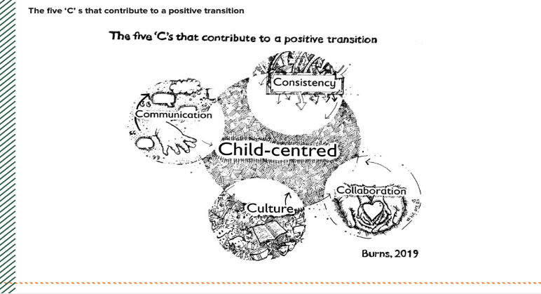
Child-centred transitions in the new context
Realising the Ambition: Being Me
Using the five ‘c’s as the basis for intentionally planning child-centred transitions
Notes:
Child-centred transitions in the new context
Realising the Ambition: Being Me
How can we be child-centred?
We can do this by referring to Realising the Ambition: Being Me the National practice guidance for early years in Scotland https://education.gov.scot/improvement/learning-resources/realising-the-ambition/national practice guidance provides a very useful starting point for discussions and signposts to additional information. Section 8 in particular, contains specific guidance on transitions.
Take a look at P96 , the five ‘c’s structure can be adapted to suit the uniqueness of each setting and school environment.
Use the five ‘c’s as the basis for intentionally planning your transition programme

Slide 6
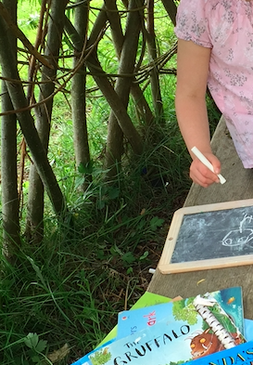
Child-centred: transitions matter - to me
Transitions do matter to children and families, in the new context they matter even more.
The traditional induction processes no longer fit with the challenges of Covid-19 but we can still support children’s transition from home to ELC, within ELC and from ELC to P1.
We will be doing the right thing for children if nurturing principles permeate all of our transitions planning.
For Scotland's learners, with Scotland's educators
Notes:
https://www.epinsight.com/post/supporting-post-lockdown-education-using-the-6-principles-of-nurture
Child-centred: transitions matter- to me
Learning is understood developmentally-any notions of filling gaps or catching up are unhelpful. Early learning and
childcare practitioners understand the value of observation to determine how well children are doing socially
emotionally and cognitively.
The way ahead is taking a strengths-based perspective.
The way ahead is to resist pressures to cover the curriculum. We need to fulfil children’s need to play, to engage with
meaningful provocations that may help them adjust, to allay their fears, and address the anxieties they may hold about
being separated from parents and their siblings.

Slide 7
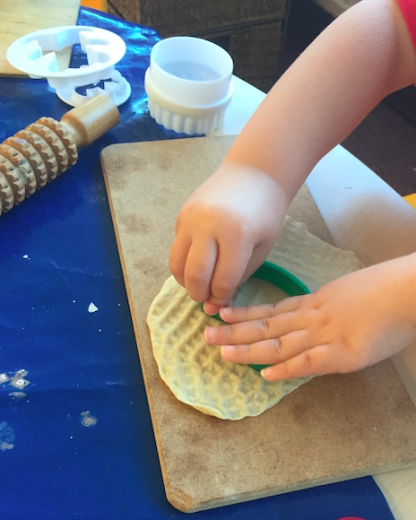
Things to think about…
Rather than thinking about catching up, plan relevant experiences that reinforce previous learning.
Play can help children feel successful and celebrate what they know already.
Consider how the look and feel of your playroom/classroom/outdoor spaces can help children make links with home.
For Scotland's learners, with Scotland's educators
Notes:
Things to think about…
We can ease children into settings and classrooms by carefully considering the spaces available. How do these spaces
invite children in? How can they reflect a nurturing and homelike environment to help children make the transition from
their home?
What interesting play experiences can be safely offered?
You may think about having displays of family photographs and other transitional objects (a favourite toy or significant
object from home) that don’t compromise infection control measures or social distancing.
Additional advice can be found in RTA section 4 Child’s work: the importance of play and the UNCRC article 31 The right
to play.

Slide 8
Child-centred: transitions matter- to me
Are there other things we can do?
We can start with the child, reconnecting with them and their families.
We can make connections with the children and families we do not yet know.
We can capitalise on digital technologies to make and sustain connections, to share and seek information.
We can invite children and families to create and share social stories that will influence the shape our learning environments.
Notes:
Child-centred: Transitions matter -to me
How good is our early learning and childcare? QI 2.6 Transitions p35
Theme: Quality of support for children and their families
We understand the importance of building relationships and developing secure attachments.
We acknowledge the impact of life events and provide effective support to help with these times making adjustments as necessary to ensure equity for each child when attending the setting/school and when moving to another setting/school
HGIOS 4 QI 2.6 Transitions, p42
Theme Arrangements to support learners and their families
We understand there is a need to focus on supporting children as they move from ELC to school and that continuity is crucial to maximising children’s successes.

Slide 9
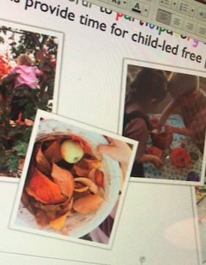
Communication: making digital connections
Things to think about when creating a virtual tour…is this for the child or the parent/carer?
When filmed at adult height can children fully relate to what they are seeing? Do they see the same things as you?
Does the commentary build in thinking and reflecting time for the child viewing the playroom/ classroom/outdoor spaces?
Does the language you use speak to the child? Try to avoid the language of compliance-rules to be followed, rather suggest how children might safely use a particular space. Invite suggestions from children/parents.
Here is an example transitions video made by Wyndford Nursery in Glasgow
Notes:
Communication: making digital connections
We live in a digital world and the use of technologies to keep in touch during lockdown has expanded significantly and creatively. Children have been keeping in touch with family and friends using various IT related platforms and hardware. Some practitioners and teachers are creating virtual tours of their settings/school as part of their transitions arrangements.
Virtual tours are being created in an effort to familiarise children starting nursery and school with settings and classrooms. Children and families can benefit from entering settings remotely. Children are offered a glimpse of the spaces they left behind and settings or classrooms they do not yet know with any deep understanding of what it feels like to be there.
Consider how accurately the visual images represent the environment, would the child interpret the space differently? Might you offer a virtual tour that is for the child and not the adult and vice versa?
Reflect on the messages you convey.
How good is our early learning and childcare? QI 2.6 Transitions p35
Theme: Collaborative planning and delivery
Our arrangements for passing over information ensure continuity of learning and we have agreed shared approaches for record keeping [information sharing]
HGIOS 4 QI 2.6 Transitions, p42
Theme Collaborative planning and delivery
We understand that continuity is crucial to maximising children’s successes and that sharing of information concerning learner’s progress and needs is important.

Slide 10
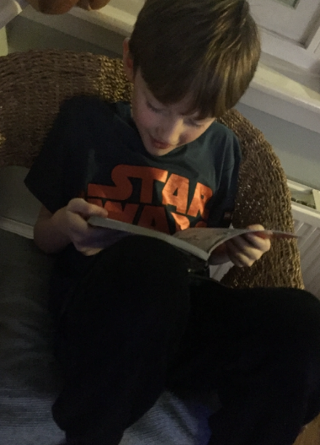
Communication: connecting and reconnecting
Communicating visually through digital technology offers children and families an immediate connection.
Staying connected and making connections at times of transition can promote children’s confidence and self esteem. Children will be curious to ask questions of what they see, to find out if they will have the same key worker, teacher, friends…we need to listen to their voices. How do we create a pedagogy of dialogue (Malaguzzi) that includes the voice of the child?
Things to think about
Not all of our families will have Wi-Fi and the necessary hardware to keep up in touch with practitioners and teachers.
How can social stories be used to connect and reconnect previously established communication networks?
Notes:
Communication: connecting and reconnecting
Being connected to known networks of family and friends are especially important right now can ease children’s anxieties and questions about starting nursery or school. Sharing progress in learning and success in wider achievements can be achieved innovatively and creatively by parents by inviting the child to create their own social story. The parent can be a contributor too, but be mindful of the adult’s influence in the content over the child’s voice.
Check out Julie Fisher’s blog. She is talking about the English education system but the messages about talking and playing are relevant in a Scottish context. Also you may need to support children settle in again after being away from a previously familiar ELC setting or into different/new environments.
https://www.early-education.org.uk/news/guest-blog-time-key-stage-1-developmentally-appropriate-julie-fisher

Slide 11
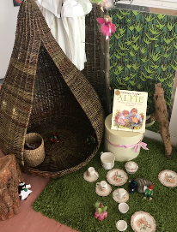
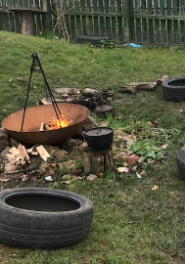

Collaboration: spaces that support transitions
In these challenging times we will need to think creatively in our teams and across sectors.
We need to explore possibilities for the design and layout of environments in ways we never could have imagined.
Finding safe solutions together to physical distancing will challenge even the most creative thinkers and problem solvers.
Things to think about
Outdoors spaces can offer some solutions, or at least things to consider.
Can you create designated spaces for smaller groups of children?
RTA section 5.3 offers practical advice on the unique role of outdoor play.
Notes:
Collaboration: spaces that support transitions
We know that children thrive in environments and spaces especially outdoors, where they feel safe and secure, where relationships are sound, and built on responsive nurturing interactions that occur between children, parents, key adults and others in their lives.
Children are inherently sociable, they are curious and many want to get close when they are sharing personal stories. Being outside children offers possibilities for playing independently on wheeled toys, to construct using loose parts and transient art can provide a conduit for children to express themselves imaginatively and by themselves.
To help children adjust to the challenges of having less physical contact with their peers and practitioners and teachers the formation of smaller key worker groups will reduce the opportunities for touching each other. A nod and a smile can be just as reassuring to a child. Some children may be wary of any physical contact, their experience away from a setting/school may require tuning in again, renewing attachments to known adults.
Building into your transitions planning will be a recognition that colleagues in health and SW and SALT will work with you to address specific issues and concerns that may arise over time.
HGIOELC 2.6 Transitions
Theme: Collaborative planning and delivery
We actively work in partnership with others including the named person, to ensure transition arrangements are effective for all children, in particular for those requiring additional support.

Slide 12

Consistency: doing the right thing for every child and family
The guidance contained in Realising the Ambition: Being me conveys a consistent message.
We will be doing the right thing if we start with the child when planning for transitions in the new context.
‘Consistency does not mean doing the same thing, it means being responsive to individual needs, and preventing any needs, risks or concerns getting any worse.’ (RTA:38)
‘Getting it right for every child (GIRFEC) recognises that children and young people will have different experiences in their lives, but that every child and young person has the right to expect appropriate support from adults to allow them to grow and develop’ (RTA: 37)
Notes:
Consistency: doing the right thing for every child and family
The GIRFEC approach is designed to be flexible enough to support all children and families whatever their need, whenever they need it. It is about responding in a meaningful, supportive way, working with parents and carers wherever possible. It takes into account that everyone involved with the family has an important part to play and puts the wellbeing of children and families at the heart of any support. It puts children’s rights and wellbeing of children with services that support them such as ELC settings, schools and the NHS.( RTA: 37)
How good is our early learning and childcare? QI 2.6 Transitions p 35
Theme: Quality of support for children and families
Effective arrangements are in place to involve families and relevant agencies in carefully planning personalised approaches for those requiring additional time and support.
Theme: Collaborative planning and delivery
We actively work in partnership with others including the named person, to ensure transition arrangements are effective for all children, in particular for those requiring additional support.
We used planned opportunities with others, including practitioners and parents/carers, to develop a shared understanding of progress and play-based pedagogy across the early level. As a result, children benefit from meaningful continuity in their learning experiences as they move on to school
Theme: continuity and progression in learning
We actively work in partnership with others including the named person, to ensure transition arrangements are effective for all children, in particular for those requiring additional support.
HGIOS 4 QI 2.6 Transitions, p42
Theme Continuity and progression in learning
We understand the need to have continuity and progression in learning across the curriculum and the sharing of information between ELC and P1. Planned opportunities for children to build on their knowledge, skills and attributes and maintain an appropriate pace of progress will be considered and put in place.

Slide 13
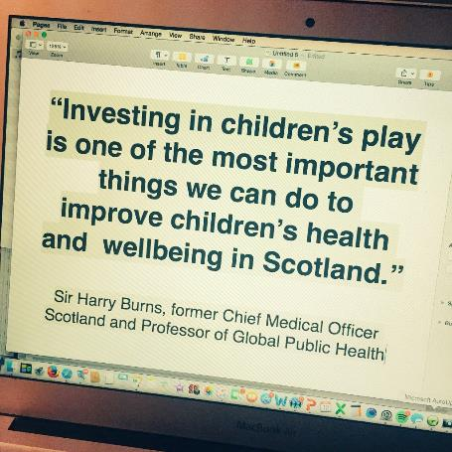
Culture: empowering you to support children and families in transition in a world of uncertainty
As children and families across Scotland live with the restrictions placed on their daily lives by Covid-19, clarity from you as practitioners and teachers on what and how you are going to support the transition from home learning to ELC settings, and to school will be welcomed.
The advice in this presentation intends to empower you to plan for these transitions.
The latest government information suggests that settings and schools are unlikely to open again this session. This gives us more time to shift the pervading culture of fear and uncertainly to one that exudes, hope, safety and renewal.
Notes:
Culture: empowering you to support children and families in transition in a world of uncertainty
Many families will be struggling to cope in a dramatically different culture. A culture shift that will be phasing many who do not have the cultural capital to draw on, to help them remain resilient to the toxic stress they face.
Too many parents will be experiencing unemployment and as a result, will be facing the challenge of keeping food on the table. The thought of their child transitioning from home to ELC and to school while living with stress, wellbeing issues, bereavement and anxiety. All of this is actually adding to the culture of uncertainty that is gripping our country. Recent media coverage shows there is a reluctance for settings and schools to reopen.

Slide 14
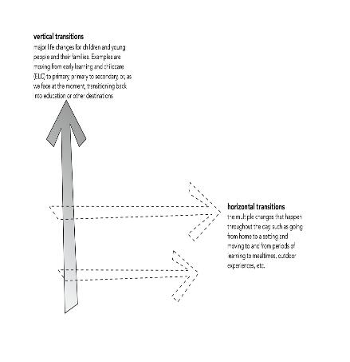
Supporting children’s multiple transitions
As children move from home to ELC or from ELC to starting school this is considered a major vertical transition.
Children may experience more than one horizontal transition in the course of their day-these transitions are part of everyday life. From home to childminder for example, then to a setting or school. Moving within a setting/school, stopping to have a meal, before going to grandparents after nursery or school.
In these challenging times we need to consider how best to support children’s horizontal and vertical transitions. The next three slides offer some advice and a set of reflective questions.
Notes:
Supporting children’s multiple transitions
We can begin by reflecting on our own policies and practice. How relevant are they now? How will you redesign curriculum programmes. This is especially important for P1 teachers who may want to reconsider the content of their early level programmes of study. There is surely an opportunity here to reflect with ELC colleagues on curriculum continuity and progression in learning across the early level.
We advise a strong focus on promoting nurturing relationships by considering the type of interactions, experiences and spaces that children will encounter as they transition vertically from home learning to ELC and from ELC to P1. And horizontally at different times in their day: the small routines such as handwashing and mealtimes. (see also RTA, pages 89 and 90)
The next three slides offer some advice, some of it is applicable to vertical and horizontal transitions.

Slide 15
Advice and reflective questions: transition from home to ELC- a vertical transition
Reflective questions
Do you have effective two-way communication with parents and other adults who are involved with the baby/child to include regular, face to face meetings, including home visits, and written communications using a variety of appropriate platforms?
Do you have a family learning strategy? If not or if it needs refreshed, you may wish to work with your current families and partner agencies to do so. Use the link to the Engaging Parents and Families toolkit to help you.
Do you plan regular child-centred opportunities for talk and discussion, stories and play, which help babies and children to express their feelings, and respond to any anxieties they may have about their new surroundings?
Do you have protected time for practitioners to collaborate in planning for a holistic transition for individual babies and children?
Advice
Early communication with parents by phone, email, face to face using digital media.
Involvement-include parents in any arrangements-seek their views and use these to shape revised transition programmes.
Planning ahead, be transparent about the need to change arrangements.
Respond to concerns and acknowledge you don’t have all the answers,
Be transparent about what can and cannot be done safely to environments
Notes:
Advice and reflective questions: transition from home to ELC- a vertical transition
The next three slides outlines specific advice which relates to both horizontal and vertical transitions. Some of this advice may apply to each transition.
For more detail see RTA p89- 90

Slide 16
Advice and reflective questions: transitions within and across ELC-a horizontal transition
Advice
Early communication with parents by phone, email, face to face using digital media.
Involvement-include parents in any arrangements-seek their views and use these to shape revised transition programmes. Memory boxes can be made by children and their parents. Filled with reminders of being in a setting.
Planning ahead, be transparent about the need to change arrangements.
Respond to concerns and acknowledge you don’t have all the answers,
Be transparent about what can and cannot be done safely to the environments (inside and outside) children will access-strive for consistency of approach with the needs of the individual in mind.
Reflective questions
Are there communication systems that keep parents well informed about when and why a move to a new playroom for their child is likely?
How will you adjust induction programmes to include involvement from parents, relevant health care specialists and others who can provide targeted and universal support for parents of children with additional support needs, with EAL, and for families facing multiple barriers including poverty related challenges linked to Covid-19?
Critically reflect on your outdoor learning provision. Can it be adapted ? What can you do to extend outdoor play? What are the values of outdoor learning you can use in your play rationale to support transition?
Notes:
Advice and reflective questions: transitions within and across ELC- a horizontal transition

Slide 17
Advice and reflective questions: transitions from ELC to P1- a vertical transition
Advice
Early communication with parents by phone, email, face to face using digital media. Regular check-ins with families to share concerns, issues etc.
Develop a communications plan across clusters, agree a consistent message and protocols for sharing information-collaborate with key players and agencies.
Involvement-include parents in any arrangements-seek their views and use these to shape revised transition programmes.
Planning ahead, be transparent about the need to change arrangements, responsive and intentional plans.
Respond to concerns and acknowledge you don’t have all the answers,
Be transparent about what can and cannot be done safely to environments
Adjust early level curriculum programmes to ensure they allow children to play for extended periods of time.
Reflective questions
How do you provide opportunities for children to talk about communicate their feelings and needs? What changes to practice in your situation do you need to make to ensure that children/parents are well supported ?
How are you involving parents in determining reasonable adjustments to the physical environment to ensure children are able to adhere to physical distancing and can still access resources inside and outdoors?
To what extent is there collaboration between practitioners and teachers which is focused on planning a continuous ‘early level’ curriculum experience.
Have you adjusted the early level planners to ensure children have increased possibilities to talk, to play outside more often than inside?
Notes:
Advice and reflective questions from ELC to P1 – a vertical transition
Advice on making a memory box from Midlothian -Rannoch ELC
drive.google.com/file/d/1R8_61Q…

Slide 18
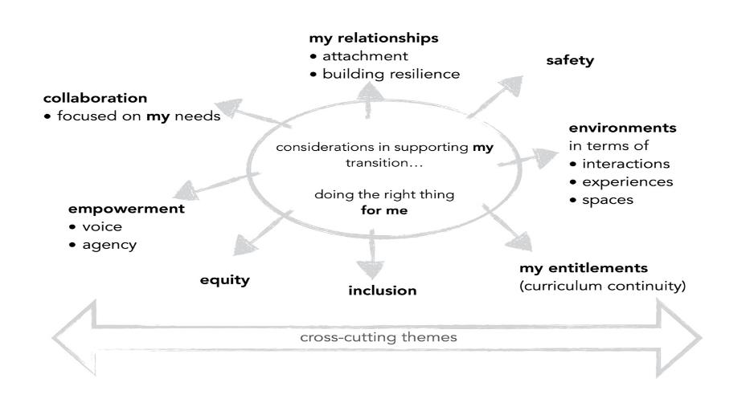
Notes:
The diagram shows how this advice links to the generic principles for supporting children’s transitions in the new context and the cross cutting themes in COVID – 19 – a framework for decision making
Scottish Government: April 2020
The cross cutting themes are: situational poverty and stress, building understanding of trauma, interrupted learning, supporting parents, ASN, vulnerable children and families and the longer term consequences.

Slide 19
Useful links and resources
https://famly.co/blog/covid-19/denmark-reopening-child-care-corona/
https://www.epinsight.com/post/supporting-post-lockdown-education-using-the-6-principles-of-nurture
www.recoverycurriculum.org
https://earlyexcellence.com/latest-news/press-articles/what-comes-next-key-issues-for-the-eyfs-and-key-stage-one-after-lockdown/
ipaworld.org/wp-content/upl…
https://earlyexcellence.com/latest-news/press-articles/transient-art-and-loose-parts-play/
Notes:
Useful links and resources

Slide 20
Useful links and resources
https://earlyexcellence.com/latest-news/press-articles/transient-art-and-loose-parts-play/
https://earlyexcellence.com/latest-news/press-articles/change-isnt-always-for-the-better/
https://www.theguardian.com/education/2020/may/07/prioritise-play-when-schools-reopen-say-mental-health-experts-coronavirus-lockdown
bit.ly/2JBeEe8
http://www.oecd-forum.org/users/396106-tracey-burns/posts/responding-to-coronavirus-back-to-school
https://www.schudio.tv/courses/preparing-autistic-send-children-for-going-back-to-school
https://www.early-education.org.uk/news/guest-blog-time-key-stage-1-developmentally-appropriate-julie-fisher
https://www.theguardian.com/uk-news/2020/may/10/scotland-eyes-outdoor-learning-as-model-for-reopening-of-schools
Notes:
Useful links and resources

