Slide 1




ASN Transitions and COVID 19
Supporting children, young people who require additional support, their families and practitioners
For Scotland's learners, with Scotland's educators
Notes:
This is a front cover page and can only be used once. Use the corresponding blue internal and back pages if you are using this page. You may add a title and a subtitle if needed only. Do not add anything else or move elements around.

Slide 2
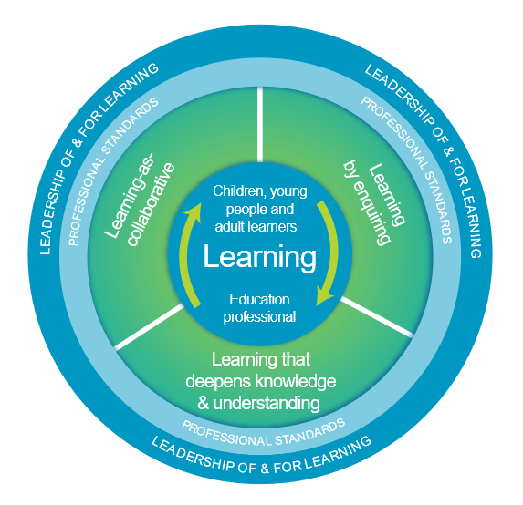
Welcome
This presentation aims to support your professional learning.
After participating in this introductory learning activity you will have an awareness of:
Additional Support
Transitions for learners who require additional support in the context of COVID-19.
Suggestions and information which support ASN transitions.
You will also have an opportunity to explore and reflect on the provision of transition support for learners.
The National Model of Professional Learning
Notes:
The National Model of Professional Learning developed by Education Scotland underlines that professional learning should challenge and develop thinking, knowledge, skills and understanding and should be underpinned by developing skills of enquiry and criticality.
The National model also emphasises that professional learning needs to be interactive, reflective and involve learning with and from others.
Further information on the national model of professional learning is available on the National Improvement Hub.

Slide 3
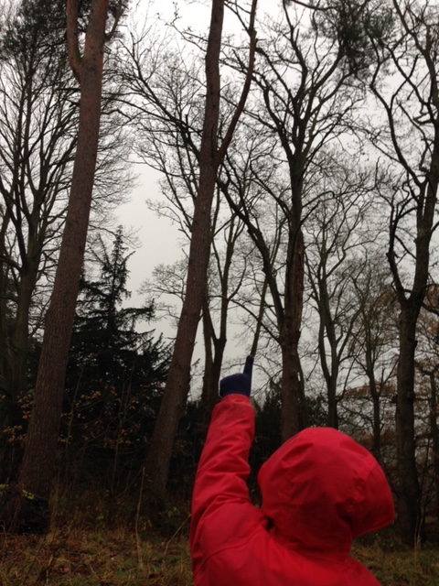
”The path before us is through uncharted territory and will need careful navigation.
Our guiding values should be kindness, compassion, openness and transparency.”
COVID – 19 – a framework for decision making
Scottish Government: April 2020
Notes:
Education Scotland intends to offer the best practical transitions advice and support to staff in ELC settings and primary schools in planning children’s transitions.
The emergence of the COVID-19 virus quickly changed our Scottish education system in an unexpected and unprecedented way. The impact on every child has been profound. Every life has been affected. For many this has meant real and possibly long-lasting difficulties.
It is clear we cannot expect to return to how things were such a short time ago. The task before us is not straightforward.
Our whole education system will clearly have to engage and respond openly, collegiately, flexibly and transparently in supporting all the transitions being made by our children and young people , particularly those who require additional support.
As children and young people move from their homes to new environments, they will experience changes in their daily routines. They will be required to re-establish relationships and forge new ones with their peers and the adults who look after and educate them. To start the next part of their learning journey, periods of adjustment will be required, and planned for in the short and longer term. This includes anticipationary planning for learners who require additional support.
The advice in this presentation offers practitioners, teachers, senior leaders and others a starting point for discussions. Discussions that will require us to work together to intentionally plan for the transitions of children and young people who may require additional support as they move from home learning to ELC/schools and home again if they are participating in a phased return.
We are living in uncertain times, where significant concerns are rightly being expressed by parents, by policy makers, senior leaders, others, staff and children themselves, about how we can safely plan for transitions. By being solutions-focussed and responsive to the changes yet to come, transitions will be more effective if we adopt a child-centred approach.

Slide 4

Child-centred transitions in the new context
Why is this advice needed for all sectors of education?
To ensure practitioners and teachers have access to practical advice based on what we currently know about best transitions practice, learning from others, and applying this in a Scottish context
To intentionally plan for a safe transition that builds on the learning children and young people bring with them from home
To provide reassurance that despite the significant impact that COVID-19 is having on all of our lives, we will be doing the right thing for our children and young people if we adopt child-centred approaches which are grounded in nurturing principles.
To empower practitioners and teachers to embrace play as pedagogy.
Notes:
Child-centred transitions in the new context
Why is this advice needed?
On the 20th March children and young people across Scotland left their familiar educational settings facing a period of significant change and uncertainty that may have a lasting effect on their future lives. The full impact of these system-wide changes on the wellbeing of children, families and their communities, is as yet, unknown.
Transition is a complex and dynamic process. To better understand this complexity, particularly in the current climate, we need to be aware of the shifting social and cultural contexts that are a reality for our children, young people and their families. More specifically, being responsive through intentional transition planning for the needs of those most at risk, and who may show symptoms of traumatic stress.
Reassurance is needed in these challenging times. Advice that is practical, flexible and achievable is offered here. We offer advice that is inclusive, considered, reasonable, fair and equitable.
The advice in this presentation is inclusive for all children and young people but ha s particular focus on those who require additional support – often referred to as additional Support Needs (ASN) The advice will be updated and extended to reflect emerging scientific data and changes to the lockdown and physical distancing arrangements as set out by SG to tackle the impact of COVID-19 on our children and families.

Slide 5

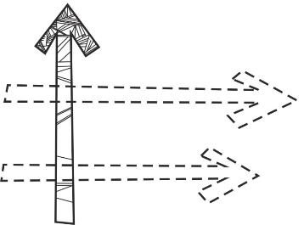
Transition
Transition is not a single event, such as leaving school, but a process that unfolds over many years and involves significant emotional, physical, intellectual and physiological changes.
Transitions can be associated with changes in people, place, or routine (horizontal) or more significant changes such as returning to school after school holidays, changing class, moving to a new school, or leaving school (vertical). How individual learners react to different changes will vary, some learners will find horizontal changes very challenging.
More significant changes
Transitions also impact on the family or on those who care for the child or young person

Slide 6

Scottish Context for Inclusion, Equality and Equity
Scottish education is based on the belief that education is a human right and that all children and young people should be supported to reach their fullest potential. Children’s rights and entitlements are fundamental to Scotland’s approach to inclusive education. It is supported by the legislative framework and key policy drivers
Scotland’s education system is designed to be an inclusive one for all children and young people in Scottish schools, with or without additional support needs.

Slide 7
Additional Support Needs
‘Additional Support Needs’ (ASN) is the standard terminology used in Scotland when children and young people need more – or different - support to what is normally provided in schools or pre-schools to children of the same age.
Additional support is a broad and inclusive term which applies to children or young people who, for whatever reason, require additional support, long or short term, in order to help them make the most of their school education and to be included fully in their learning.
Education authorities are required to identify the additional support needs of each child or young person for whose school education they are responsible. This can be achieved in a range of ways.
COVID-19
Emergency COVID-19 legislation has extended some time frames for the Additional Support for Learning Act 2009 as amended. Further information can be found on the emergency legislation can be found at http://www.legislation.gov.uk/asp/2020/7/contents/enacted

Slide 8
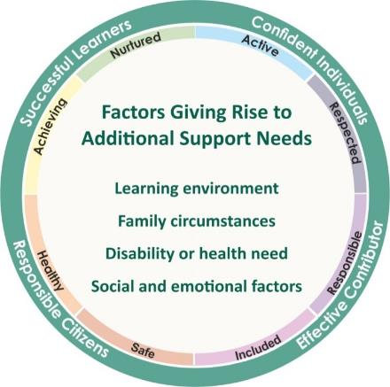
Barriers to Learning
There are a wide range of factors which may lead to some children and young people having a need for additional support. These fall broadly into the four overlapping themes highlighted in the graphic.
COVID-19
All children and young people, their families and practitioners in Early years and childcare settings (ELC) and schools will feel the impact of COVID 19 on all four overlapping themes.

Slide 9
Additional Support Needs and Overlap
A child or young person may be affected by more than one barrier to learning. There can be an overlap between:
co-occurring additional support needs e.g. particularly able or talented and being a young carer
health/disability and social and emotional factors e.g. physical disability and trauma
additional support needs and disability e.g. Autism , Dyslexia (when there is a significant impact on day to day living).
COVID-19
Emergency COVID-19 legislation has extended some time frames for the ASfL Act 2009 as amended.
Further information can be found at http://www.legislation.gov.uk/asp/2020/7/contents/enacted

Slide 10
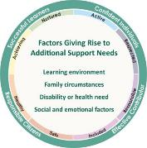
ASN Transitions and COVID 19
COVID-19
COVID-19 has brought unexpected transitions for every child and young person in Scotland.
For example
extended time at home
changes in family circumstances
learning in a different school/centre/hub,
returning to school after an extended period at home
changes of address/placement.
The school closures happened quickly, and the reduced time and transition planning could have a significant impact on whole families or on those who care for a child or young person.
The return to school will also look very different from any previous experience. They may not learn alongside their friends, be in the same classroom, or be able to access the same learning experiences as they did before COVID-19.

Slide 11
Transition Principals , ASN and Covid 19
The Transition Principles below provide a framework of reflective questions for practitioners, schools and local authorities to support and prepare learners who require additional support during transition at this difficult time.
Equity and Inclusion
Universal and Targeted support to achieve equity and inclusion.
Safety
Keep everyone safe and minimise harm. Proactively seek out the best possible solutions to ease their transition from their homes to continue their educational journeys.
Empowerment
Enable/equip learners with skills and learning experiences that are important to them.
Collaboration
Make decisions collectively. Plans are clear and transparent (across/within sectors)
Relationships
Use our knowledge of CYP to be responsive to anxieties/challenges.
Entitlement
High-quality learner lead curriculum. Tailored transitions experiences.
Environments
Creative and safe. Offer interaction, experiences and space to motivate learning.
A professional learning resource is available to support reflection and explore solutions to these areas.
Notes:
Further information on the professional learning resource developed to support reflection and explore solutions to these areas are on slide 15

Slide 12
Knowledge of Additional Support
No practitioner is required or expected to be an expert or have deepened knowledge about all the areas of additional support. However, an awareness of ASN areas, appropriate pedagogy and knowing where to access support is required in order to support learners. This support could be accessed through:
Online resources developed for Scottish schools such as the National Improvement Hub, the Addressing Dyslexia Toolkit , the Autism Toolbox
Discussions with colleagues
ENQUIRE and other 3rd Sector organisations
COVID-19
Learners who were not previously recognised has requiring additional support prior to COVID 19 may require support and are entitled to have there needs identified and met.

Slide 13
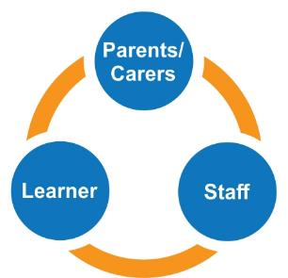
Effective Partnership and Communication
The Additional Support for Learning (Scotland) Act 2004 (as amended 2009) aims to ensure a partnership with parents/carers and collaborative working with professionals from partner services and agencies, to meet the needs of the child or young person.
COVID-19
Effective communication and partnership working is crucial to supporting learners who require additional support during this difficult time.

Slide 14
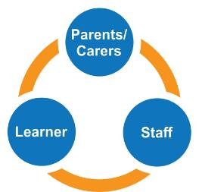
Supporting Effective Transitions
Effective communication processes and channels between professionals, parents/carers and learners is essential when supporting and planning transition.
COVID-19
For learners who require additional support it is extremely important to ensure that effective 2-way communication processes are established between school staff, their families and the learner.
This is vital to support families and learners who are anxious about the transitions. They will have valuable information and suggestions to share which can support transitions to be more positive for their child.
Reflective activities been developed to help practitioners, schools and local authorities ensure the there collaborative approaches are supporting effective communication and building relationships.

Slide 15
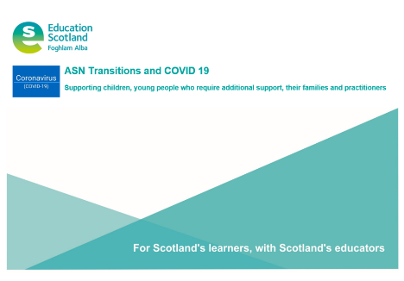
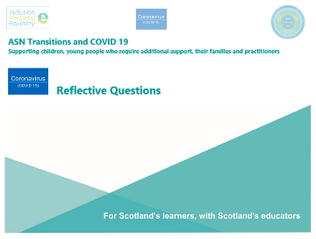
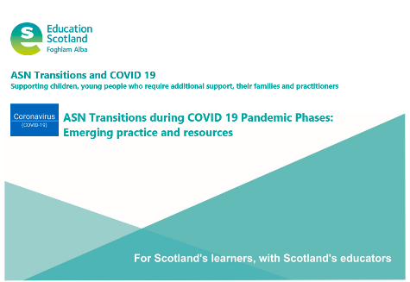
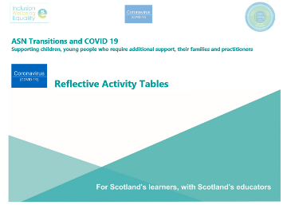
COVID 19 Information, Support and Professional Learning
Notes:
Education Scotland have published a range of resources which have been developed to support practitioners, schools and local authorities ensure they are effectively supporting their learns who require additional support during COVID 19 to help them with the different transitions they will and are experiencing.

Slide 16
Activity :
Supporting transitions for learners who require additional support
This activity can be done individually or with colleagues – make a note on your reflections
Focus – How effective are transitions for learners who require additional support?
Reflection | In my class | In our school community | In our local authority
What I /we do well
What needs to improve
How to improve
Notes:
This evaluation tool can be adapted to suit a range of focus areas , for example ‘How are the views of learners who require additional support taken account of?’
Access the file ‘Reflective Activity Tables - Supporting ASN Transitions through COVID 19’ which has all the transition focus areas within tables for staff to record their reflections and areas for improvement. This is a word document and can be edited.

Slide 17

Education Scotland
Denholm House
Almondvale Business Park
Almondvale Way
Livingston EH54 6GA
T +44 (0)131 244 5000
E enquiries@educationscotland.gsi.gov.uk
For Scotland's learners, with Scotland's educators
Notes:
This is a back cover page in blue. You may edit the address if needed only. It can only be once and at the end of the PowerPoint presentation. Use the corresponding blue internal and back pages if you are using this page.

