Slide 1

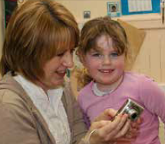




Transforming Learning
The approach
Empowering transformational change and leadership at all levels.

Slide 2
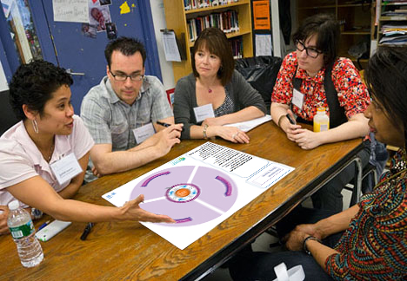
Printable and digital for practical use

Slide 3
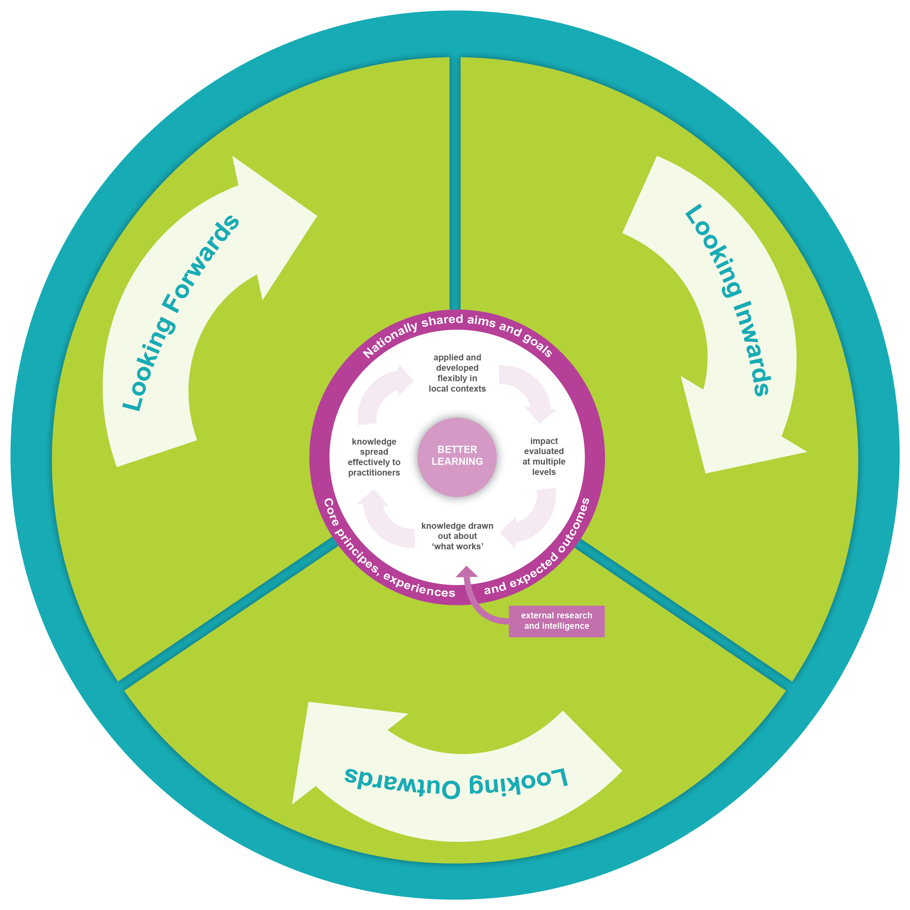
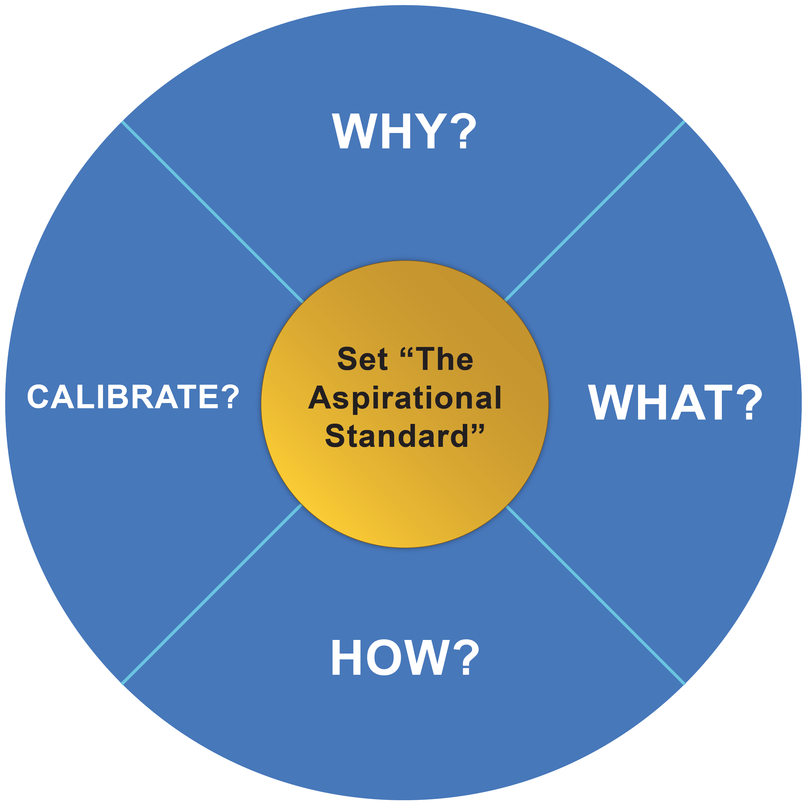
Using the three change wheel process.
A straightforward but comprehensive process.
An approach to support transformational change actions.
Fully integrated with Education Scotland’s culture of creative and innovative continuous improvement.
Notes:
A straightforward three change wheel process

Slide 4
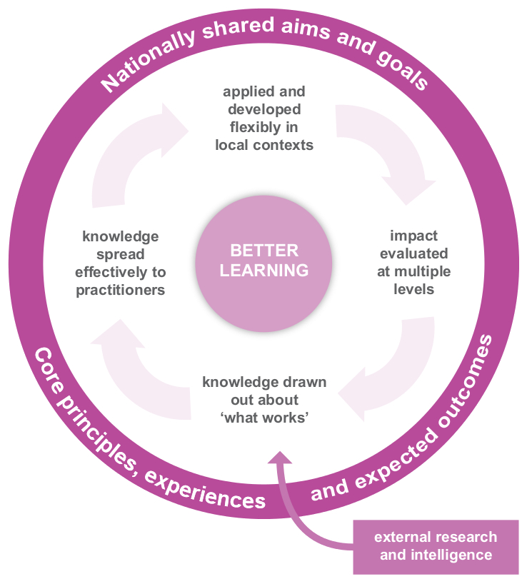
The Virtuous cycle of Improvement
We want to build and support a learning system in which the strong collective engagement of a highly professional workforce creates a virtuous cycle of improvement.
This learning system has learners at the centre and relies on a high-quality professional workforce to make it work.
Notes:
Taking account of the “virtuous cycle”

Slide 5
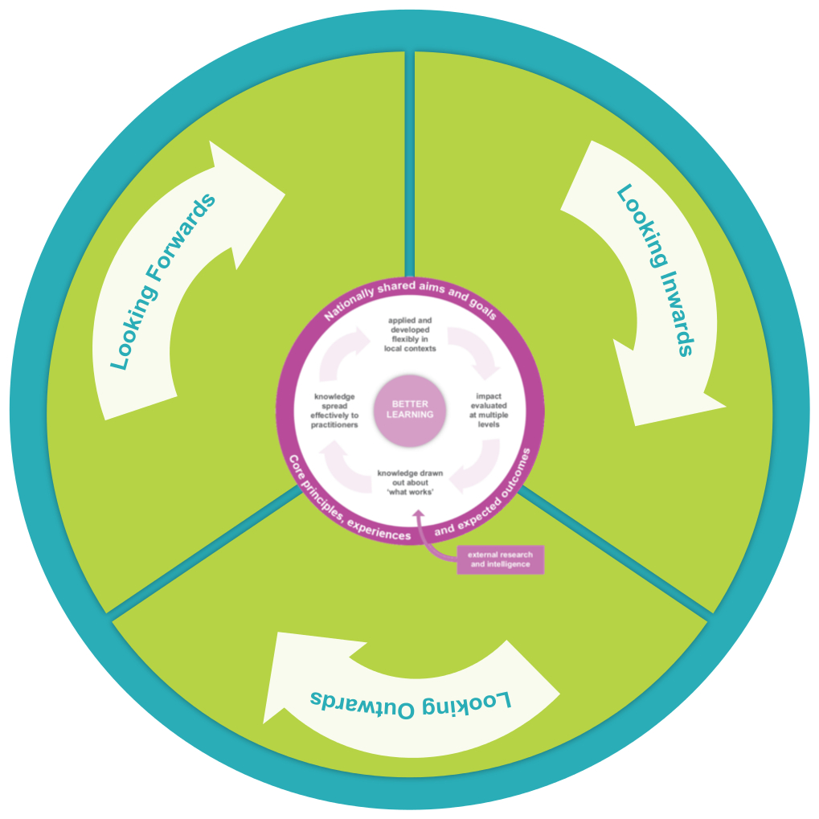
Looking inwards, outwards and forwards
Record the evidence, evaluation frameworks, research information, systems management and resources from your area of expertise to demonstrate the inwards, outwards, forwards strategy suggested by Education Scotland.
Looking inwards: to evaluate performance at every level and use the information gathered to decide on what needs to be done to improve.
Looking outwards: to learn from research, others and best practice and use this to facilitate innovation and creativity and inform improvement actions.
Looking forwards: to explore what the future might bring and use this information to anticipate what change is required to ensure the education system is responsive to the future needs of all learners.
Notes:
Always looking inwards outwards and forwards

Slide 6








Example

Slide 7
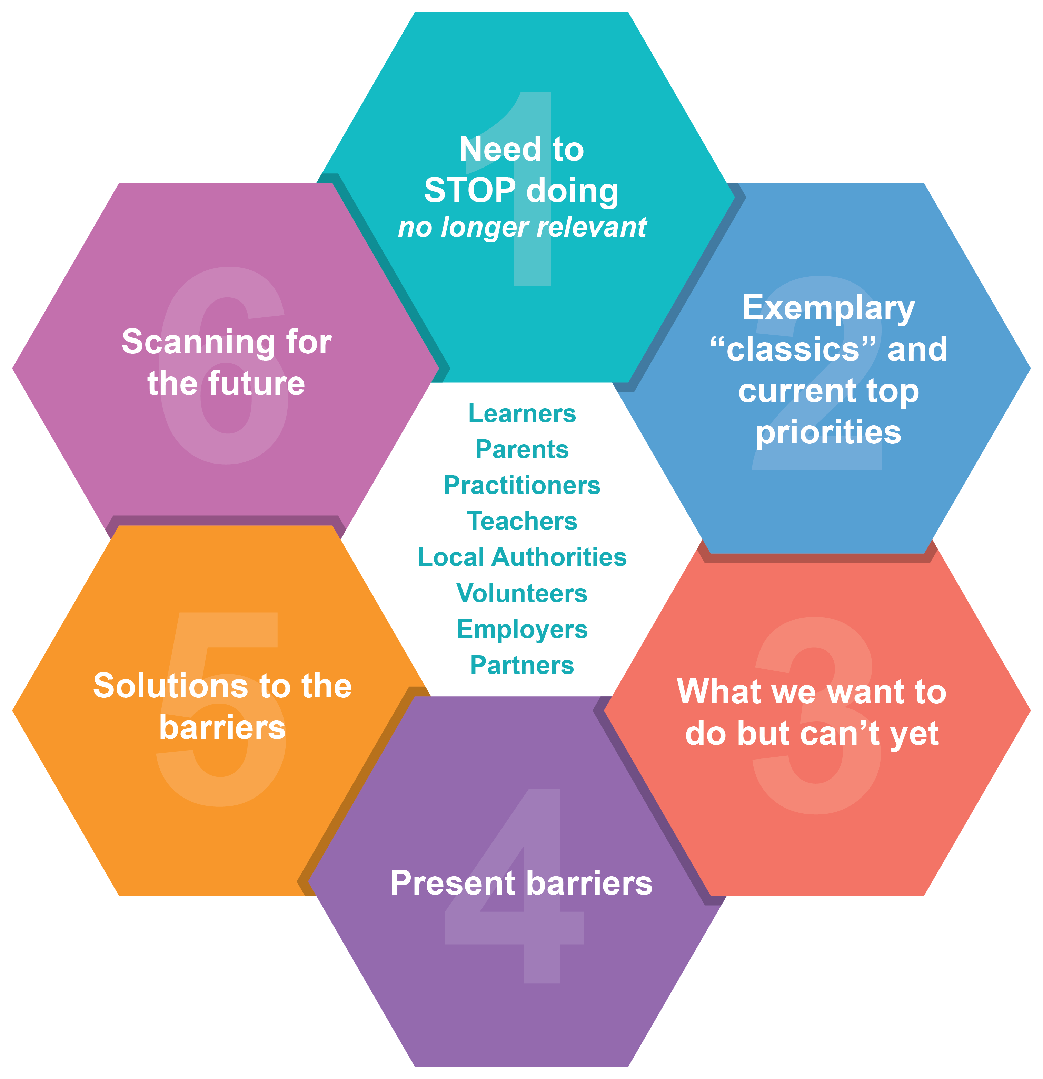
Scoping and scanning
Complete the scoping and scanning cycle, responding to the six prompts to understand the past, present and potential future in your learning environment.
Use this knowledge to consider what the top priorities are to be developed in order to be responsive to the future needs of all learners.
Notes:
Complete this scoping and scanning session to understand what need to stop doing and what we need to consider to improve learning and teaching across all learning environments

Slide 8
Empowering transformational change and leadership at all levels
Transformational Actions
Choose and list transformational actions for your learning establishment. You may wish to pick from the list below or add others from your own list.
Choose the number of actions to suit the size of your establishment.
Attainment - Improving data literacy or using data to identify areas to improve.
Reducing the effects of poverty
Partnership working with parents and your local community
Embedding ICT for all learners
Using International Education as a stimulus for learning
24 /7 learning
HWB
Preparing learners for the workplace
Notes:
Now choose an action to improve. For larger learning environments there may be more than one action being completed

Slide 9
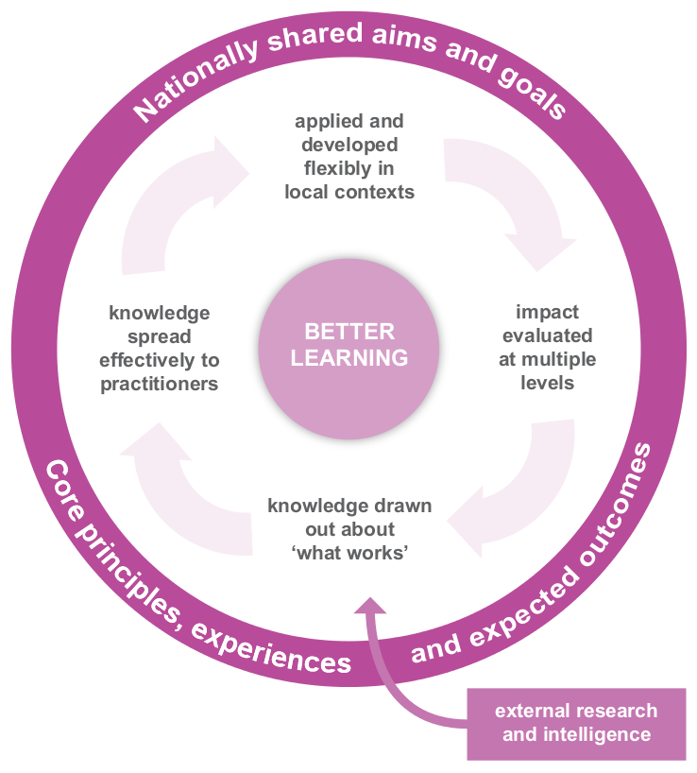
Empowering transformational change and leadership at all levels
Transformational Actions
Choose and list transformational actions for your learning establishment. You may wish to pick from the list below or add others from your own list.
Choose the number of actions to suit the size of your establishment.
Attainment-Improving data literacy or using data to identify areas to improve
Reducing the effects of poverty
Partnership working with parents and your local community
Embedding ICT for all learners
Using International Education as a stimulus for learning
24 /7 learning
HWB
Preparing learners for the workplace
Notes:
Use this slide for an environment with two actions being completed

Slide 10
Empowering transformational change and leadership at all levels
Transformational Actions
Choose and list transformational actions for your learning establishment. You may wish to pick from the list below or add others from your own list.
Choose the number of actions to suit the size of your establishment.
Attainment-Improving data literacy or using data to identify areas to improve
Reducing the effects of poverty
Partnership working with parents and your local community
Embedding ICT for all learners
Using International Education as a stimulus for learning
24 /7 learning
HWB
Preparing learners for the workplace
Notes:
Use this slide for an environment with four actions being completed

Slide 11
Empowering transformational change and leadership at all levels
Transformational Actions
Choose and list transformational actions for your learning establishment. You may wish to pick from the list below or add others from your own list.
Choose the number of actions to suit the size of your establishment.
Attainment-Improving data literacy or using data to identify areas to improve
Reducing the effects of poverty
Partnership working with parents and your local community
Embedding ICT for all learners
Using International Education as a stimulus for learning
24 /7 learning
HWB
Preparing learners for the workplace
Notes:
Use this slide for a large learning environment with eight actions being completed

Slide 12
Define your actions and link them to your improvement plan
Your chosen action :
Link to improvement plan:
What are we going to achieve?
High level outcomes from our actions:
Consideration of impact:
Analyse all available data when considering what the high level outcomes are.
How will we know there has been impact on outcomes for learners from this work?
Notes:
Now define your initial thinking on what actions you will take forward

Slide 13
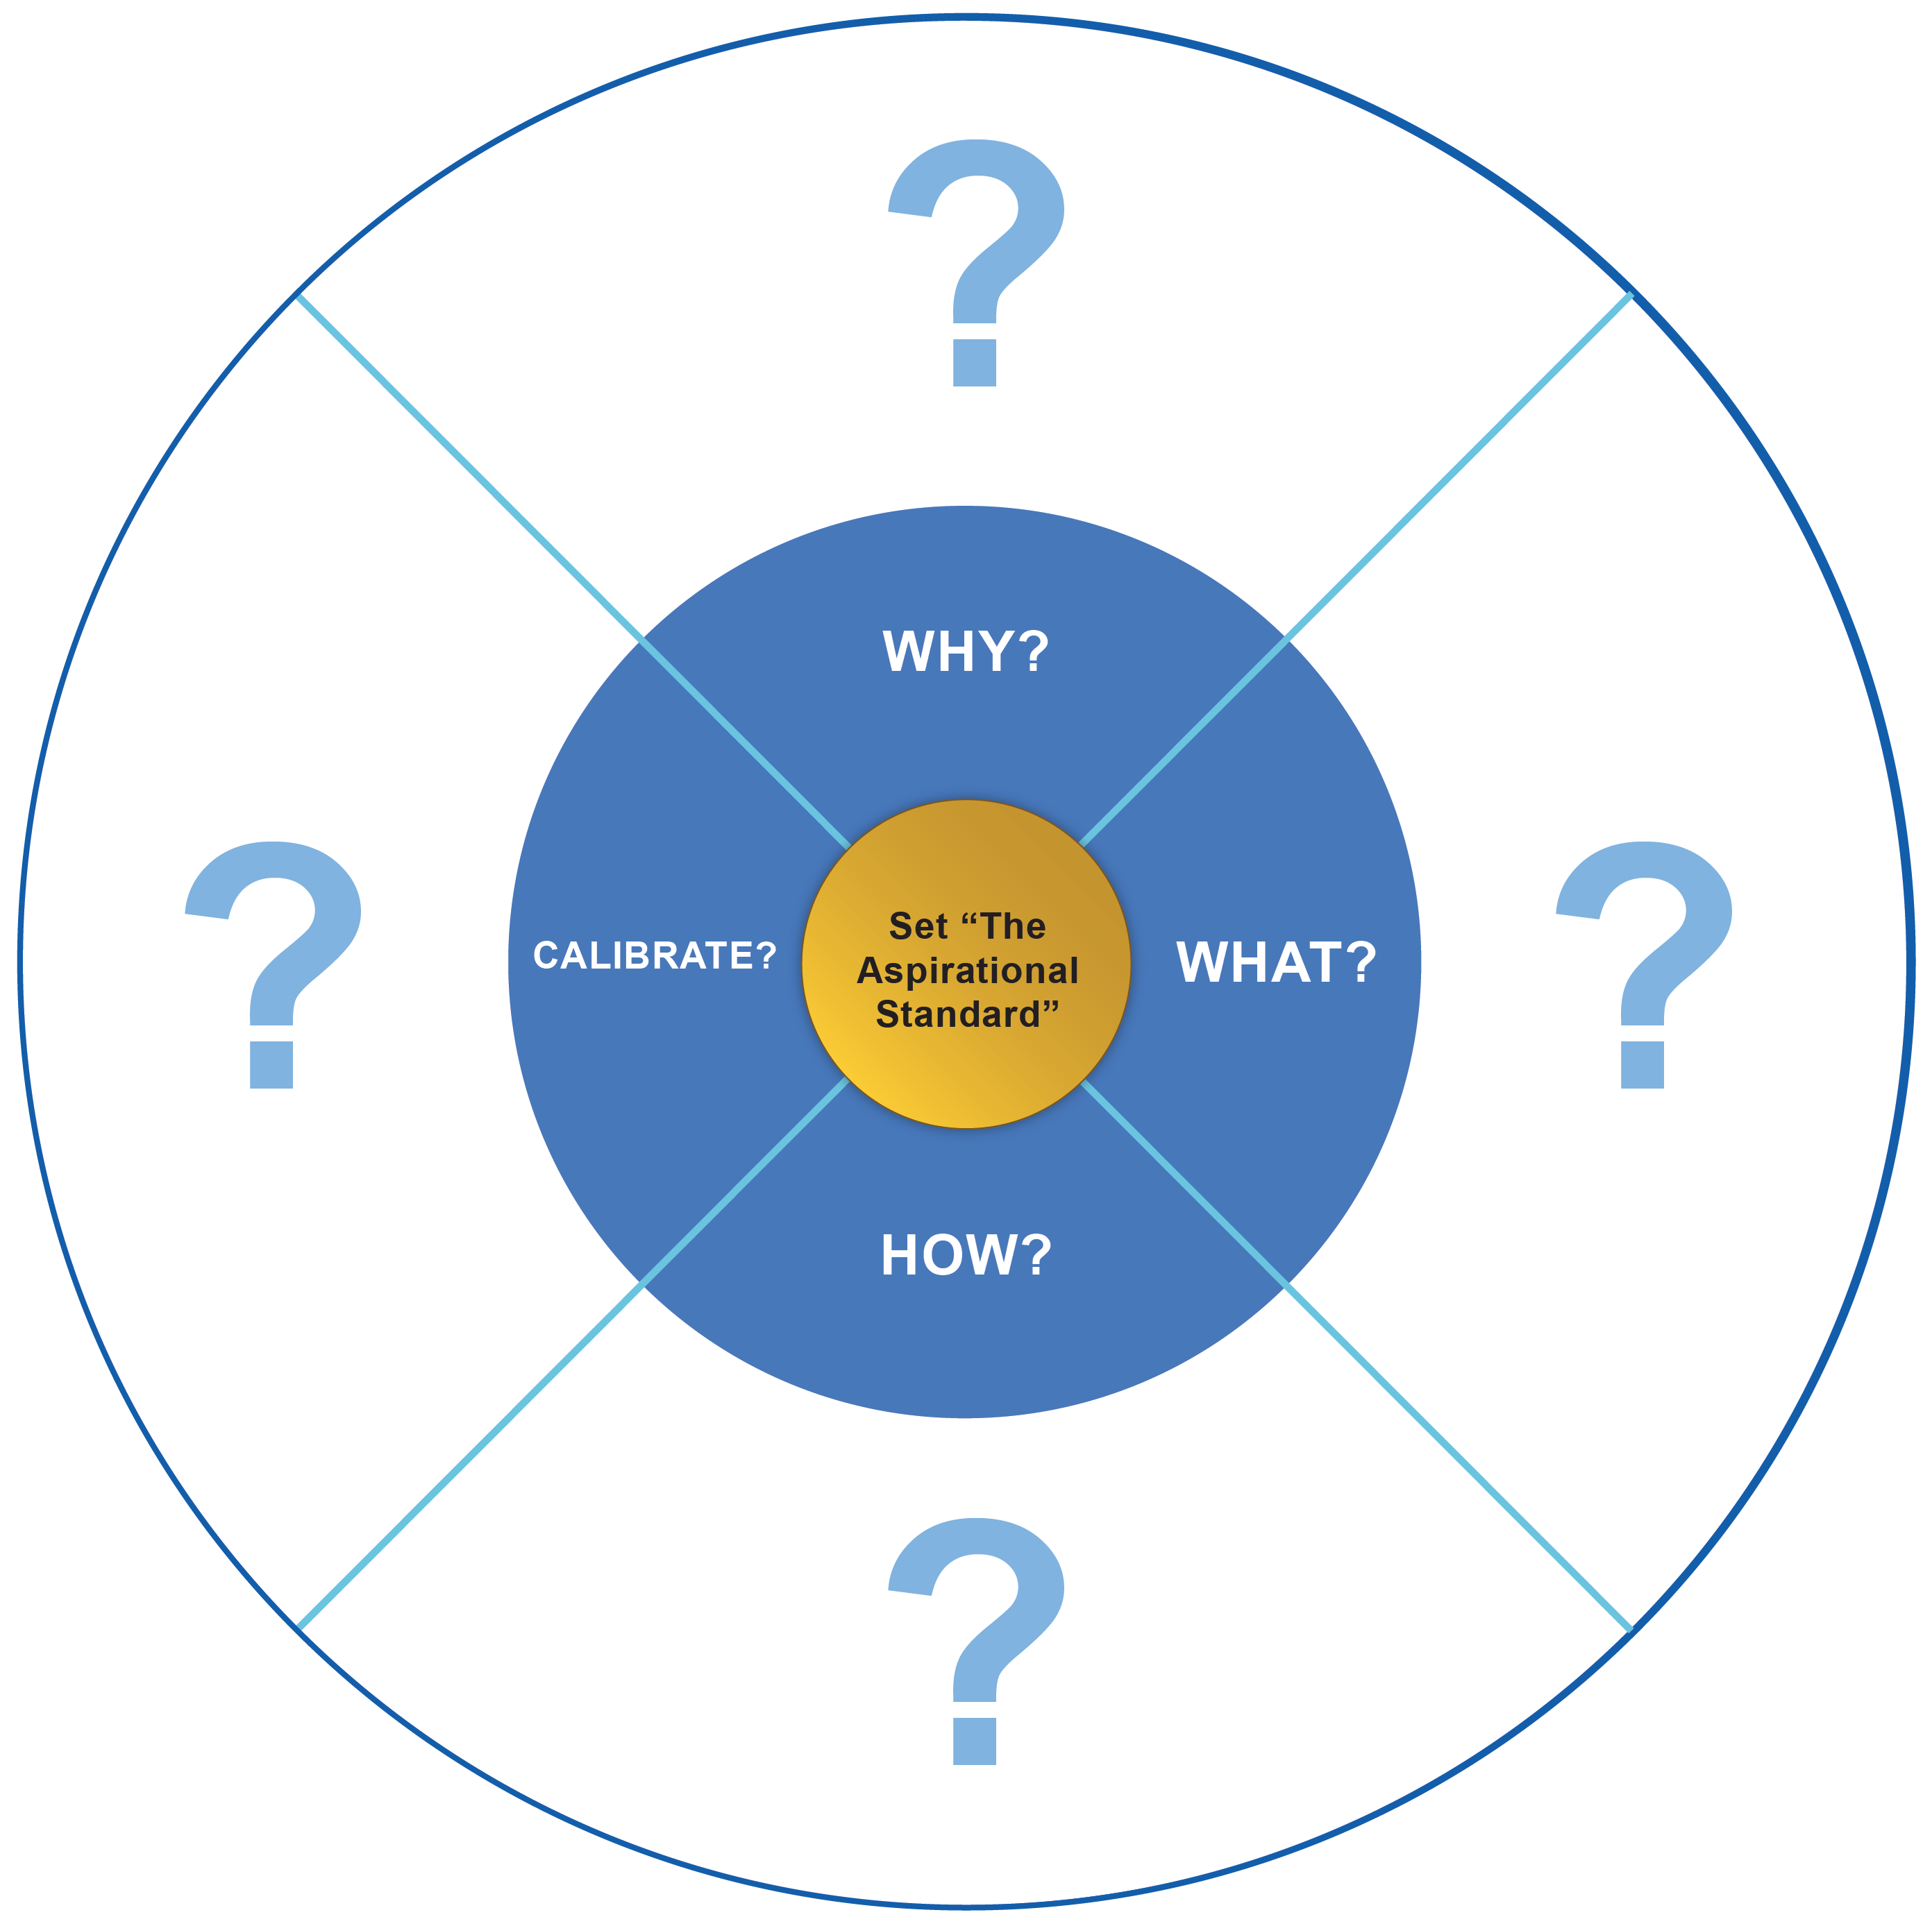
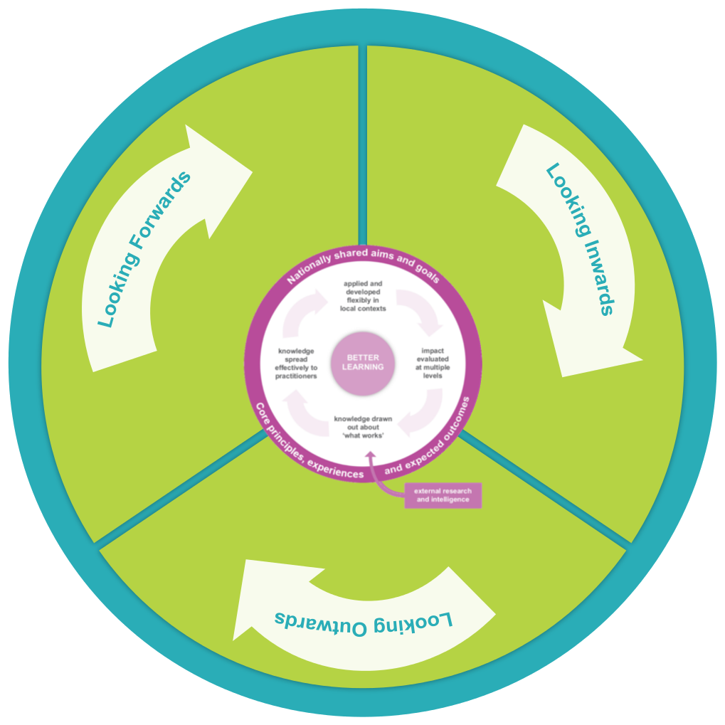
Summary and planning to support chosen actions:
Use the cultural cycle of improvement to ensure you are looking inwards, outwards and forwards.
Notes:
Step 4 : Having identified priorities to take forwards, this exercise allows you to interrogate your chosen action, and ensure that the steps you envisage are fit for purpose.

Slide 14
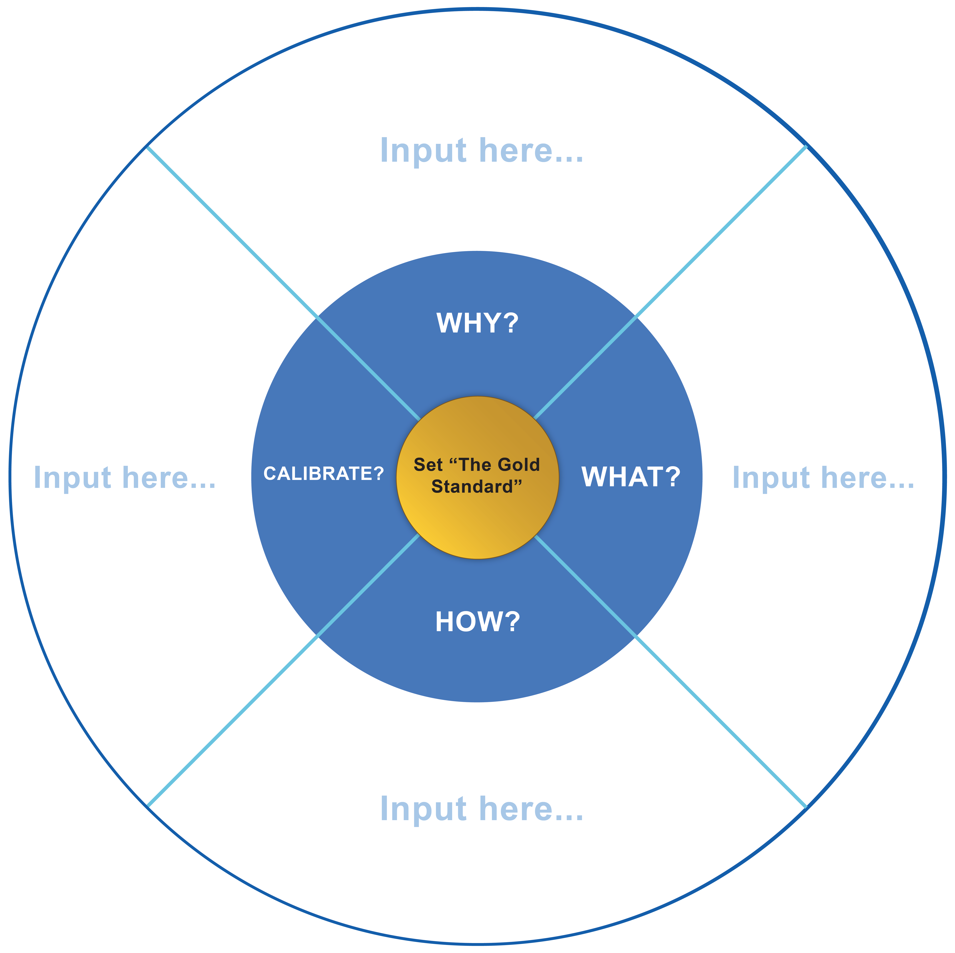
Why? Why do we need this action?
Your chosen action:
The big questions:
Why do we need to change?
Why are we doing this? – personal
Why are we doing this – establishment?
What is available data telling us ?
Why are we doing this – learners?
Is there evidence of the need?
Is there research on this?
Is someone else already doing this?
Consider future changes needed, national priorities and local issues
What disruptive change may be nearly here or coming shortly?

Slide 15
What? What do we have? What do we need? What is already out there?
Your chosen action:
The big questions:
What are we going to do to achieve this change?
What is working well? What is the data telling us?
What does research say? What is happening internationally/globally?
What does current best practice look like locally, nationally, internationally?
What have we got in place already?
What do we need (that we don’t have already)?
Do we have the skills?
Do we have the right partners?
Do we have the permission to achieve this.
ARE WE ABLE?
Where can we access support opportunities?
What future skills will we need?
What are the barriers/challenges?
What are the resources we need?
What is the vision? The big picture?
What difference will it make to learners?
What is the legacy we will leave?
What support do we need to maximise our potential for change?

Slide 16
How? How will we know that change is an improvement?
Your chosen action:
The big questions to consider if relevant:
Personnel? Timeframe?
Finance and other resources ?
Monitoring?
Links to Professional Development?
Links to the NIF drivers?
How will we know? Evidence- impact – measure
Methodologies used? e.g. consultative, participative, communities of practice
How are we going to share the vision for this change to ensure there is widespread ownership?
How do we take it forwards, share with the community, consider local contexts and ensure all learners benefit?

Slide 17

Enquiry skills development
The team go back round the Why? What? How? a second time to ‘calibrate’ (check, adjust, adapt, explore further) their responses with the full cycle in place.

Slide 18
Calibrate? List here your chosen action linked to your establishment improvement plan:
Your chosen action:
Enquiry skills:
What have we learned from the process to date?
What checks, adjustments adaptations, do we need to make from what we have learned to date?
How confident are we that this action is still a priority?

Slide 19
Aspirational actions
If we are successful what will the aspirational action points look like?

Slide 20
1 Year Plan ‘for an aspirational standard’
Your chosen action:
Tasks | Resources | Personnel | Timescale | Risks | Progress checks
Where do you want to be in 1 year?
How will the vision look in progress?
Evidence
Impact
Notes:
Step 5: Short term actions will benefit from revision, evaluation and consideration of how the priorities will develop. The one year planning sheet will help you to think longer term about the priorities you have identified.

Slide 21
Risks, dependencies and hazards analysis
Low level risks | Medium risks | High risks
Best practice to avoid these risks
Notes:
Step 6: This exercise helps staff to reflect upon the possible risks surrounding a chosen action, suggest solutions and identify which risks are manageable and which should be avoided.

Slide 22
Evidence of impact
Explain how you will evaluate your progress and impact
How will we know there has been an impact on outcomes for learners from this work?
Possible measures used | Comments
Stakeholders surveys
Learners’ views
User evaluations
Use of data
Impact reviews
Site visits
Analysis using improvement frameworks
Others please specify
Notes:
Step 7: This part of the transformational change approach enables staff to plan and document how to gather evidence that will allow value judgements to be formed on the transformational work planned and the impact it has on learners.

Slide 23


Impact analysis
Demonstrate the impact achieved from actions completed.
Impact achieved
Learner and other stakeholder’s response:
Leadership team response:
Possible digital exemplification
Remember the Education Scotland “tackling bureaucracy” advice when completing this section.
Notes:
Step 8: This single page document can be shared with colleagues and the wider community, offering a succinct overview of the transformational changes completed and the impact achieved. The best examples will be shared nationally with all practitioners to support ongoing transformational change.

