Slide 1


Slide 2

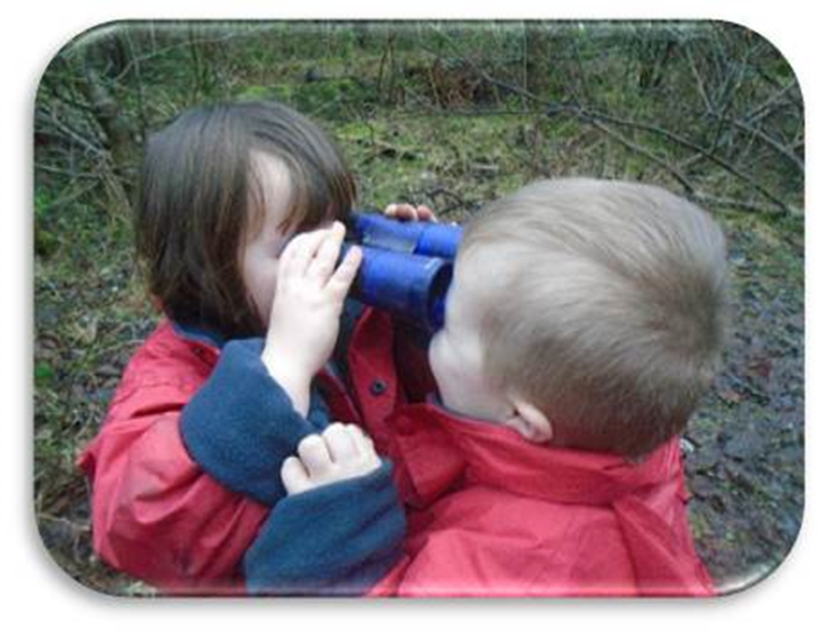
Schematic Play:
Taking a closer look

Slide 3
What is a schema?
Schemas are behaviours that children may display when they are exploring the world and trying to find out how things work.
Schemas vary from child to child.
Schemas are both biological and socio-cultural.
Children have a very strong drive to repeat actions, moving things from one place to another, covering things up, putting things into containers, moving in circles and throwing things – these actions can be observed running through their play
Louis et al, 2013)
How does an understanding of schemas help us to provide what children need to support their learning? Find out more…
Building the Ambition Section Six

Slide 4
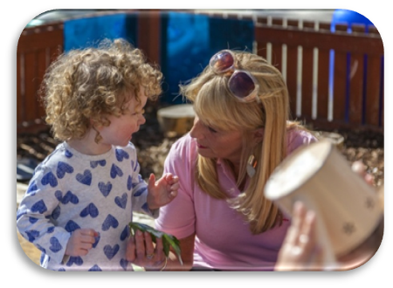
The Role of the Adult
Children benefit from adults who observe, are responsive and are led by children’s actions and creativity.
Young children need time to become engrossed in their play without interruptions. For children absorbed in a schema, there is the potential for high levels of involvement. This requires the practitioner to stand back and not impose their ideas and thinking on the child too soon.
“Piaget was an avid believer that in order for children to learn most effectively they had to be active learners, therefore, they need to explore for themselves. It is this theory that is the foundation of modern thinking behind schematic behaviour”.
(Constable, K. 2013)

Slide 5
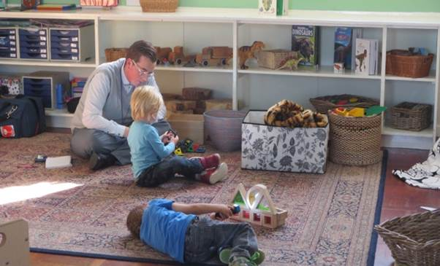
The Role of the Adult
It is important for practitioners to be highly skilled in the observation of children’s play. This will enable them to identify and understand the schemas children display so that they can effectively support their learning.
How do your observations about children’s schema inform your planning to support individual children’s learning?
Want to find out more?
Click here: Effective observation leading to effective assessment

Slide 6
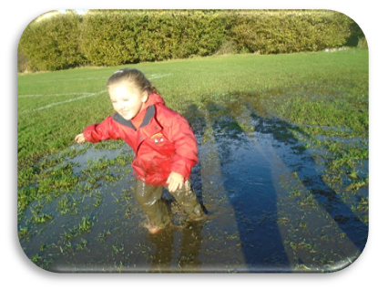
Quality of the environment
Children need to feel supported within a nurturing environment that gives them the confidence to explore their thoughts and ideas. They learn through repetition, making mistakes and trying again. This allows them to have ownership of their learning in order to make connections and develop as learners.
Providing children with resources to support their schema will ensure that they can facilitate their ideas.
Play spaces need to be exciting, inventive and inspiring with lots of opportunities giving children ownership of the experience.
The quality of the learning environment is crucial in providing the potential for children’s creativity and allowing them to confidently follow their own particular interests.
Considering these points, in what ways do you use your observations and knowledge of children’s play to help you organise your learning environments both indoors and outdoors?
Want to find out about inspiring environments? Click here: Inspiring environments for high-quality learning

Slide 7
Introducing the Levels of Engagement within Schematic Play
Stage 1:
Sensorimotor
Stage 3:
Functional Dependency
Stage 2:
Symbolic
Symbolic representation is when children use an object to represent something else. Children engage in pretend play with toys or open-ended resources and begin to make believe by pretending. For very young children this can be imitative play such as feeding baby.
Children can now use their prior experiences and knowledge in new situations. They know that objects can be used in different ways. They begin to understand the relationship between two separate objects and begin to develop their understanding of cause and effect.
Stage 4:
Abstract Thought:
Children demonstrate their knowledge and understanding by being able to talk about and describe events or experiences. They can now use this to create and develop their own ideas. They use language as a means of sharing their thoughts and feelings and can recall past events and anticipate what might happen next
Children learn through actions, movement and through their senses. Their complex multisensory connections act as the main source of information from the brain and these, in turn, strengthen their schemas. Children use the skills and abilities they were born with to learn more about their environment. They crawl, roll or move around to investigate a range of resources through sensory exploration using their whole body.
Adapted from Louis S et al (2013)

Slide 8
Engaging families in children’s learning
When a child transitions from home into an ELC setting, this can be an anxious time for both children and their parents. Parents’ own experience of educational settings can often determine how they may feel. Therefore, how does your work with families help parents to support and understand their child’s development and learning?
.
How frequently, and in what ways do you engage parents in dialogue about their child’s play?
Think about how creating these opportunities will build a shared understanding of the patterns of behaviour children demonstrate at home and within your setting.
Consider:
How does working with families to support and understand their child’s development and learning secure better outcomes?
We would love to hear about ways that you share knowledge about children’s schemas with your families and the difference this has made for children. See slide 18.

Slide 9
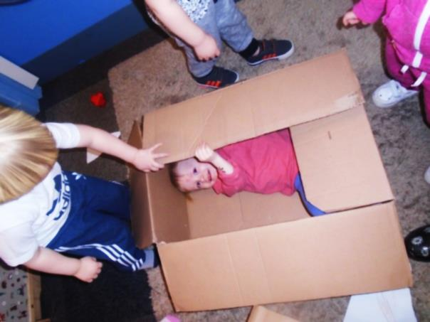
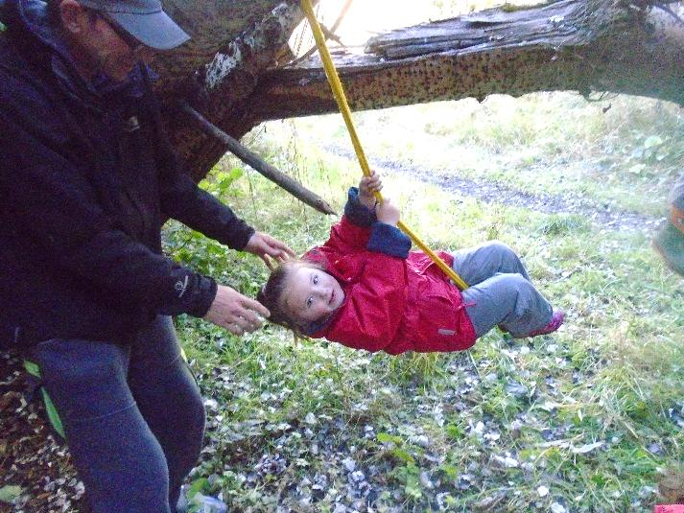
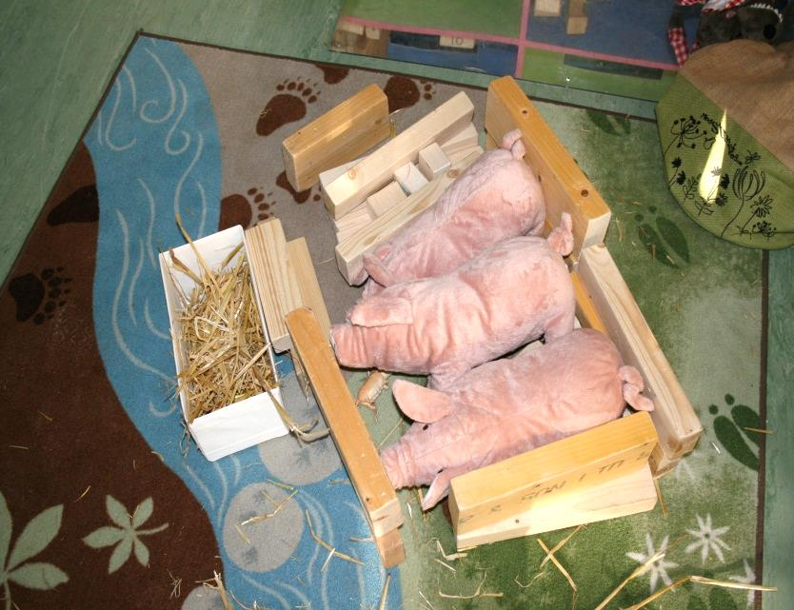
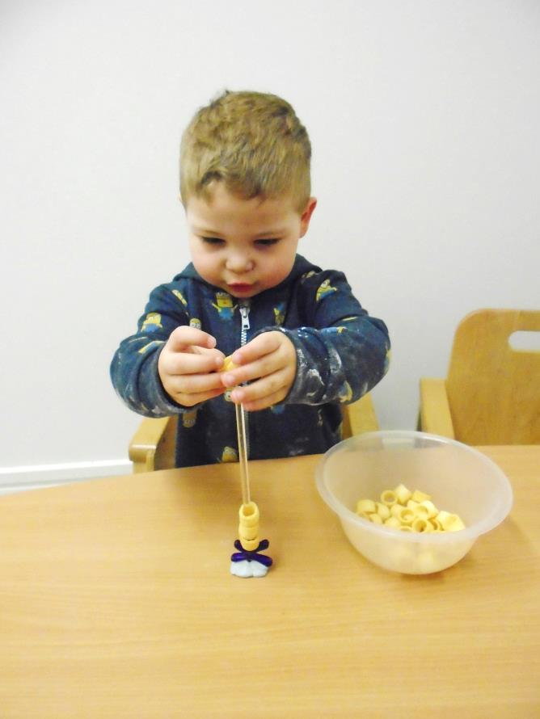
Types of Schema
Theorists have identified many types of schemas that children will often display. Some children will never appear to be engaged in schematic play. Others will have a predominant schema and some will be engaged with more than one at a time. The following slides identify and describe the more common schemas.

Slide 10
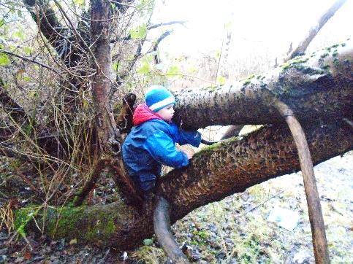
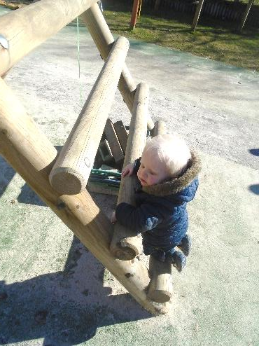
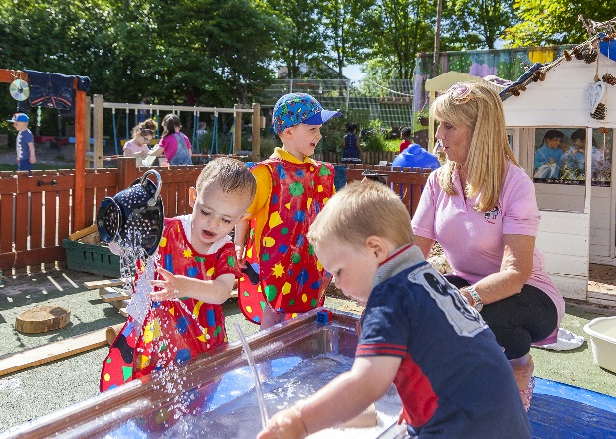
What is trajectory?
The trajectory schema is one of the earliest schemas observed in babies and incorporates a fascination with the horizontal, vertical and diagonal movement of things and self.
Children will throw objects or food, climb and jump. As they display this schema children may kick, not only balls but also other things not made for this purpose.
To be able to explore this schema, children need to experience space and how movement occurs within it. They may also have a fascination for running water.
As children develop and learn they may explore the use of lines and shapes within their drawings and mark making.
Think about how you would support a child demonstrating this type of play? Consider resources, your role and the learning environment.

Slide 11
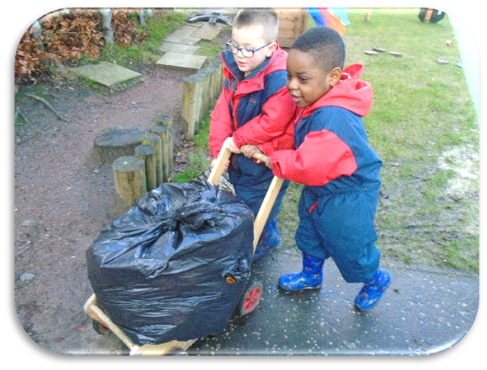
What is transporting?
In your indoor and outdoor learning environment, how accessible are additional resources to support this type of play?
Children enjoy repeatedly moving resources around, from one place to another. They will carry many items at a time using their hands, pockets, containers, baskets or transporters.
Children displaying this schema can be viewed as being flighty not settling at any one experience long enough to participate. Being physically active outdoors will support this schematic behaviour.
In your setting, is this type of play encouraged or discouraged? Is there an understanding that this type of play is a developmental stage for many children?

Slide 12
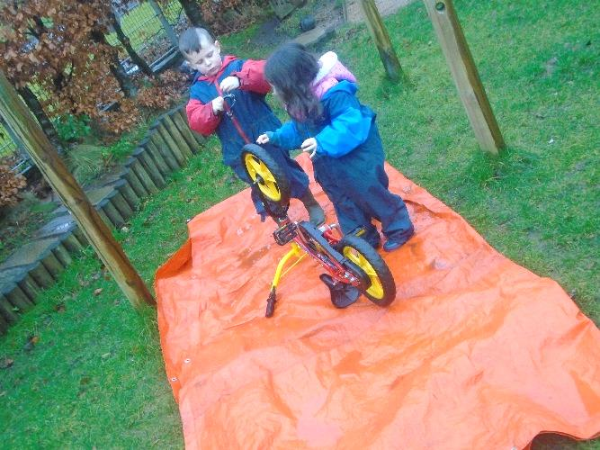
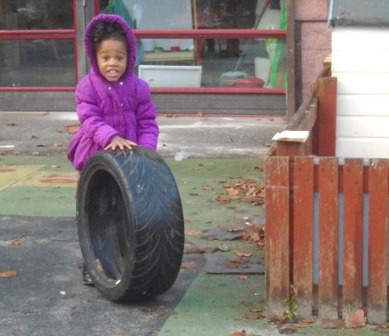
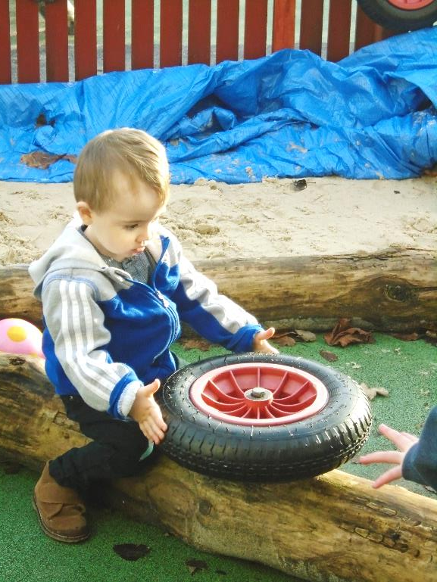
What is rotational?
Are your resources sufficient and readily available to support rotational schema both indoors and outdoors?
Children with a rotational schema display a preference for turning taps on and off, winding and unwinding string, and playing with hoops.
They may also be fascinated with the physical experience of twirling and twisting the body, spinning around in the one spot or rolling themselves down a hill.
They have an interest in things that turn such as wheels, rolling tyres around, turning lids and watching the washing machine on a spin cycle.

Slide 13
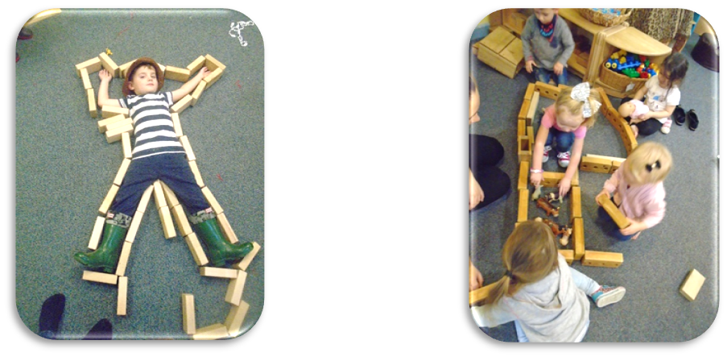
What is Enclosing?
Children show an interest in enclosed spaces. They construct fences and barricades to enclose animals or themselves. They may build the train track and put the animals in the centre. Borders may appear around their drawings or paintings.
Children who are following an enclosure schema enjoy tents, tunnels, dens and climbing into a cardboard box.
The enclosing schema is often observed in combination with other schematic behaviours.
In your indoor and outdoor learning environment, how accessible are additional resources to support this type of play?

Slide 14
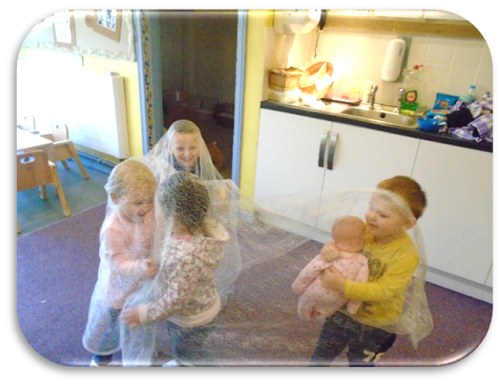
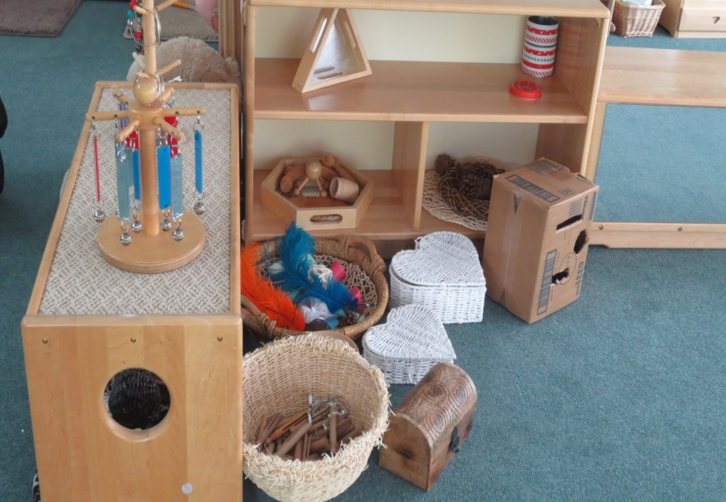
What is Enveloping?
Children with an enveloping schema are interested in covering and hiding items and themselves. They actively fill and empty various containers with natural materials and other objects.
They will become deeply involved in exploring how they and items can be covered with material . They bury items in the sand and wrap up toys using blankets or paper. Children will spend time folding up paper and their notes into a tiny size to fit in their pocket.
Consider the availability of open-ended resources to support children in enveloping. Are they sufficient to support this type of play?

Slide 15
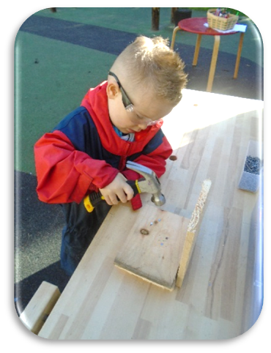
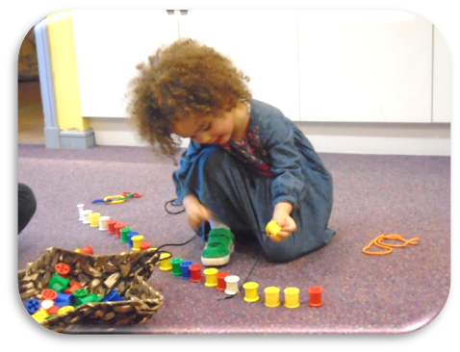
What is connecting?
Point for reflection!
Children engaged in this type of play can often be viewed as disruptive.
How do you support children engaged in this type of play?
Children displaying the connecting schema want to join items together. They find resources like string to tie things up or they staple paper together. They may tie string to crates to drag them around. They will work at the woodwork bench with the hammer, nails and wood connecting pieces together.
At the construction area, they will join the train track and other connecting resources. Children displaying this schema will also enjoy taking things apart, for example, investigating how to take the wheels off toy cars. Water play will offer children the opportunity to practise connecting pipes and guttering with creative experiences providing opportunities to stick, staple, tie, cut and tear.

Slide 16

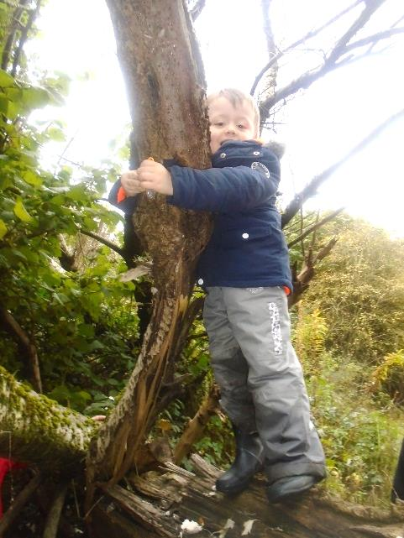
What is orientation?
Children have the urge to turn objects and themselves around and upside down to get a view from under the table or on top. They may bend over and look at the world backwards through their legs.
Children experiment by seeing things from different views, using cardboard tubes, binoculars or a magnifying glass to look through.
Children displaying an orientation schema may have difficulty in being able to sit still.
How are children in your setting encouraged to identify and manage risk? Are they encouraged to take part in risky play?
How flexible is your routine in supporting children who may be displaying orientation schema?
Want to find out more: http://www.careinspectorate.com/images/documents/3091/My_world_outdoors_-_early_years_good_practice_2016.pdf

Slide 17

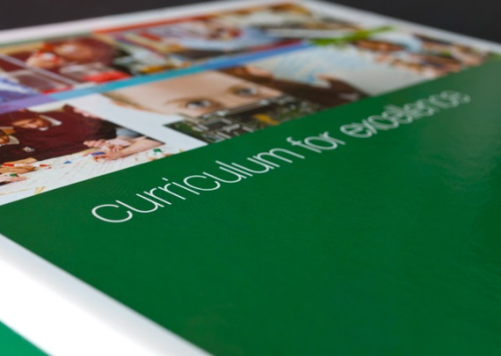


What to consider now
Professional dialogue will enhance the quality of experiences you provide for children’s learning.
Think about ways you can continue to use theory and research to enhance the quality of experiences you provide for children’s learning.
How are you using national guidance to plan for children’s learning and to improve the quality of your provision for babies, toddlers and young children?
Consider how you would support the development of children’s schemas in spaces where older and younger children learn alongside one another?

Slide 18

Making connections
Join the conversation with other ELC practitioners on the GLOW EarlyLearn Yammer group and using Twitter with @CafTeam using #schemascot.

Slide 19
References
Scottish Government (2014). Building the Ambition: National Practice Guidance on Early Learning and Childcare, Children and Young People (Scotland) Act 2014. Edinburgh: Scottish Government.
Else P (2014). Making Sense of Play: Supporting Children in their Play. Berkshire: open university press.
Mairs Â—K. & Arnold C. (2013). Young Children Learning through Schemas: Deepening the dialogue about learning in the home and in the nursery. Oxon: Routledge.
Louis S. Featherstone S. Macgraw L. Hayes L. Beswick C. (2013). Understanding Schemas in Young Children: Again! Again! London: Bloomsbury Publishing PLC.

Slide 20
References
Constable K (2013). Planning for Schematic Learning in the Early Years: A Practical Guide. Oxon: Routledge.
Care Inspectorate (2016). My world outdoors: Sharing good practice in how early years services can provide play and learning wholly or partially outdoors. Dundee: Communications.
https://education.gov.scot/improvement/. 2018. Effective observation leading to effective assessment. [ONLINE] available at: https://education.gov.scot/improvement/learning-resources/Effective%20observation%20leading%20to%20effective%20assessment.

Slide 21
Education Scotland
Denholm House
Almondvale Business Park
Almondvale Way
Livingston EH54 6GA
T +44 (0)131 244 5000
E enquiries@educationscotland.gsi.gov.uk

